Slide 1
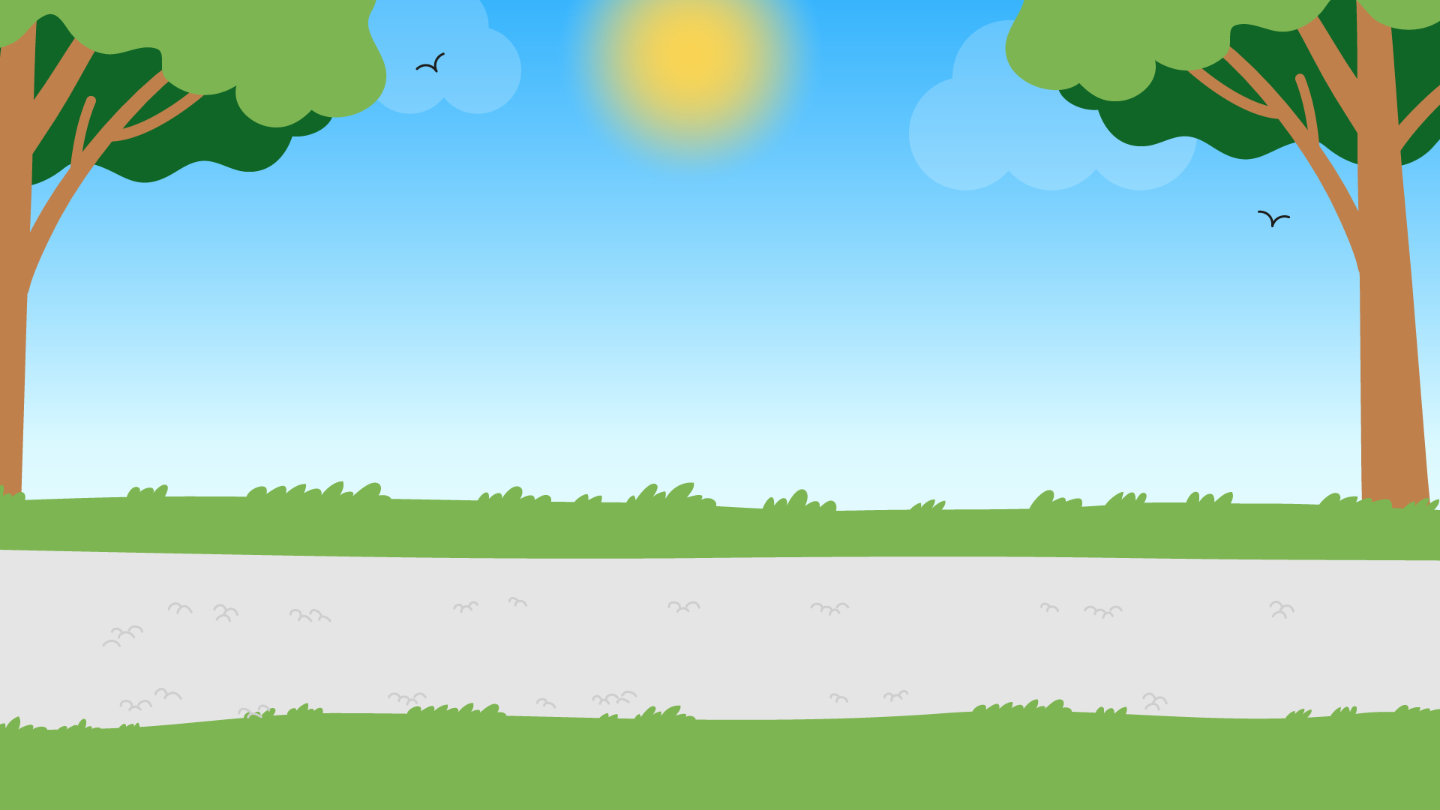
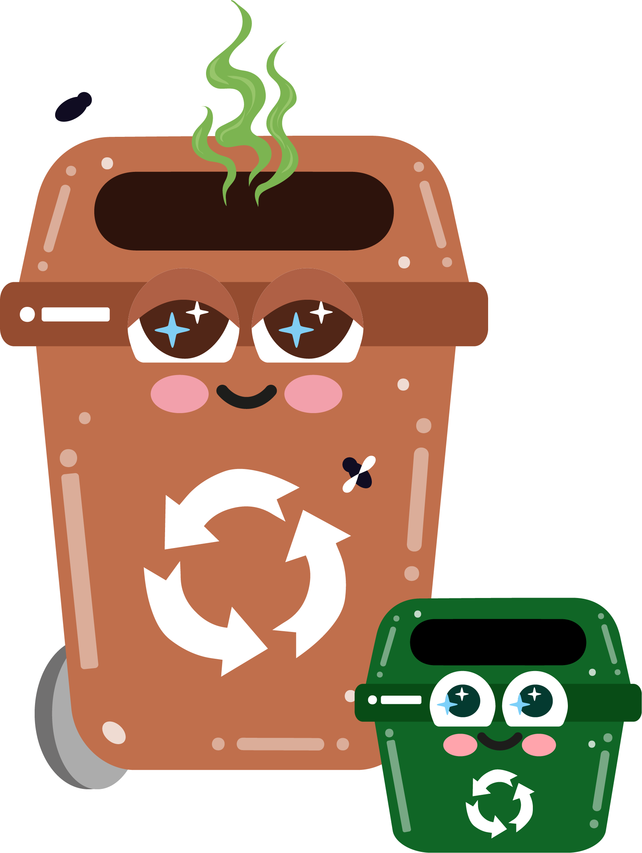




Part 5
The environmental impact of waste
Recommended for: Key Stage 3- 4

Slide 2

Learning
Objectives:
By the end of this lesson, you will:
Understand the environmental impact of improper waste disposal on ecosystems, wildlife, and human health.
Explore the long-term effects of landfills, pollution, and plastic waste in oceans.
Evaluate the role of individuals and communities in reducing waste and mitigating environmental damage.
Learn how you can contribute to waste reduction through practices such as recycling, upcycling, and waste minimisation.

Slide 3

An introduction to the environmental impact of waste
?
?
How does our waste affect the environment?
  How does our waste affect animals on our planet?
  Why should we care about waste management?
?
?
Click for discussion…

Slide 4
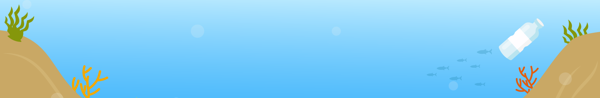

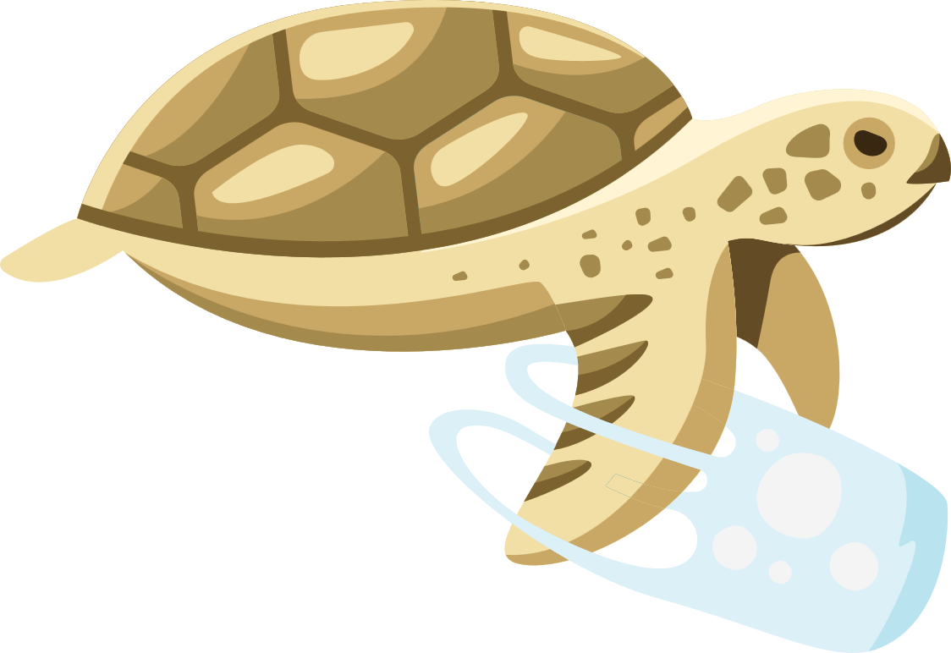

What happens when waste isn’t put in the right place?
Air and soil pollution
Waste incineration and uncontrolled waste dumps can release toxic pollutants into the air and soil.
Ocean pollution
Waste, especially plastics, that enters the ocean, can harm marine life and ecosystems.
Landfills
Accumulation of waste that doesn’t decompose, releases harmful gases like methane, and can lead to soil contamination.

Slide 5
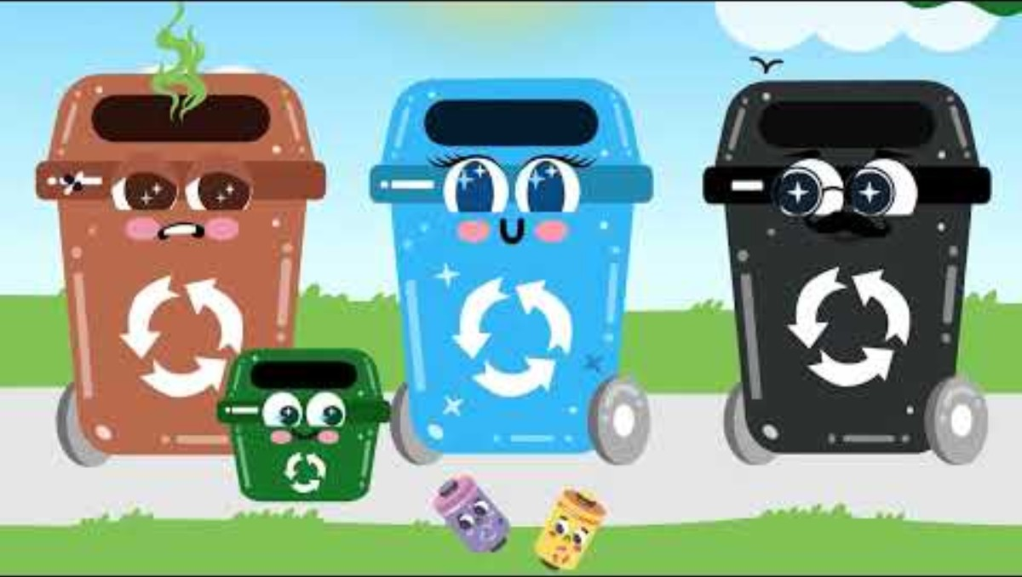

Slide 6
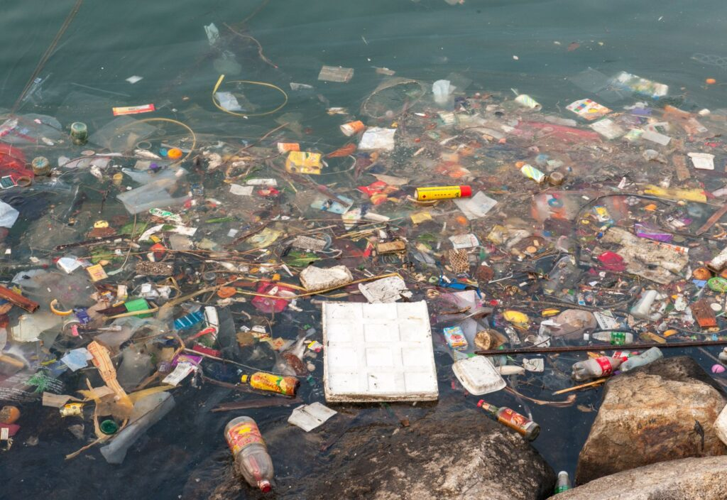
Did you know?
The world generates an estimated 2.12 billion tonnes of waste annually.
215 million tonnes of waste was generated in the UK in 2024, 28 tonnes of which is produced by households.
1.3 million tonnes of waste is produced on average by every single person annually.
Residents in Hull and the East Riding generate approximately 340,000 tonnes of waste each year.
These figures show the importance of waste management.

Slide 7
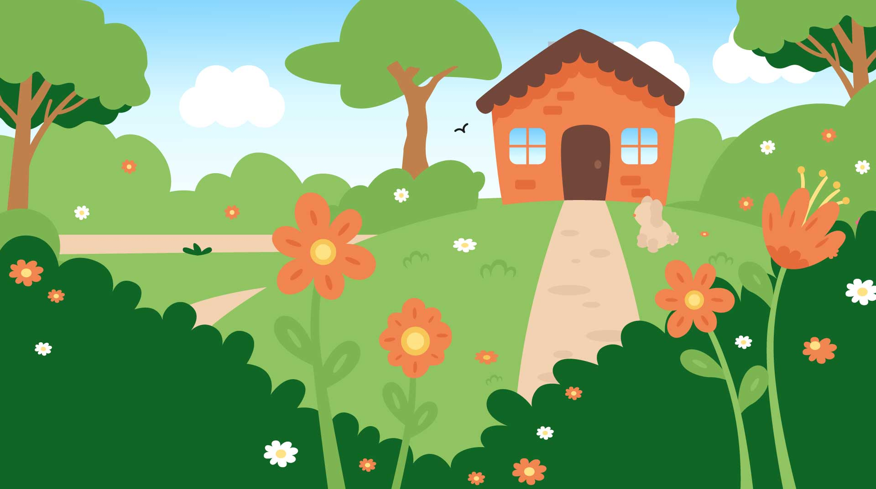
Let’s discuss…
80% of household waste is potentially recyclable: This includes materials like paper, cardboard, plastic, glass, and metal.
Only 44-45% of household waste is recycled: This figure represents the actual recycling rate for household waste in the UK.
The difference (36%) is the amount of recyclable waste that is not recycled.
This gap shows the potential for improvement in recycling efforts within the UK.

Slide 8
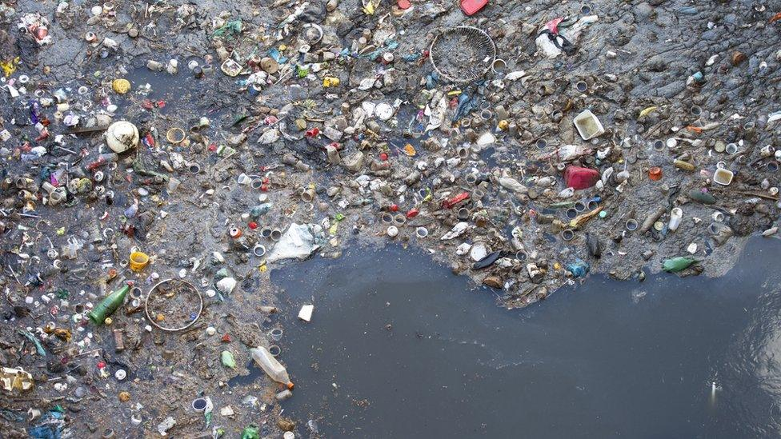
Environmental impacts
Water pollution
Waste washed into rivers, canals, and seas contributes to water contamination.
Plastics break down into microplastics, which enter the food chain and harm marine life.
Soil degradation
Chemicals from discarded waste (e.g. batteries, paint cans, or plastics) can leach into the soil, reducing fertility and affecting plant growth.
Source: Getty Creative

Slide 9
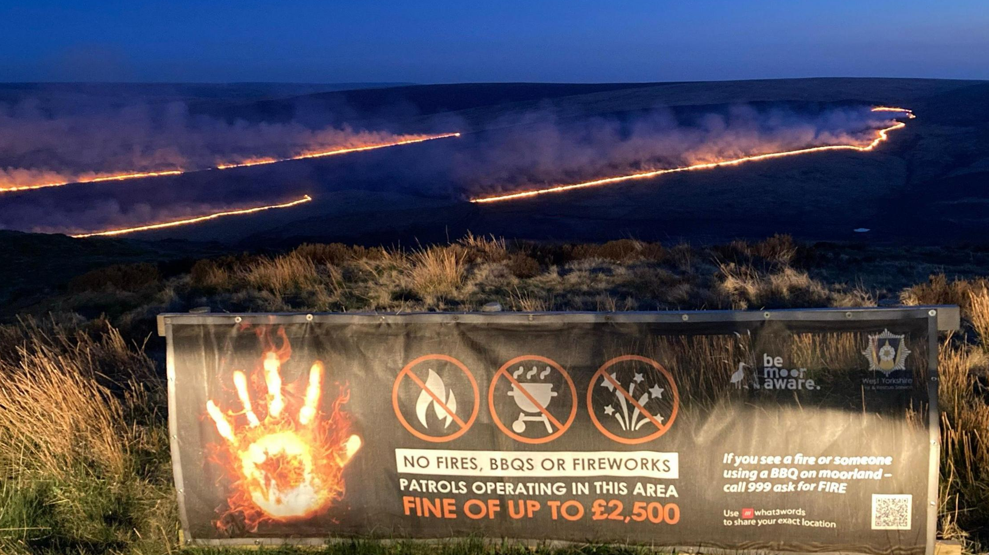
Source: Charles Heslett/BBC
Environmental impacts
Fire hazards
Discarded glass bottles and cigarette ends can start fires in woodlands, heathlands, and grasslands — especially during hot, dry UK summers.
Air pollution
Burning litter illegally releases toxic fumes and greenhouse gases, harming air quality and contributing to climate change.

Slide 10
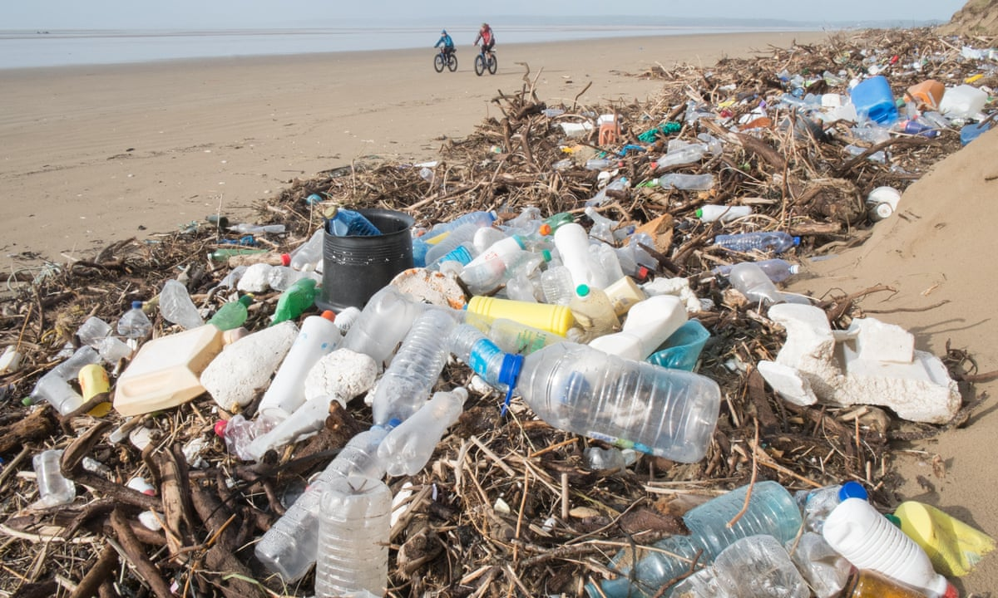
Environmental impacts
Damage to natural beauty and biodiversity
National parks, coastlines, and countryside areas suffer from visual pollution, which reduces biodiversity when litter crowds out plants or affects habitats.
Impact on marine ecosystems
In the UK, up to 80% of beach litter is plastic. This harms marine species, affects fisheries, and damages ecosystems like salt marshes and estuaries.
Source: The Guardian

Slide 11
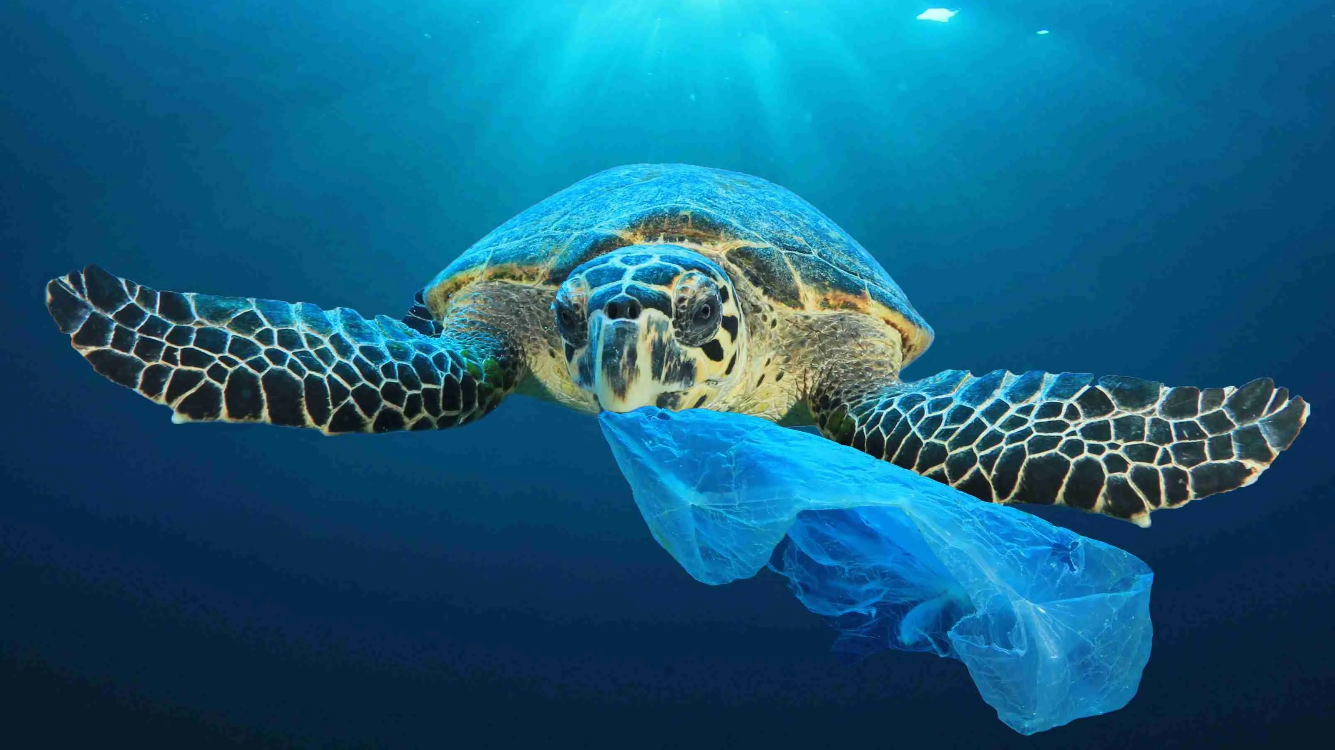
Waste, especially plastic, doesn’t just affect humans, it also harms biodiversity
(the variety of living things in nature)
Sea turtles and plastic bags:
Sea turtles often mistake plastic bags for jellyfish, their favorite food. Eating plastic can block their stomachs and lead to starvation.

Slide 12
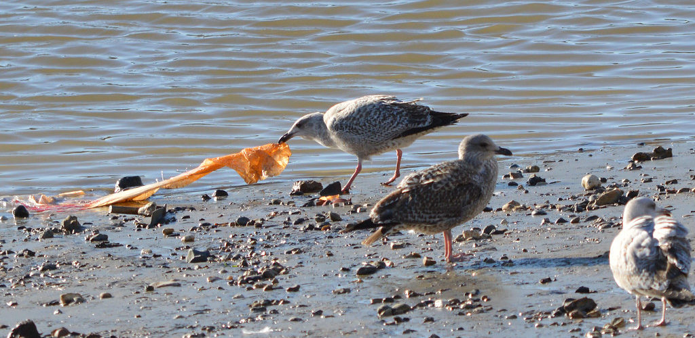
Birds and plastic debris:
Birds, like seagulls, swallow small pieces of plastic, thinking they’re food. The plastic fills their stomachs but provides no nutrition, which can cause them to die of hunger.
95% of seabirds in the North Sea have been found with plastic in
their stomachs.

Slide 13
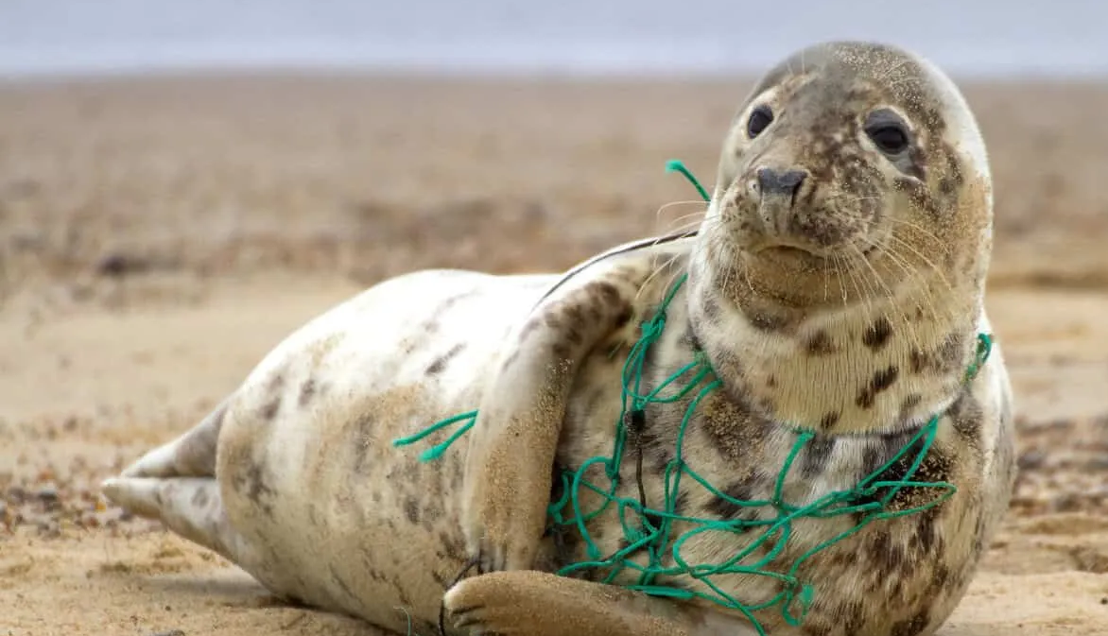
Animals getting trapped:
Animals, like seals or fish, can get stuck in plastic rings or fishing nets. This can injure them or stop them from moving or feeding properly.
Pollution of habitats:
Litter and chemicals from waste pollute rivers, oceans, and forests, making them unlivable for many species.
Threat to food chains:
Microplastics and toxins enter the food chain, affecting plants, animals, and even us.

Slide 14
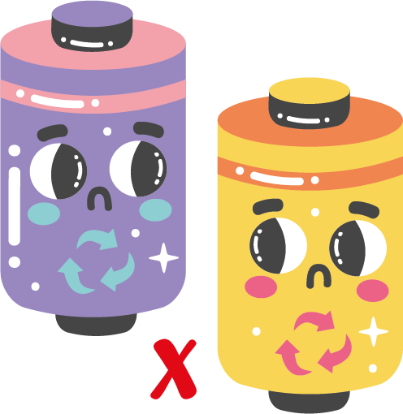



Disposing of waste safely
Recycling plants rely on clean, well-sorted materials. Taking a few seconds to clean, separate, or cut certain waste items all helps to:
protect wildlife
prevent equipment breakdowns
increase the amount that can actually be recycled instead of rejected
Optional Activity*
Looking at the items in front of you, how could you prepare them better for recycling to protect wildlife and help the recycling process run more smoothly?
*If no waste items are available, share the tips on the next slide >

Slide 15

Disposing of waste safely
Take hazardous waste to specialised recycling centres or drop-off locations.
Remove lids and scrunch them up to prevent hedgehogs and other animals from getting their heads stuck.
Cut can rings / elastic bands to stop animals getting stuck in them.

Slide 16

What about items that can’t fit in our household bins?
Let’s discuss…
Our household bins are great for disposing of food waste and smaller items, but what do we do with the bigger items that won’t fit like old furniture, or electronics like mobile phones and batteries?
Let’s discuss…

Slide 17

x
Let’s discuss…
Sometimes people are unsure on what to do with large waste items and put them in their black bin, where they end up in landfill or sent to incinerators.
Sometimes waste too big for the black bin will get dumped on the street: this is known as fly tipping and is illegal.
Waste dumped on the street can easily blow away and end up in rivers and the sea – this causes water pollution.

Slide 18

x
Let’s discuss…
Quite often, old furniture coated in paint or oil and large plastic items are burnt in garden bonfires.
Not only does the person burning the waste breathe in harmful toxins, but it also releases chemicals into the air, too.
Burning rubbish (especially plastics) releases toxic gases like dioxins and greenhouse gases such as CO₂. This causes air pollution.

Slide 19
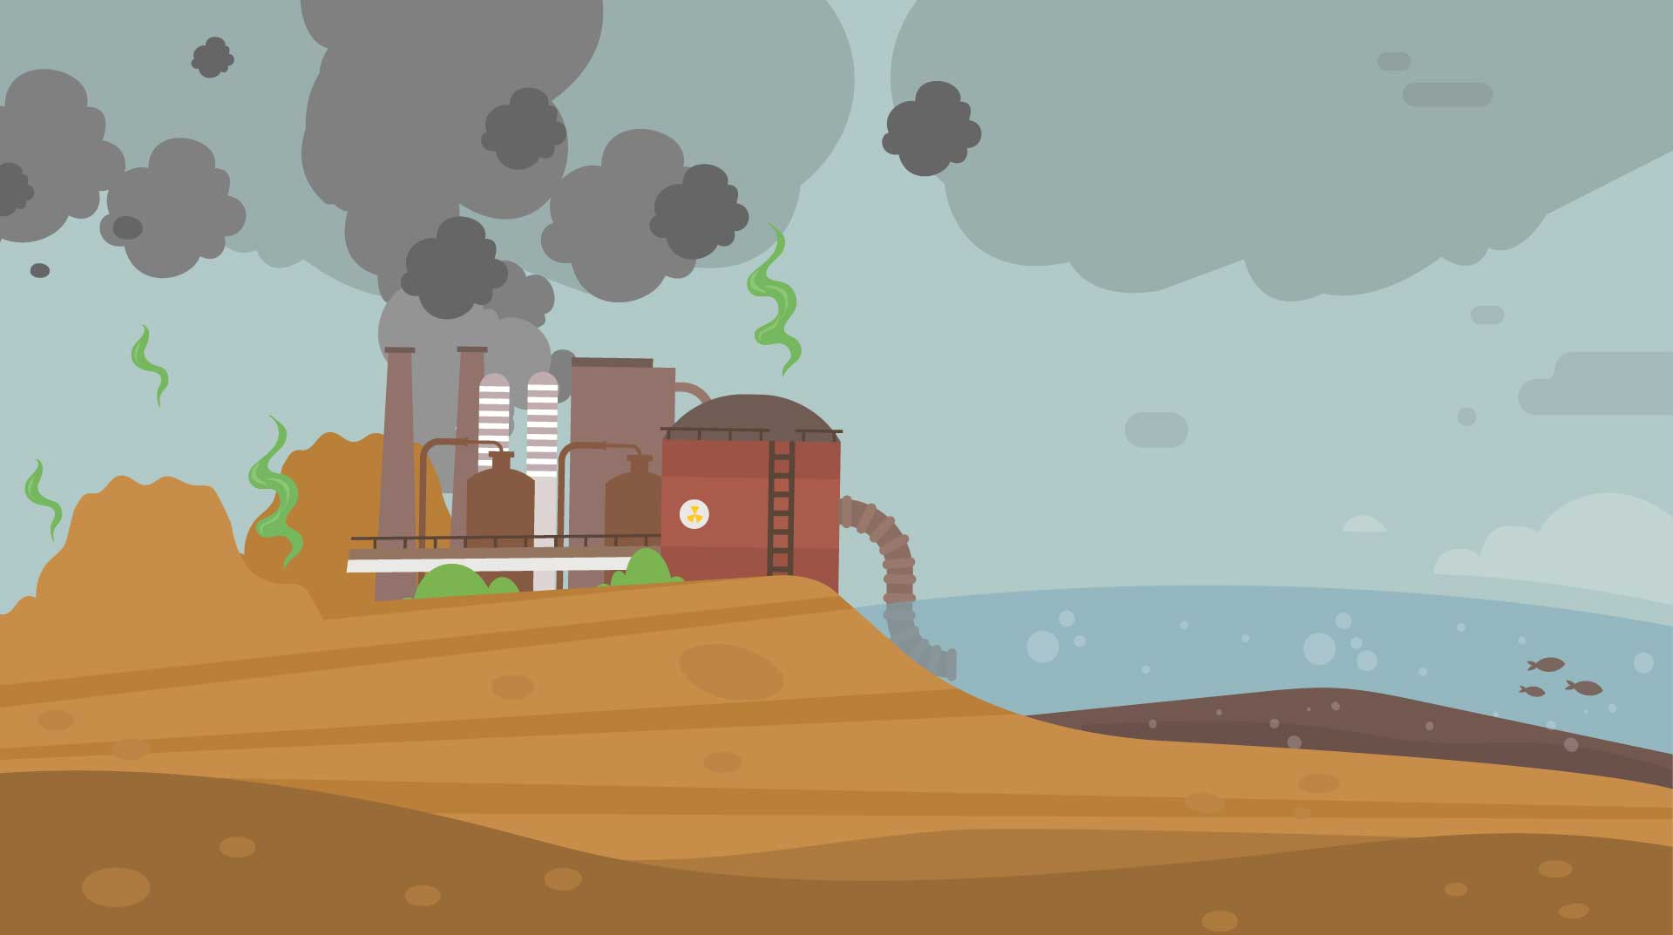
Let’s discuss…
The items placed in the wrong bins such as batteries and mobile phones end up in landfill where they sometimes explode, cause fires and leak harmful chemicals into the soil.
These leaks, called leachate, can poison plants, animals, and even drinking water supplies.
This is known as soil pollution.

Slide 20

Different types of pollution
Water pollution: Waste that gets into rivers, oceans, and lakes.
Air pollution: Harmful gases released from burning waste.
Soil pollution: Waste that contaminates the earth and harms plants and animals.

Slide 21
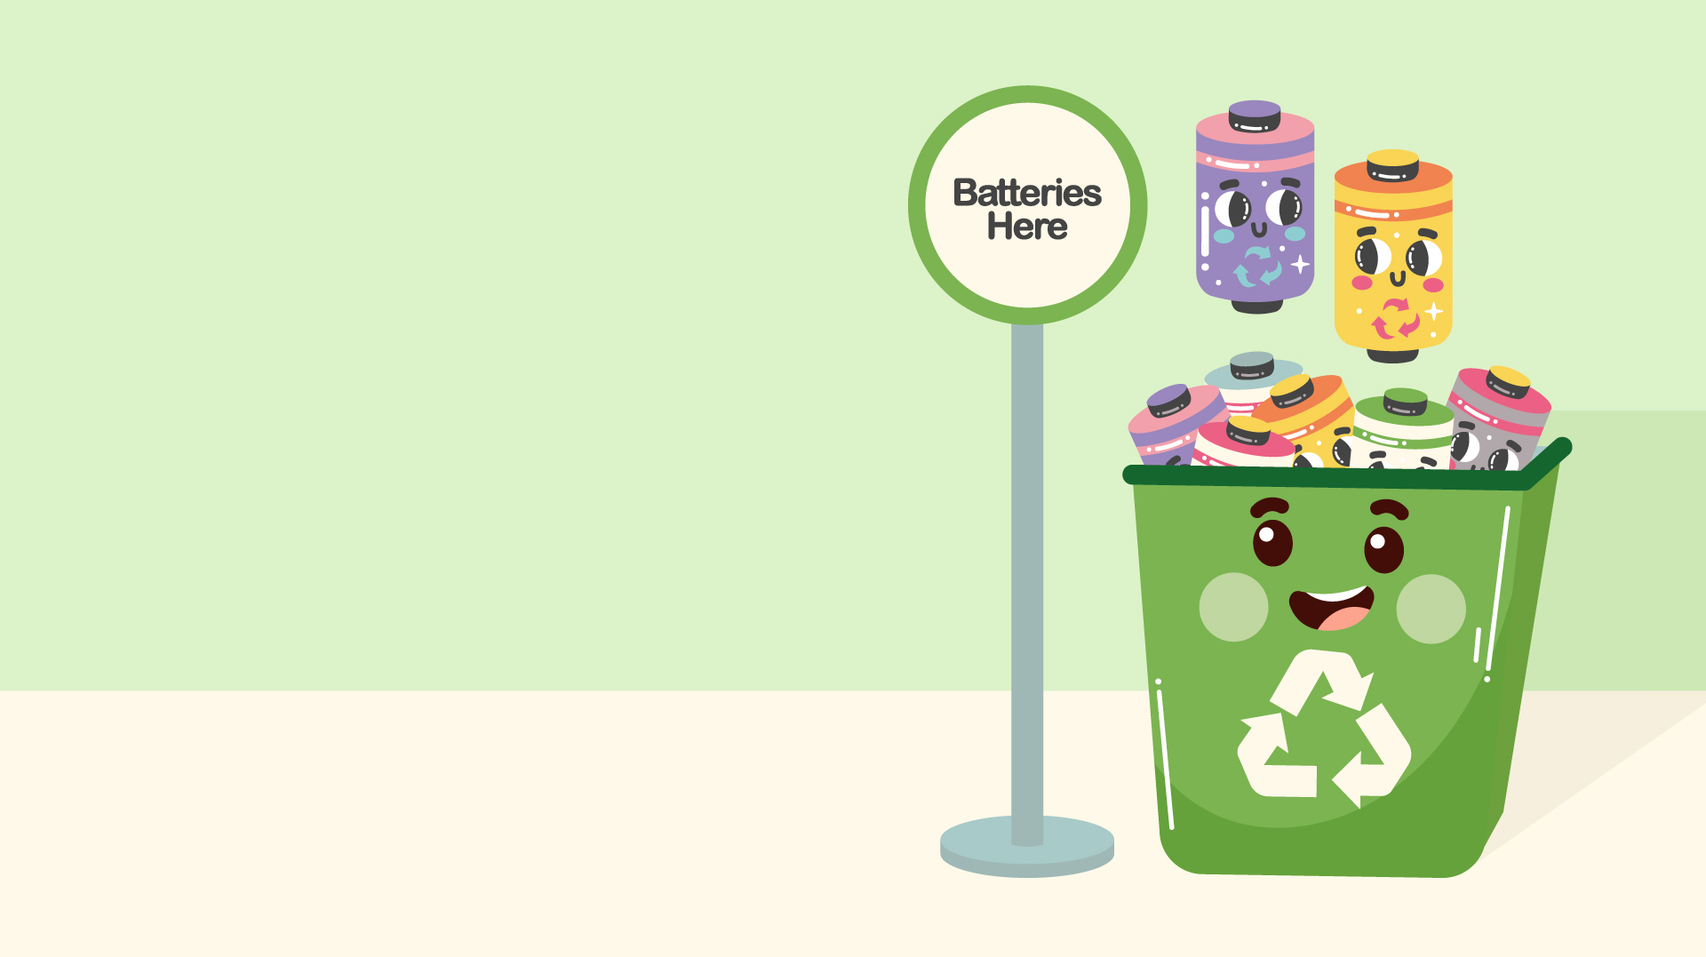
So, what do we do with these items?
Items / waste that can’t be recycled, need to be taken to special bins in supermarkets, or to Household Waste Recycling Centres near you.
Sites include:
Burma Drive household waste recycling centre
Sutton Fields household waste recycling centre
Wiltshire Road household waste recycling centre

Slide 22

Reduce, reuse and recycle
Remember the 3 Rs…
If we remember to reduce, reuse and recycle correctly, we can minimise the amount of waste that ends up on our streets, incinerated or in landfills.

Slide 23
Let’s discuss…
Discuss how individuals, communities, and businesses can reduce their waste footprint.
Reducing: Reducing the use of single-use plastics and excessive packaging.
Reusing: Repurposing items or donating them to avoid waste.
Recycling: Separating recyclables and ensuring they are processed properly.
Composting: Reducing organic waste by composting food scraps and garden waste.

Slide 24
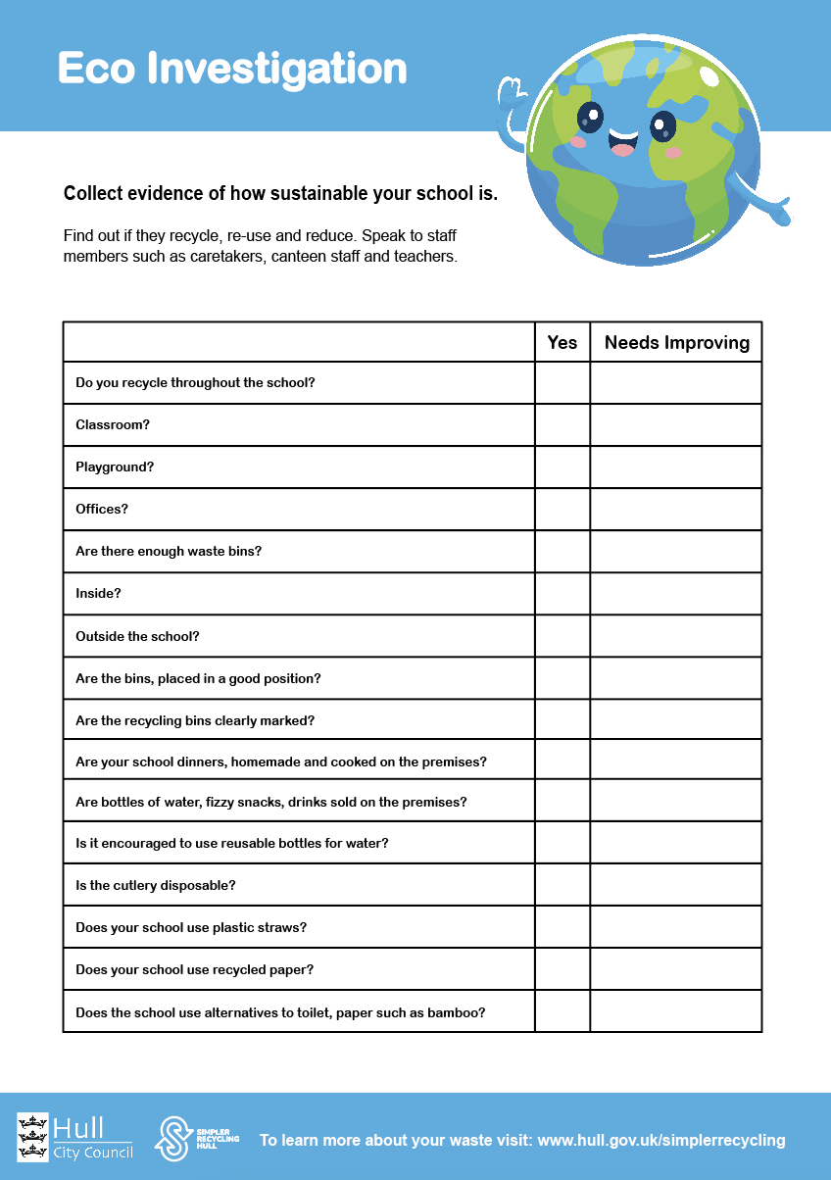
Activity!
Part 1
Using the knowledge we have gained, let’s split into small groups and discuss how we would address the problem of waste in our school.
Each group has an Eco Investigation handout to fill in.
Bonus point!
Come up with a list of potential solutions and strategies to reduce waste and protect the school environment.

Slide 25
Activity!
Part 2
Using these findings, each choose one or two impactful changes you could introduce within school.
Write a letter to your head of year / school head teacher explaining what you would like to change / introduce and explain why it is important.

Slide 26
Let’s recap:
The environmental impacts of waste in landfills, pollution, and plastic waste in oceans – can you list any?
The importance of reducing, reusing, and recycling to mitigate these impacts.
How each individual can make a difference through daily actions – can you make any suggestions?

Slide 27
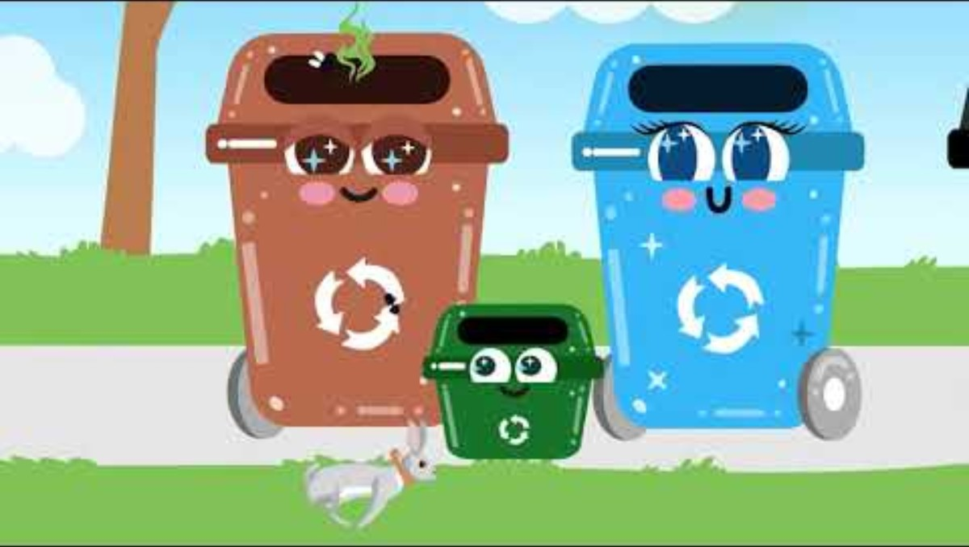

Slide 28
Congratulations!
You have now finished your Waste Management training from Talking Rubbish!
For more information and activities to learn even more, visit: www.hull.gov.uk/simplerrecycling

