Slide 1
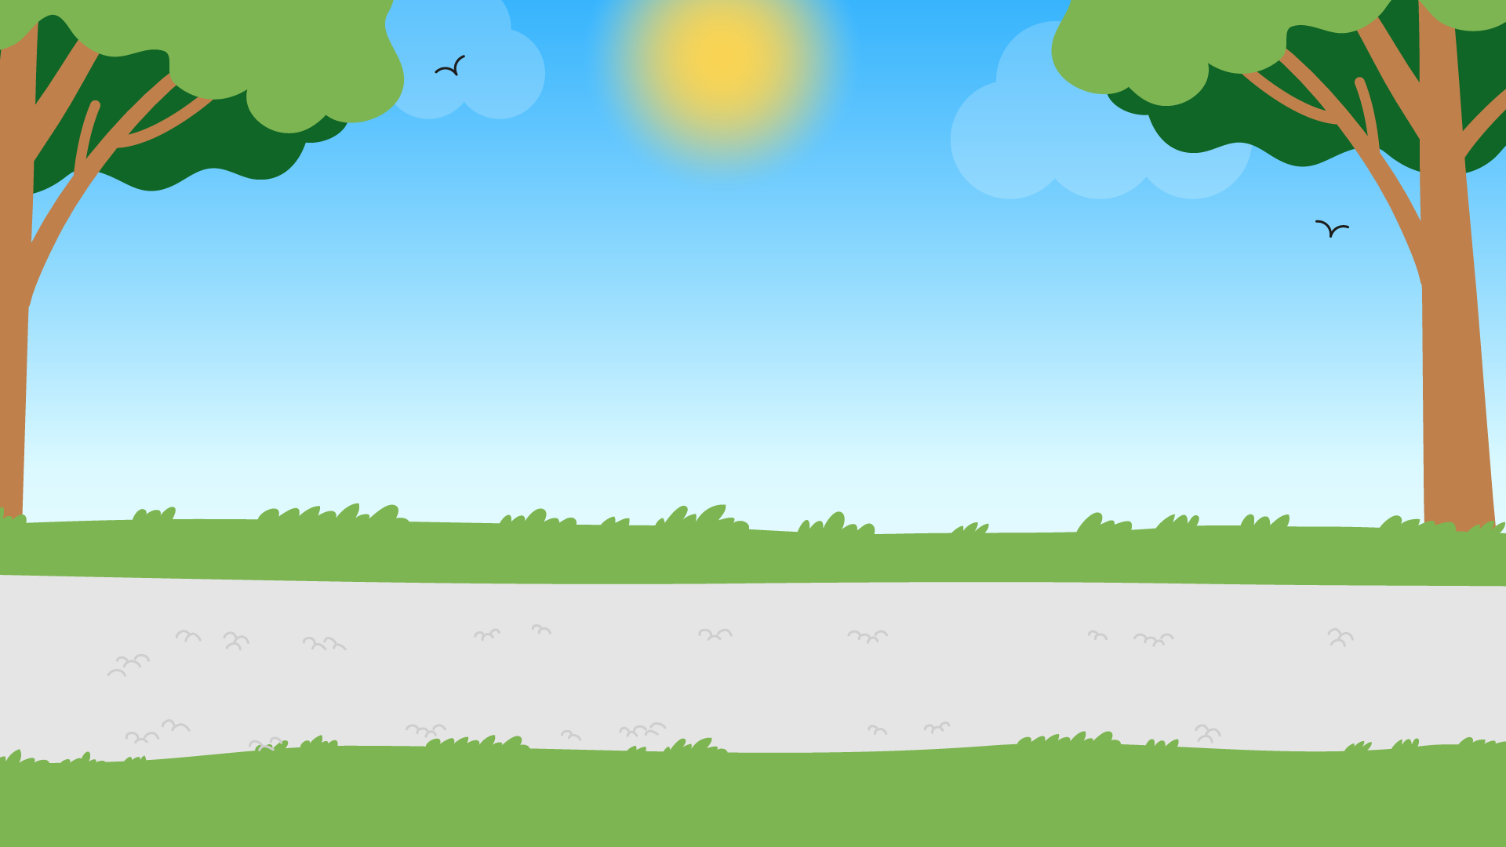
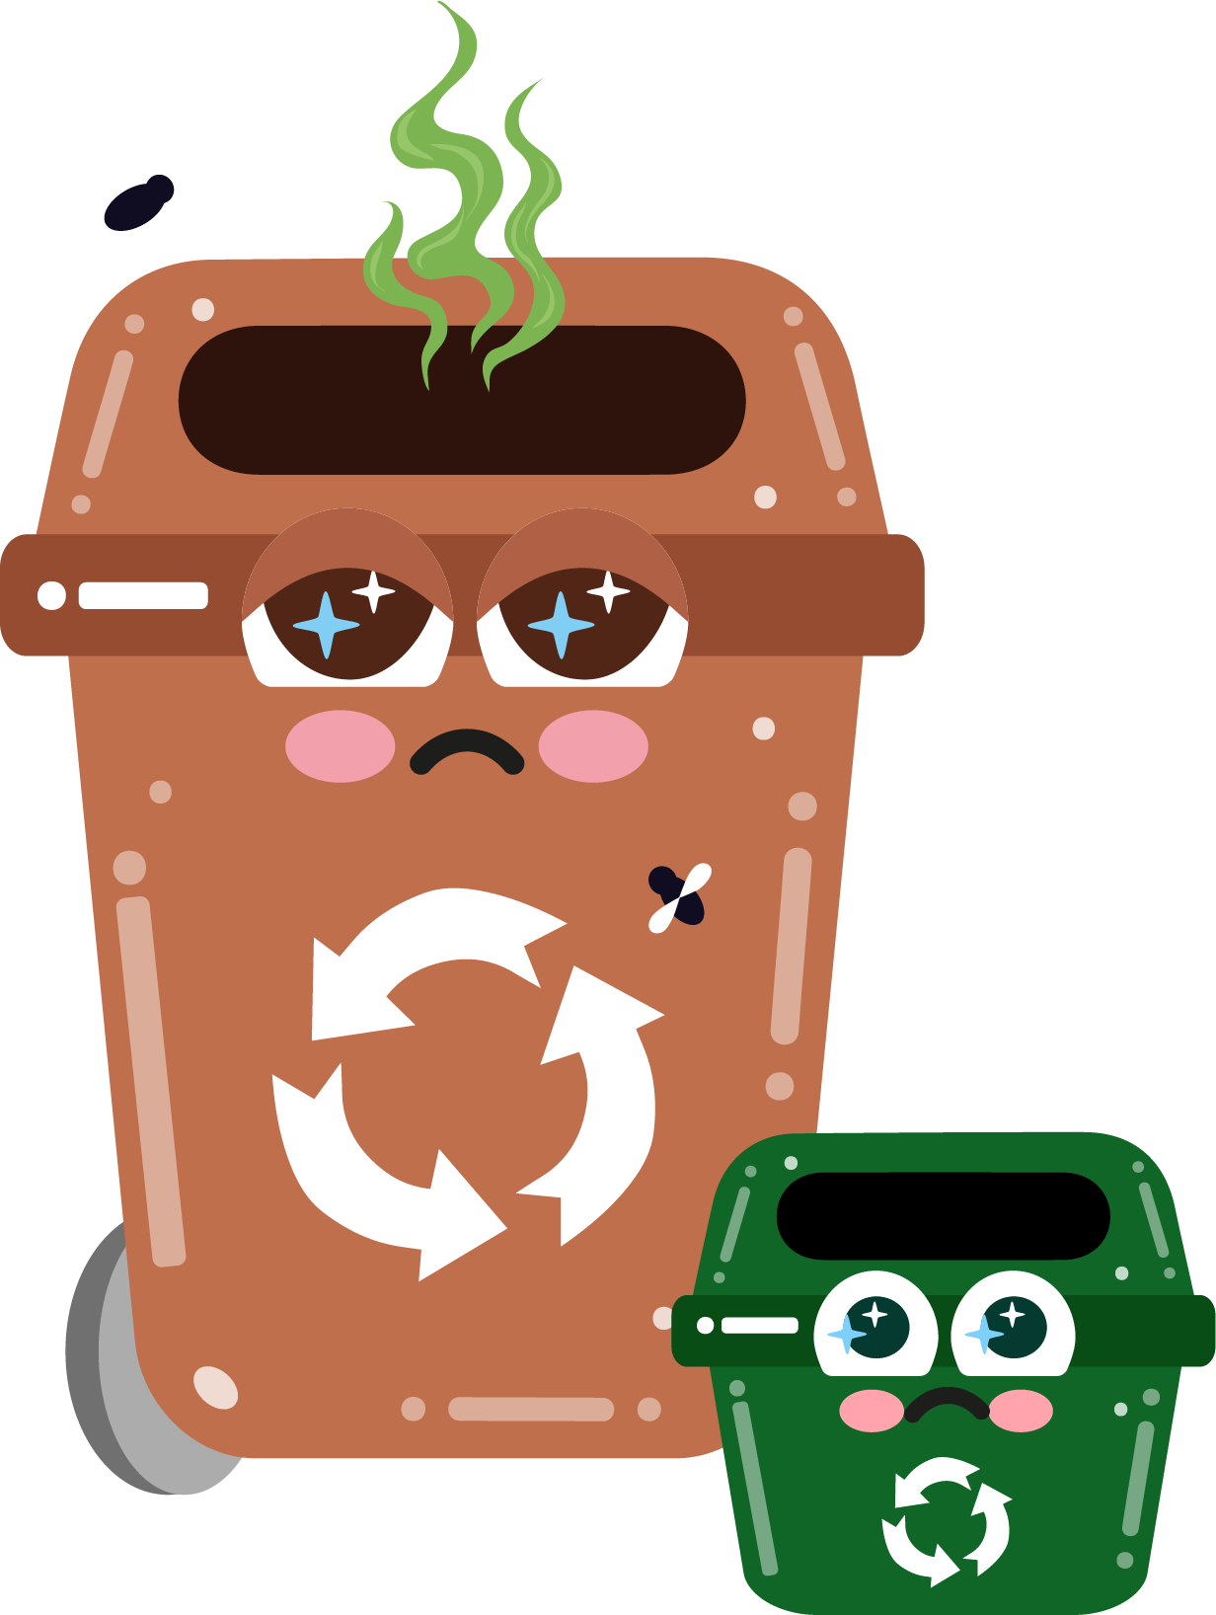








Part 4
Littering & its impact on the environment
Recommended for: Key Stage 3 - 4

Slide 2


Learning
Objectives:
By the end of this lesson, you will:
Understand the environmental and social impact of littering.
Identify the key materials that are most commonly littered and why they pose environmental risks.
Develop strategies to reduce littering and encourage positive behaviour within our school and community.
Discuss the role of individuals, communities, and governments in addressing littering.

Slide 3
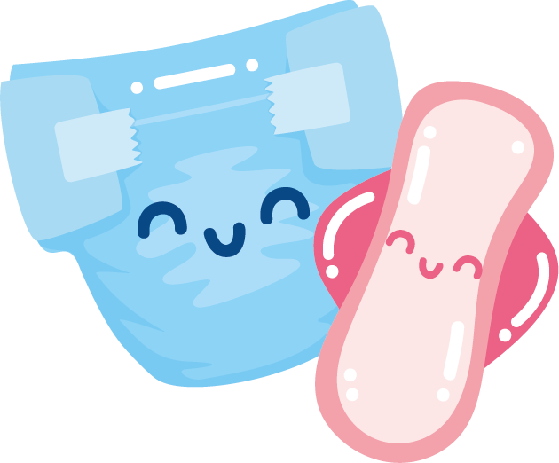
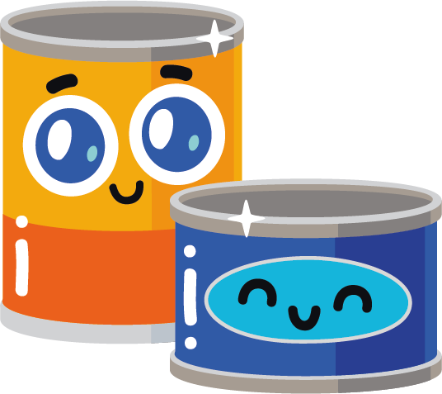
?
Littering means throwing waste, like wrappers, cans, or plastic bottles, in public spaces instead of in a bin.
?
Have you been anywhere where you’ve spotted litter?
Where does it go, and how does it impact our environment?
?
?
Let’s watch…

Slide 4
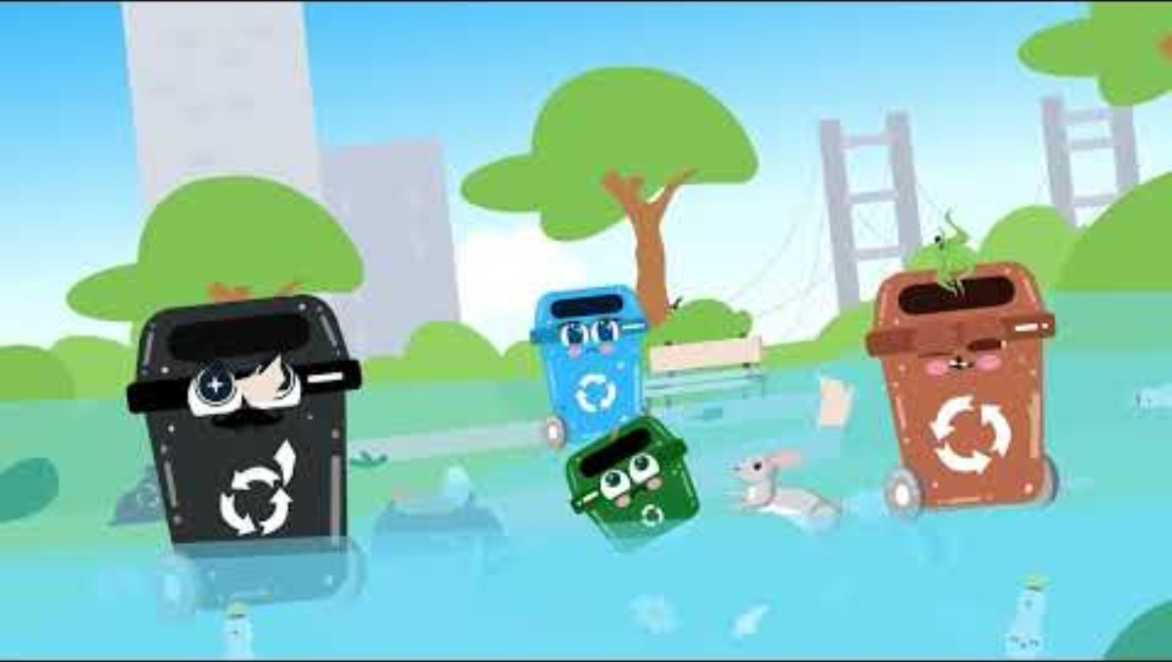

Slide 5
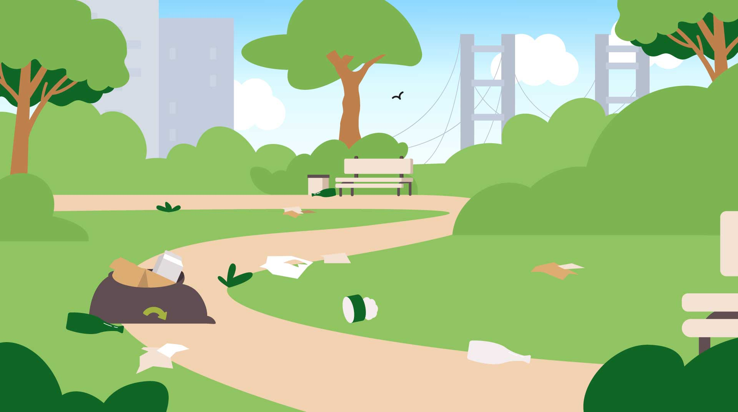
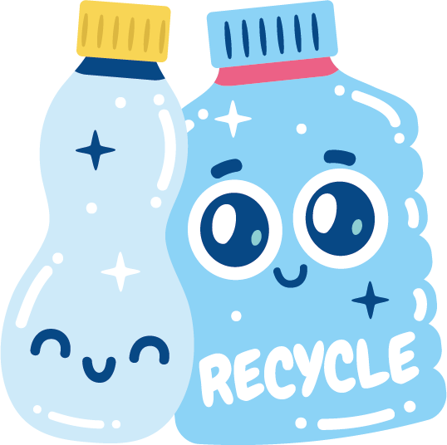
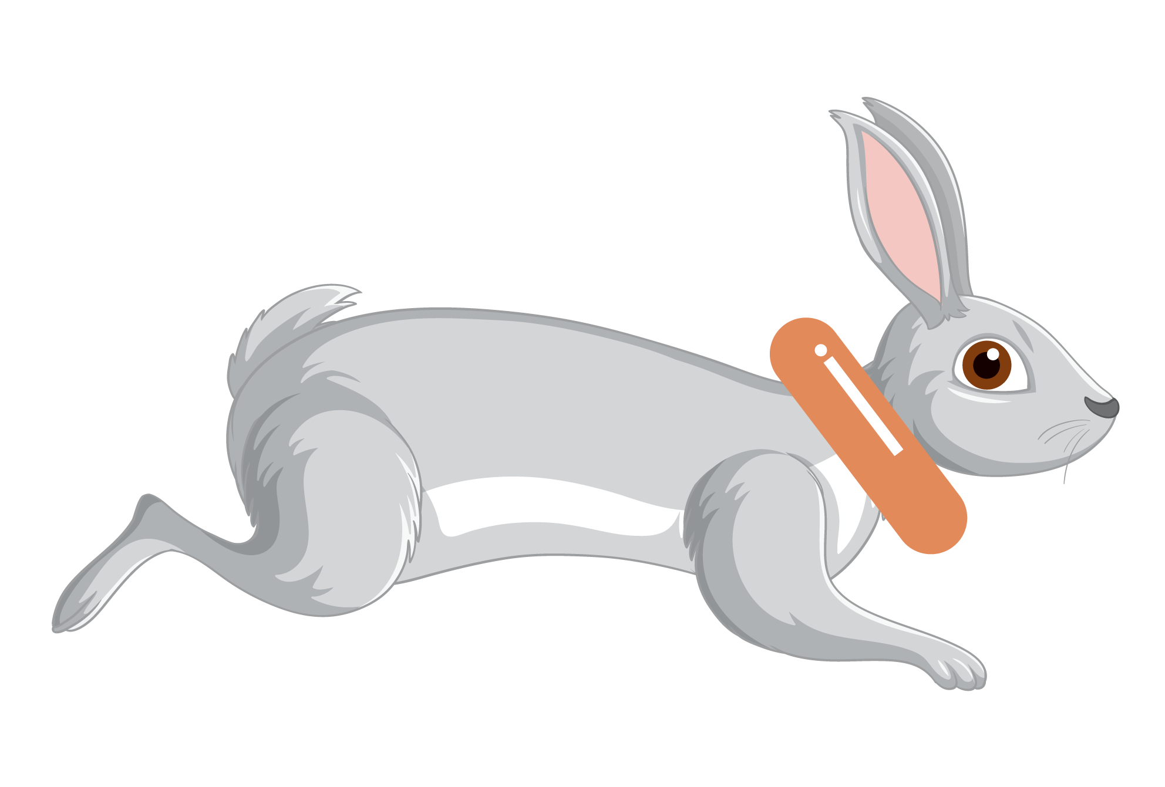
Littering causes several problems:
Pollution: Litter makes the environment dirty and can release harmful chemicals into the soil and water.
Harm to wildlife: Animals can mistake litter for food or get trapped in it, which can seriously hurt them.
Visual and ecological damage: Litter makes areas look ugly and untidy, and damages ecosystems.

Slide 6
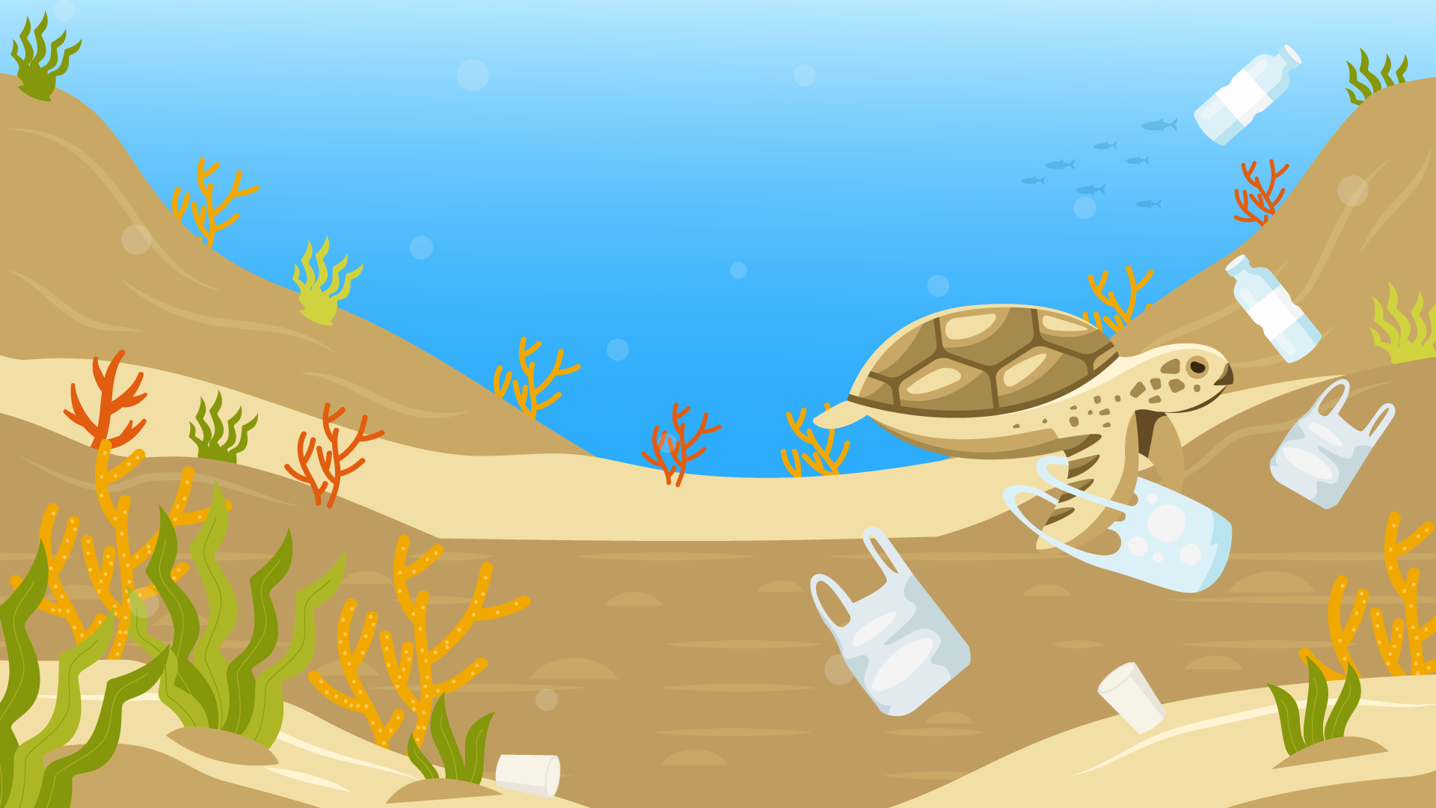
Persistent waste
By 2050 there could be more plastic than fish in the world’s oceans!
Some types of waste, like plastic, are called persistent waste because they don’t break down easily in nature.
Plastic can stay in the environment for hundreds of years, causing long-term harm.
It breaks into tiny pieces called microplastics, which can end up in the food chain for animals and humans!

Slide 7

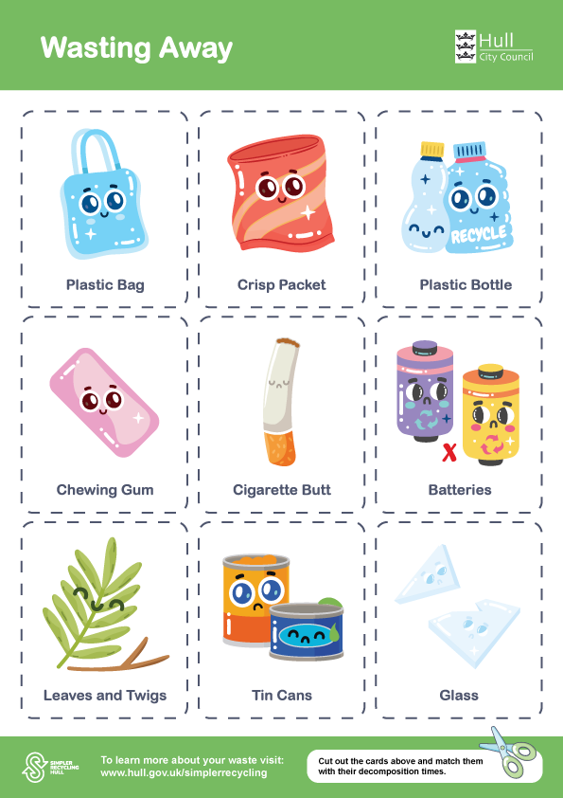
4,500 billion cigarette butts reach the moon and back 117 times
In the whole world, around 4,500 billion cigarette butts are thrown on the ground every year.
If you line up all these cigarette butts, the line would be 90,000,000 kilometres long. That’s as far as travelling to and from the moon 117 times!
Let’s guess how long some items take to decompose*…
*Worksheet available
Source: worldschildrensprize.org/

Slide 8
Guess the decomposition times
Cigarette butt
2 - 10 years
A cigarette butt takes anywhere from 2 to 10 years to decompose, depending on environmental conditions.
The filter is made of cellulose acetate, a form of plastic that breaks down very slowly and leaches toxic chemicals into the environment.

Slide 9

Guess the decomposition times
Leaves and twigs
6 months - 3 years
In a compost pile, leaves and small twigs can decompose much faster (weeks to months) compared to being left in a dry environment.
When left in a dry environment they can also be a fire hazard.

Slide 10

Guess the decomposition times
Glass
1 Million + Years
Glass from broken items or bottles does not decompose but only breaks down into tiny pieces.
If recycled correctly it is taken to a facility to be cleaned, sorted and crushed into small pieces called cullet which can then be melted to make new glass products, such as jars and bottles.

Slide 11

Guess the decomposition times
Chewing gum
5 – 1000 Years
Chewing gum is not biodegradable. Most chewing gum products are made from the same materials used to make adhesives and tyre tubes. They’re designed to be long-lasting for heavy-duty use.
That’s why so much chewing gum exists on streets lasting months, even years with very little change in their form.

Slide 12
Guess the decomposition times
Crisp packet
80 - 300 Years
Crisp packets are usually made using layers of plastic and aluminium foil.
This mixed material is very difficult to break down and doesn’t biodegrade fully. When left, the packet breaks down into microplastics and aluminium fragments, which stay in the environment much longer.

Slide 13
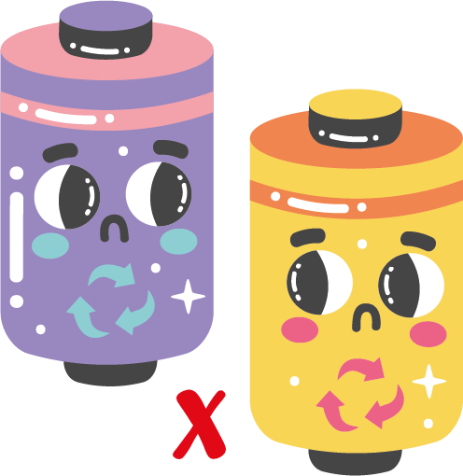
Guess the decomposition times
Batteries
100 + Years
Batteries corrode slowly, releasing heavy metals into the soil and water. The acid inside can leak in a matter of a few years, while the lead casing takes centuries to break down.
That’s why batteries should always be disposed of at special recycling centres, never in regular bins.

Slide 14
Activity time – Part 1
Litter Hunt
In pairs, go outside and spend around 5 - 10 minutes looking for any litter you can find around the school.
Using the sheet provided, take note of what you find and where you find it.
Once you have found a few things, come back in for part 2 of the activity.

Slide 15
Activity time - Part 2
The impacts of littering
Commonly littered items include plastic bottles, wrappers, cigarette butts, chewing gum, vapes and food waste.
What did you find?
Your next task is to research the environmental, social and economic impacts of these littered items. On the next slide are some examples you could use.

Slide 16
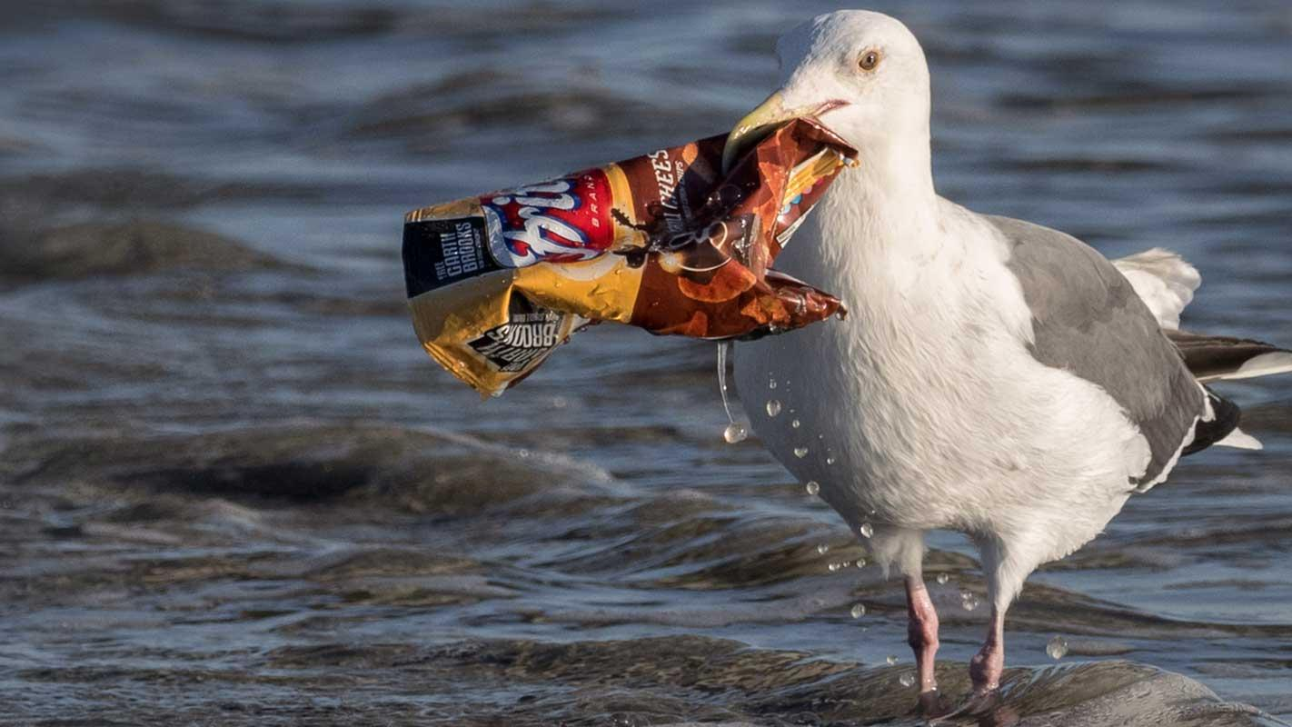
Source: worldschildrensprize.org/
Environmental impacts
Harm to wildlife
Animals can become entangled in plastic bags, fishing lines, and packaging.
Birds, fish, and mammals may ingest litter such as plastics, cigarette butts, or chewing gum, which not only then gets into our food chain, but it can even block their digestive systems and cause death.

Slide 17
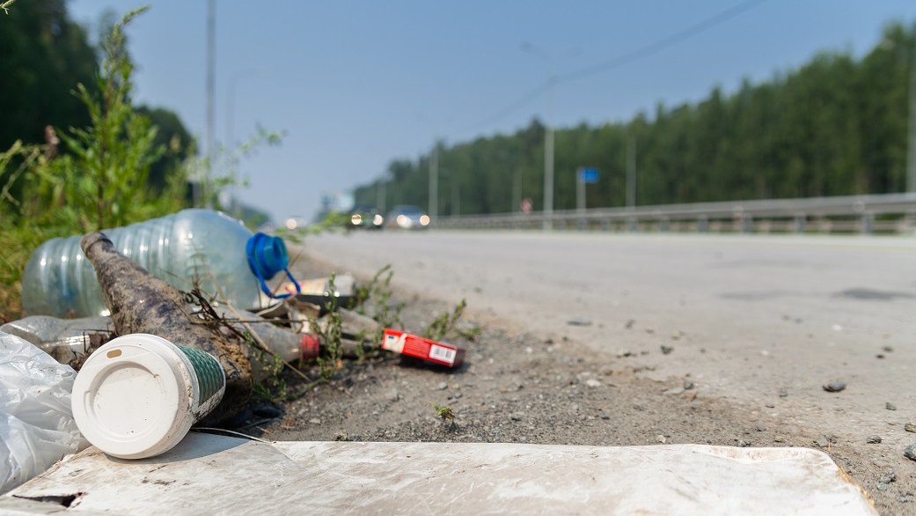
Social impacts
Traffic and safety hazards
Litter thrown onto roads can distract drivers or cause accidents (e.g. tyres punctured by sharp objects).
Fly-tipped waste can block pavements and country lanes, creating access issues for pedestrians and emergency services.
Source: autoserveclub

Slide 18
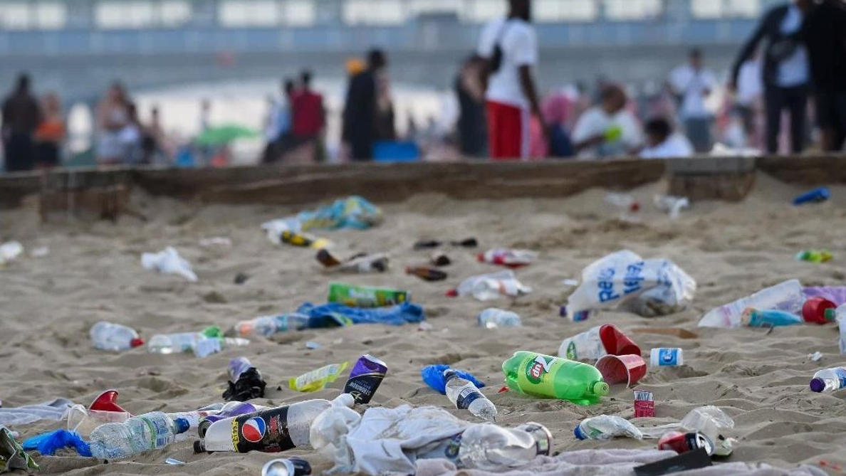
Social impacts
Damage to tourism and local economies
Litter on beaches, in city centres, or near tourist attractions puts off visitors.
A bad reputation for cleanliness can reduce income for local businesses reliant on tourism.
Increased financial costs for communities
Local councils in the UK spend hundreds of millions of pounds each year clearing litter — money that could otherwise go to schools, parks, or social care.
Source: Lancashire Evening Post

Slide 19
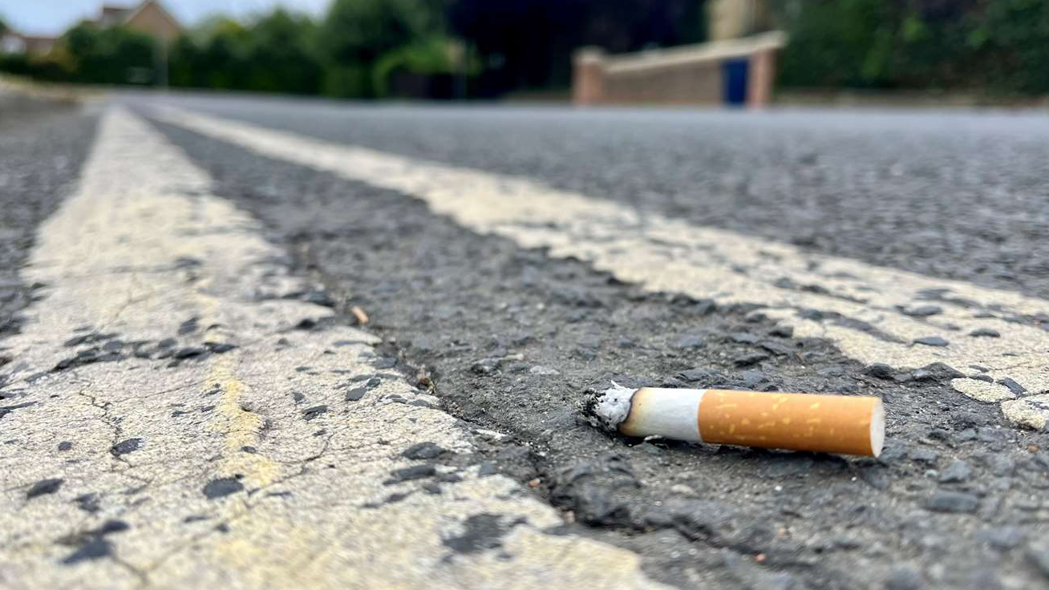
Economic Impacts
Economic impacts
In England, local authorities spend millions each year cleaning the waste up off our streets.
Can you guess, on average, how much is spent cleaning up the following…
Cigarette butts?
£140 million/year

Slide 20
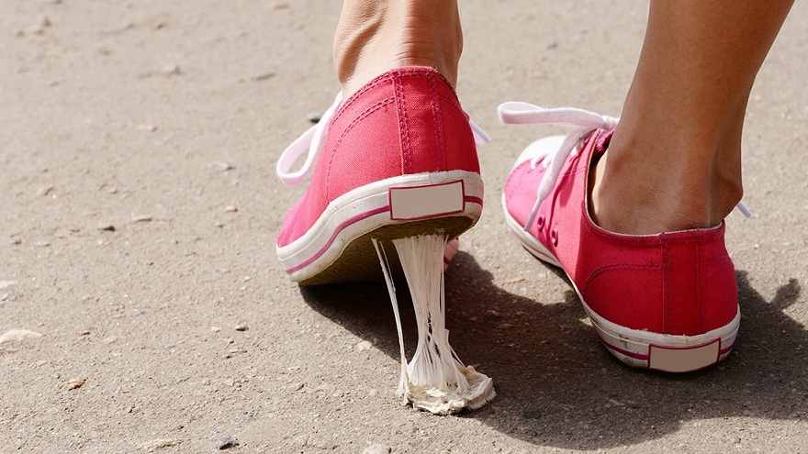
Economic Impacts
Economic impacts
In England, local authorities spend millions each year cleaning the waste up off our streets.
Can you guess, on average, how much is spent cleaning up the following…
Chewing gum?
£60 million/year

Slide 21
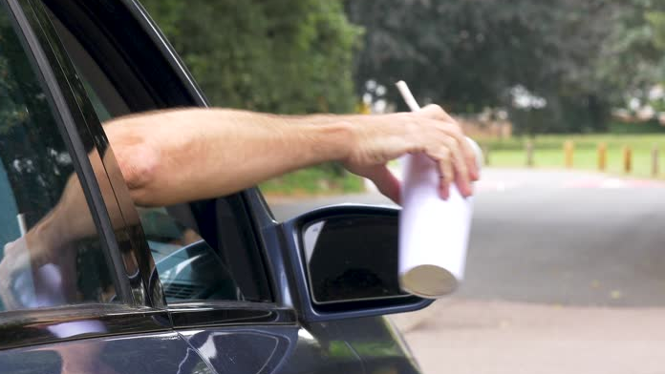
Economic Impacts
Fast food packaging?
Economic impacts
In England, local authorities spend millions each year cleaning the waste up off our streets.
Can you guess, on average, how much is spent cleaning up the following…
£100 million/year

Slide 22
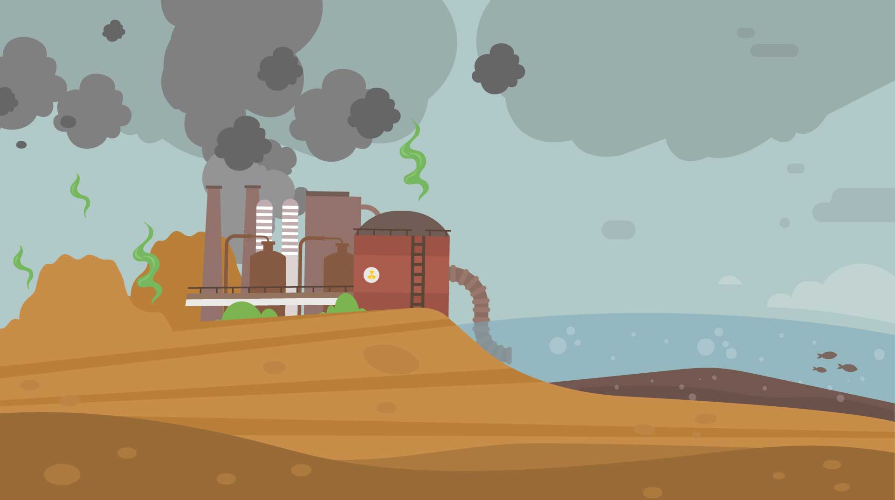
Activity time
Choosing one of the items you found, write a report covering the…
Environmental impacts: How does it harm ecosystems, animals, and plants? (e.g. ingestion of plastic by marine life, disruption of habitats, decomposition times, fires.)
Social impacts: What effect does littering have on local communities? (e.g. health risks, looking untidy, increased costs for local authorities).
Economic impacts: How much money do governments and local authorities spend on cleaning up litter? How much are fines if you are caught littering / fly tipping? Could it even lead to imprisonment?

Slide 23
Let’s discuss..
How did you find that?
Any volunteers like to share what they found?
Let’s remind ourselves of some ways we can prevent littering…

Slide 24

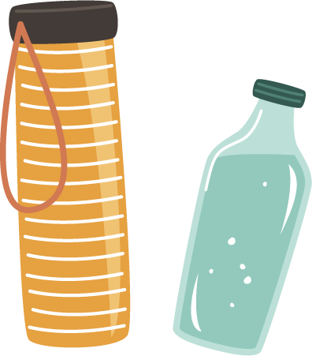

Ways we can prevent littering:
Use reusable materials such as lunch boxes, bags and water bottles
Pick up any litter you leave lying around or on the floor and take it home
Share knowledge with others and teach ways to care for the environment

Slide 25



Remember to use
the correct bins
Discard food and garden waste in the brown bin and green caddy or make your own compost bin
Recycle paper, glass, plastic and metal in blue recycling bins
Put your other rubbish in general waste bins

Slide 26
Further preventative measures…
Encouraging the use of public rubbish bins and recycling bins.
Organising school clean-up events.
Promoting awareness campaigns (e.g. through social media or school assemblies).
Improving waste management systems.
Increasing fines or penalties for littering in public spaces.

Slide 27

Home activity
Create a “Litter-Free School Campaign”
The aim of the campaign must be to reduce littering and could be:
• A social media campaign to raise awareness about the effects of littering.
• A campaign poster that raises awareness about the effects of littering and the impact on the environment.
• An app that rewards you when you recycle.
Incorporate what you have learnt today.
Try using some catchy slogans or messages!

Slide 28
Let’s recap:
Littering means throwing waste, like wrappers, cans, or plastic bottles, in public spaces instead of in a bin.
Plastic can stay in the environment for hundreds of years, causing long-term harm.
There are environmental, social and economic impacts of littering – can you remember the definitions of each?
There are many ways that we can try to reduce or even prevent littering – can you remember any examples?

Slide 29
Share one thing you
will do to help keep your environment clean.
Exit Ticket:
Be ready to share your answer when you leave the classroom!

