Slide 1
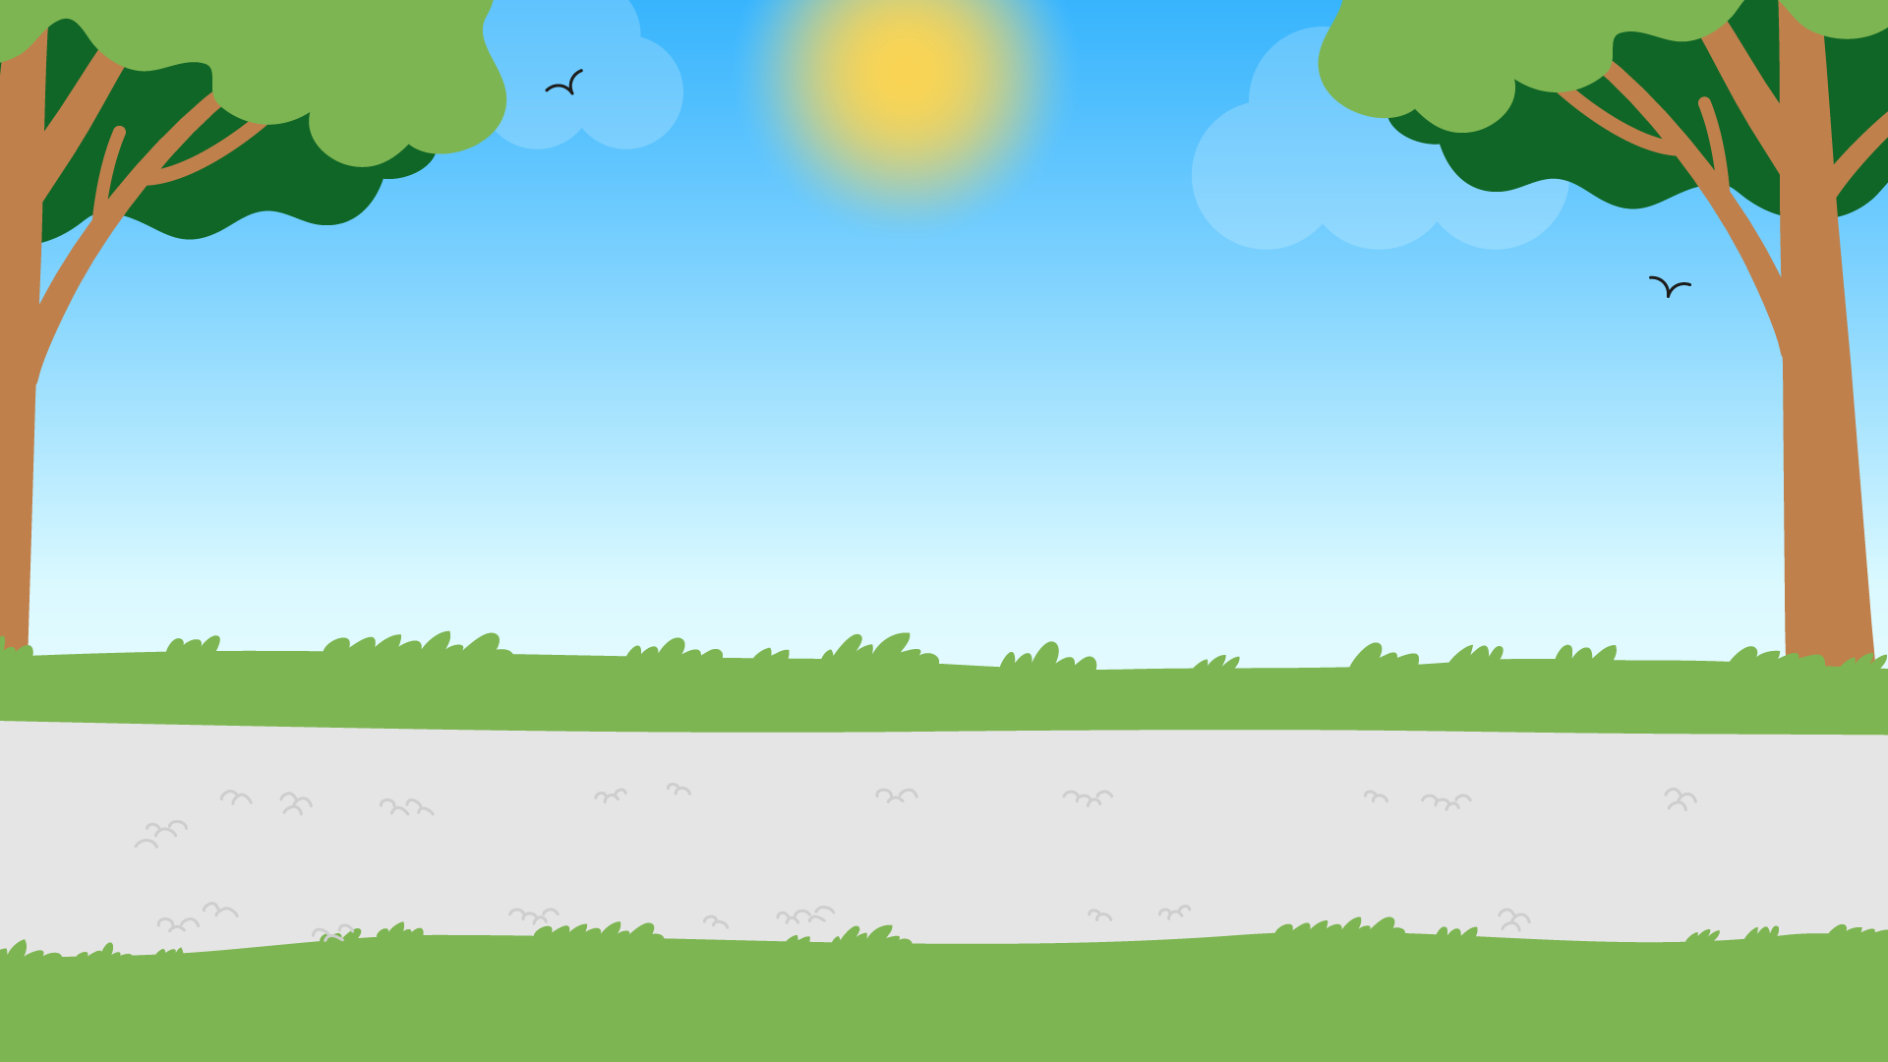
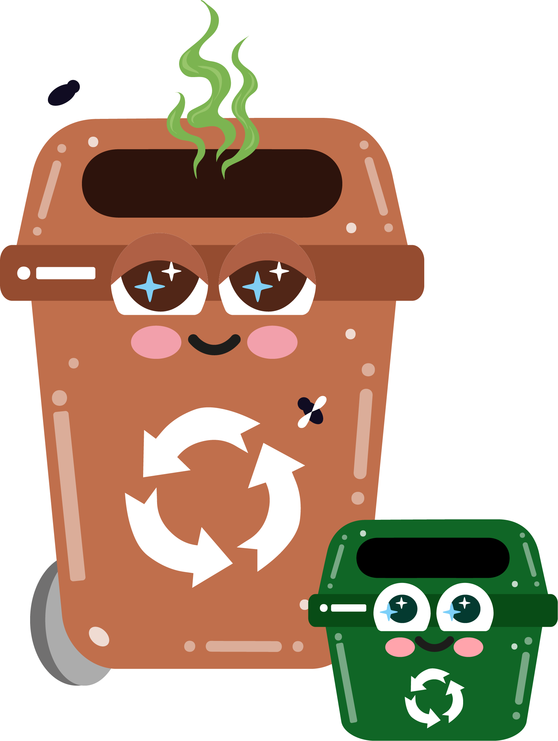


Part 3
Composting and organic waste
Recommended for: Key Stage 3 – 4

Slide 2

Learning
Objectives:
By the end of this lesson, you will:
Understand the process of composting and its importance in waste management and sustainability.
Learn what organic waste is and how it can be diverted from landfill and incinerators through composting.
Discover how composting benefits the environment, including soil health, waste reduction, and the fight against climate change.
Identify common organic waste materials and differentiate between compostable and non-compostable items.
Learn how to set up and maintain a compost system at home, school, or in your community.

Slide 3
An introduction to composting
?
?
What do you think happens to food scraps or garden waste when we throw them away?
?
?
  Where do they go?
  Have you ever thought about where it ends up?
?
Click for explanation…

Slide 4
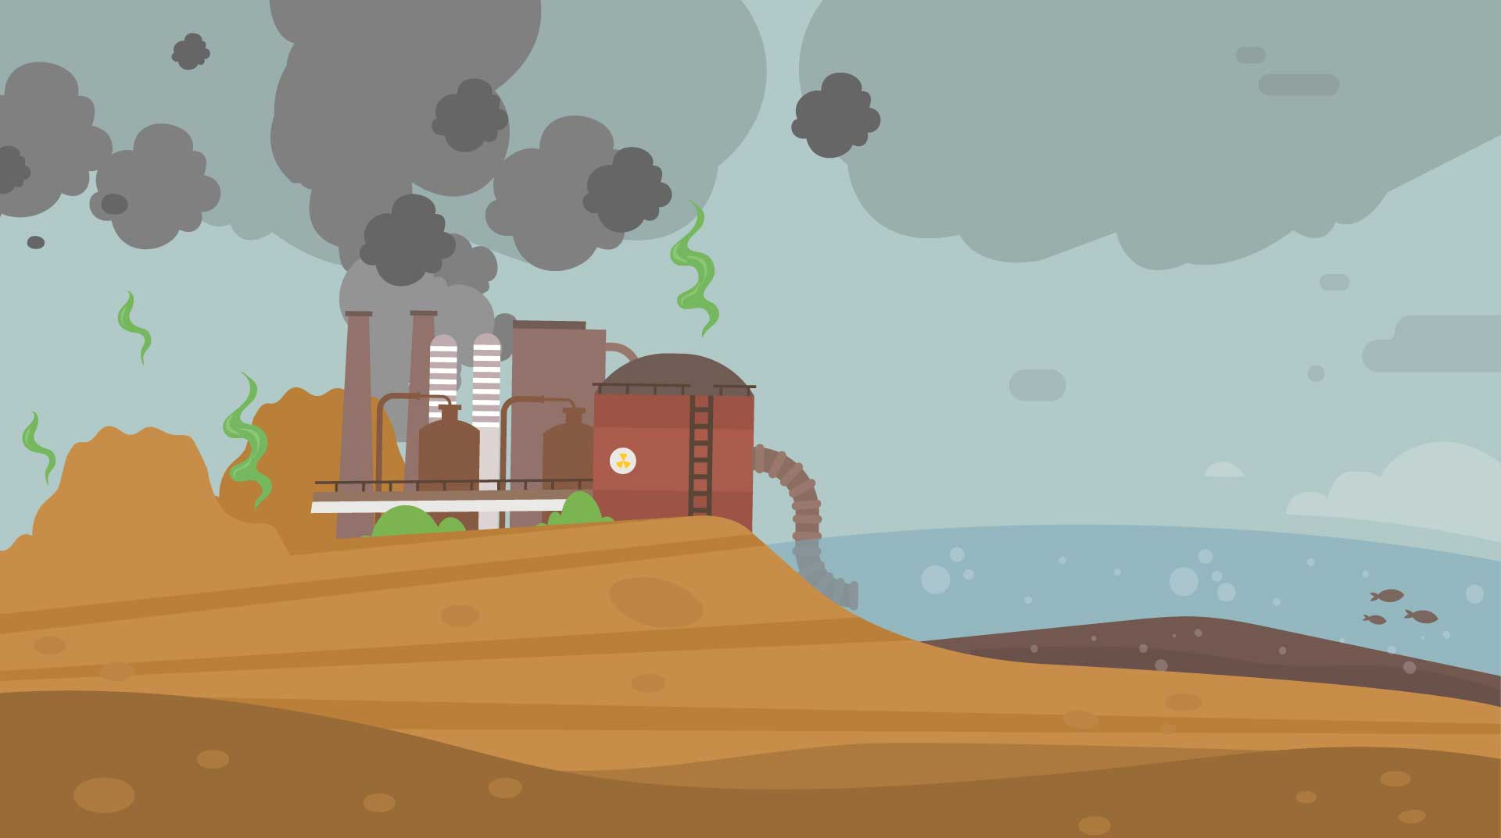
Where does waste go?
Imagine all the waste we produce being dumped in one big pile - it needs to go somewhere, right?
That’s where landfills come in. A landfill is a large area where waste is buried.
It’s like a giant bin for the rubbish we throw away.
However, landfills have problems, especially when it comes to organic waste (things like food scraps and garden waste).
Let’s break it down

Slide 5
Let’s break it down
Methane gas: In landfills, organic waste rots without air and produces methane, a powerful greenhouse gas that worsens global warming.
Composting is a smarter way to handle organic waste; it reduces methane, saves resources, and helps the environment.
Wasted resources: Organic waste contains nutrients that could be composted and reused, but instead, it’s wasted in landfills.
Space issues: Landfills take up a lot of space and can cause bad smells and pollution.

Slide 6
Let’s discuss…
What could you do at home to stop organic waste going to landfill?
Click for answers…

Slide 7
What could you do at home?
Composting:
Set up a compost bin at home to turn food scraps and garden waste into nutrient-rich soil for plants.
Recycling garden waste:
Use council provided brown bins for your garden waste, if available.
Education and awareness:
Teach others in your household to separate organic waste for composting or recycling.
Food waste reduction:
Plan meals carefully and store food properly to avoid throwing away food that has gone off and use leftovers creatively instead of discarding them.
Community composting:
If you don’t have space for a compost bin, join a community composting scheme or drop off organic waste at a local compost collection point.

Slide 8
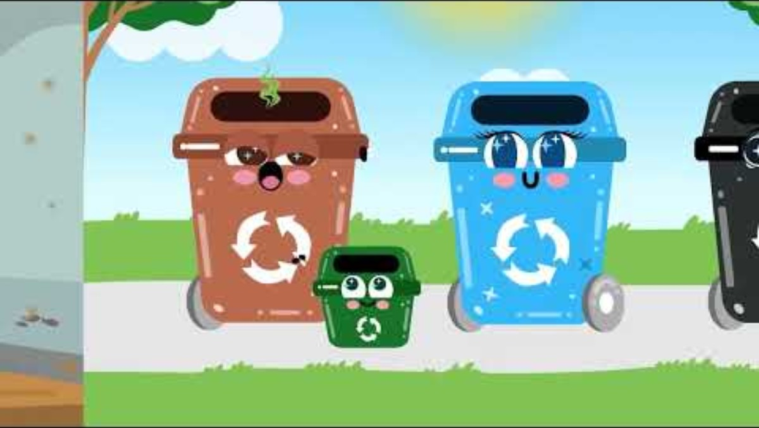

Slide 9
Let’s recap…
What can be composted?
I take your
garden waste
Fruit peels
(like banana, orange, or apple cores)
Vegetable scraps
(like carrot tops or potato peels)
Eggshells
Pasta, bread or rice
Plate scrapings or leftovers
Hair or pet fur
Shredded paper
Twigs, cut grass or flowers
..and I
take food
scraps

Slide 10


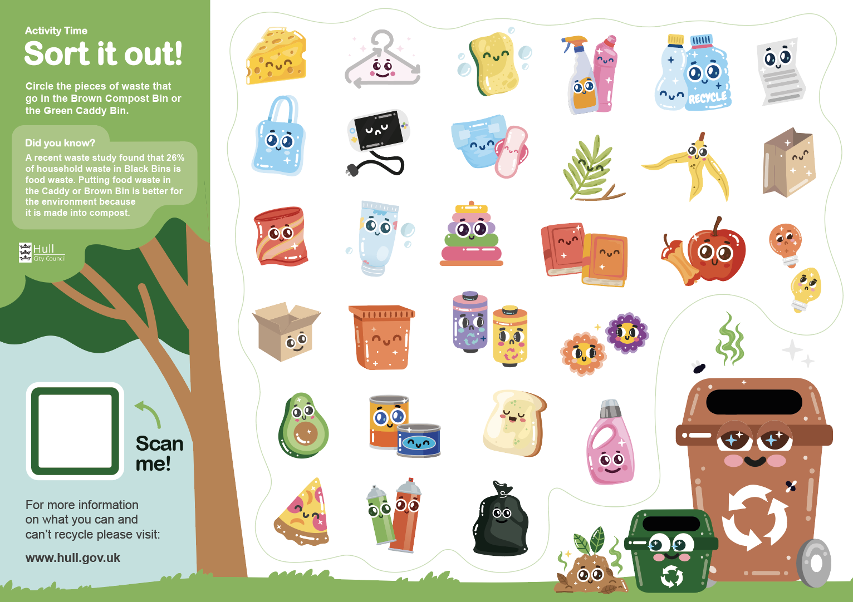




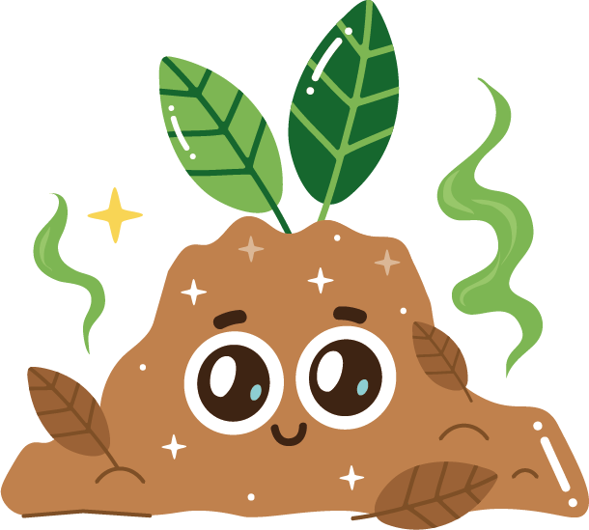
Sort it out!
Starter activity
As a class, look at the waste items in front of you and decide if they go into your brown bin and caddy bin, or if they have to be thrown away.
*worksheet alternative if no physical waste items available
Bonus points if you know
which bin they should go in!

Slide 11
Composting
Composting is nature’s way of recycling organic waste (like food scraps and leaves) into nutrient-rich compost for plants.
Reduces waste going to landfills and incinerators.
Creates nutrient-rich soil for gardens and plants.
Helping to reduce greenhouse gases by decreasing organic waste in landfills and incinerators.
The waste materials you have just sorted for the brown bin and the caddy bin are the perfect ingredients that you need to make your own compost bin.

Slide 12

The composting “recipe”
Compost requires a balance of “greens” (nitrogen-rich materials) and “browns” (carbon-rich materials).
Greens
food scraps, coffee grounds, grass clippings
Browns
dry leaves, straw, cardboard, sawdust
The proper mix of greens and browns helps maintain the right moisture level, airflow, and temperature for decomposition.

Slide 13
The composting process
How it works:
Microorganisms and fungi:
Tiny bacteria and fungi break down waste into simpler substances, releasing heat as they work.
Worms:
Worms eat the broken-down material and produce nutrient-rich waste (worm castings), great for soil.
Oxygen:
Bacteria need oxygen to work efficiently, so compost bins need to be mixed or turned.

Slide 14
Compost bin
Home or school activity
  Select a location: Choose a dry, shaded spot that’s easily accessible.
  Choose a bin or create a pile: Compost bins are great for smaller spaces, but compost piles are easier to manage in larger areas.
  Layering: Start with a layer of brown materials, then add a layer of green materials. Continue layering, maintaining a balance.
  Turning the pile: Turn the compost regularly (every 1-2 weeks) to introduce oxygen and speed up decomposition.
Monitor moisture and temperature: keep the compost moist but not too wet, and check that the temperature is between 55-70°C.

Slide 15
Let’s recap
Composting is a smarter way to handle organic waste; it reduces methane, saves resources, and helps the environment.
Food scraps go in the green caddy bin and garden waste in the brown bin; both are then taken away to be composted.
You can create your own compost bin at home using the above waste.

Slide 16

Compost care
Final activity / homework
Now you have learnt everything you need to know about composting, design a poster that you can put up somewhere within school or your home about what it is and how people can compost organic waste.
Can be done in small groups or individually.
    Remember to include key information that you have learnt today, like what can and can’t be composted and the benefits of doing so.

Slide 17
Pick one thing you have learnt about composting today
Exit Ticket:
Be ready to share your answer when you leave the classroom!

