Slide 1
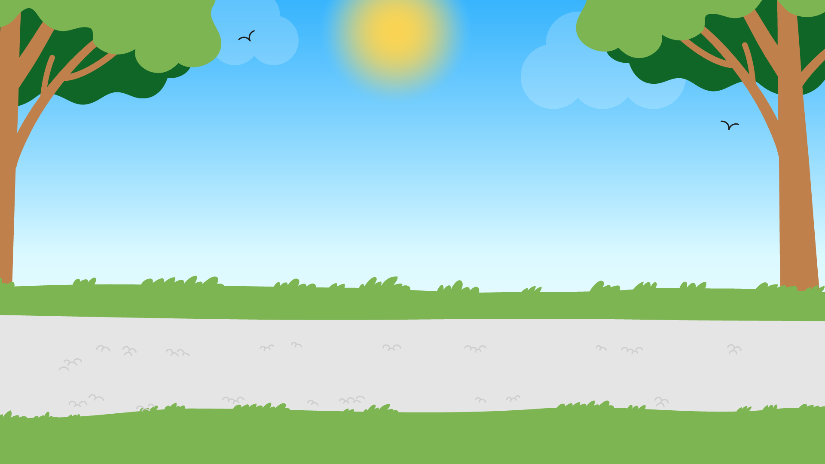



Part 2
Recycling & contaminated waste
Recommended for: Key Stage 3 - 4

Slide 2

Learning Objectives:
By the end of this lesson, you will:
1. Understand the environmental impact of waste and the importance of recycling.
2. Understand what waste contamination is, why it is important to separate waste and how to do it correctly.
3. Be able to explain the recycling process and the benefits of reducing waste.
4. Discuss the challenges and solutions to improving recycling practices in our communities.

Slide 3
An introduction to recycling
?
?
  What is recycling?
  Where does recycled waste go?
  How does not recycling affect the environment?
?
?
Click for answers…

Slide 4
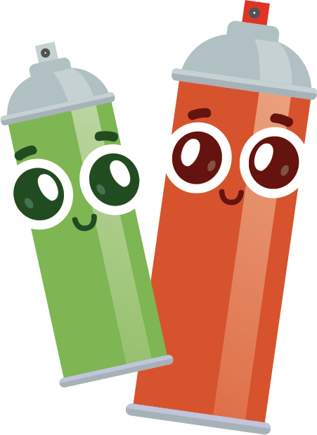
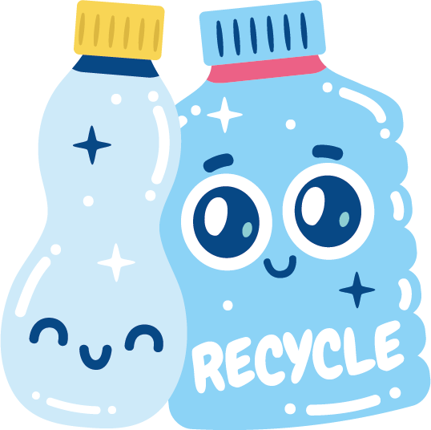



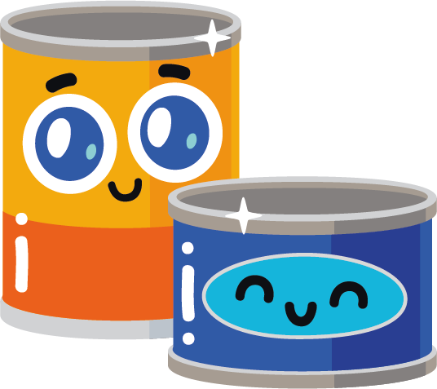
Recycling means turning old things into new things so we don’t have to use as many new resources, and we can help protect our planet.
However, recyclable items can cause contamination if, for example, they have food waste in / on them and haven’t been cleaned or separated properly.
Tip: If you see a tin or container that has some food on it, give it a quick whoosh with some water to clean it!

Slide 5
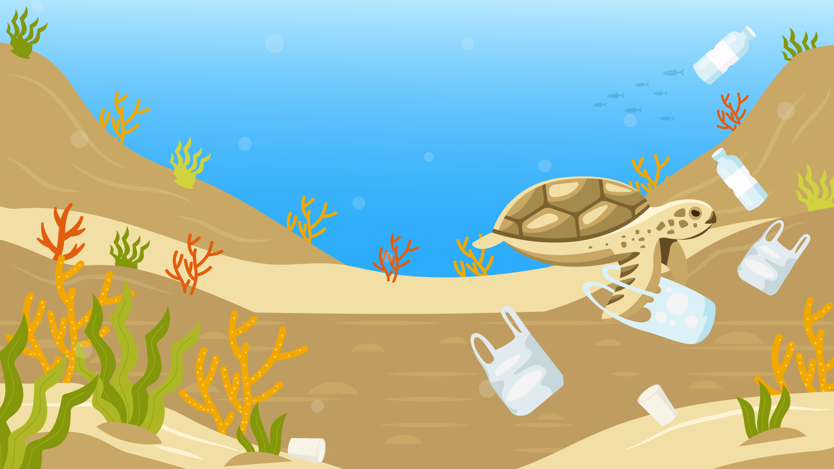
Waste, especially plastic, that isn't recycled properly ends up in incinerators or pollutes soil and oceans.
Plastics take hundreds of years to break down, harming wildlife and the environment.
Recycling helps by turning used materials into new products, reducing waste, saving energy, and protecting nature.
Simple actions like reusing items, avoiding single-use plastics, and
sorting waste properly can make a
big difference.

Slide 6
Watch the video on the next slide and take note of…
What items can be recycled?
Why should we recycle these items?
What should we check for when recycling items?
Where does food waste go?
Once finished, discuss as a class

Slide 7
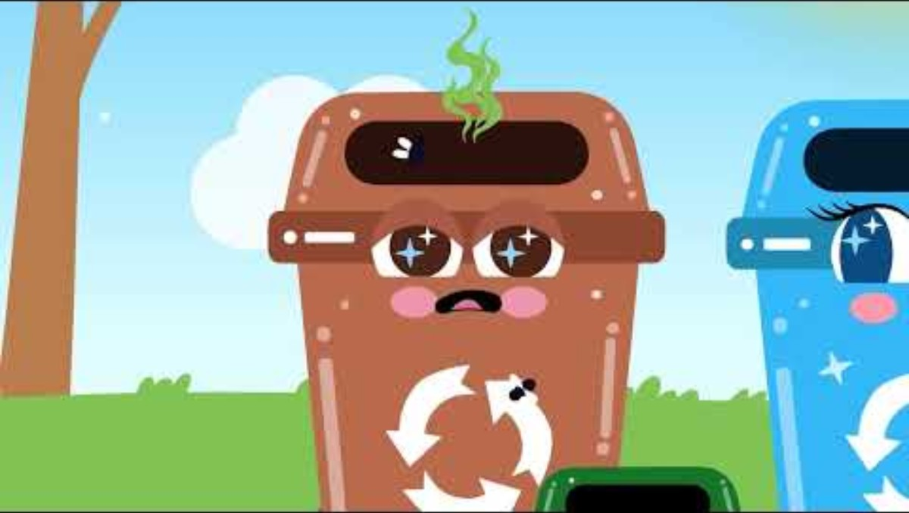

Slide 8
Recycling involves processing used materials to make new products, reducing the need for raw materials, saving energy, and lessening pollution.
There are many benefits of recycling our waste. For instance:
Conservation of natural resources.
Reduction in greenhouse gas emissions.
Decrease in landfill use.
Creation of new products and job opportunities.

Slide 9
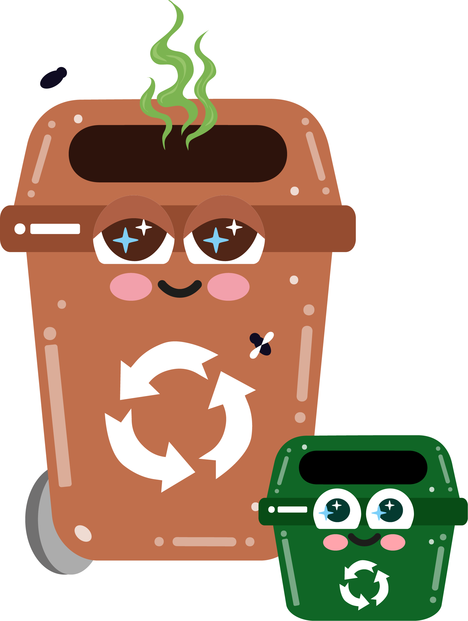

Waste categories
Compost
& food
Recyclable
waste
General
waste
Each of the bins we have at home has its own job to do to make recycling easier, it’s up to us to remember each of their purposes.

Slide 10
Compostable materials
Food scraps, garden waste,
biodegradable items.
Recyclable materials
Paper, cardboard, glass, plastic bottles, metals, etc.
Non-recyclable materials
Items that can't be recycled or composted (e.g. broken glass, hard plastics) etc.).
Some waste items such as batteries, vapes or mobile phones need to be taken to drop off points to be recycled safely.

Slide 11

What is waste contamination?
Let’s discuss…

Slide 12

Here is a recycling bin, filled with mixed recyclables and non-recyclables…
This bin has been contaminated with food waste and non-recyclable materials.
By adding non-recyclable items and waste containing food or chemical residue, you run the risk of contaminating the full bin which means all the items will no longer be recyclable or will have to go through extra processes to resolve it.
It is important to give your waste a whoosh and check the recycling logo / read the small print on waste that is made using different materials when deciding if it can all go in the blue bin.

Slide 13
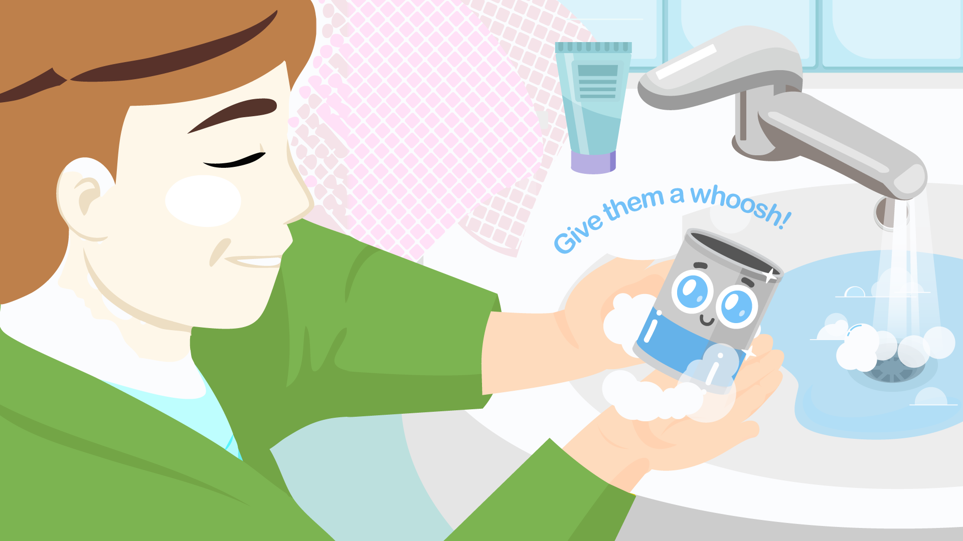
To avoid contamination…
make sure you rinse out any food waste or chemicals from things such as tins, cans or bottles that contained cleaning products for example.
You don’t need to thoroughly clean the items or put them in a dishwasher, just a whoosh will do!
Remember: We don’t want to use more water than needed as this will have an impact on the environment too!

Slide 14
In front of you, there are some contaminated items.
Although some of these items are okay to recycle, contamination occurs when these items are not cleaned or separated properly, making it harder to recycle or not possible at all.
Click for activity…

Slide 15
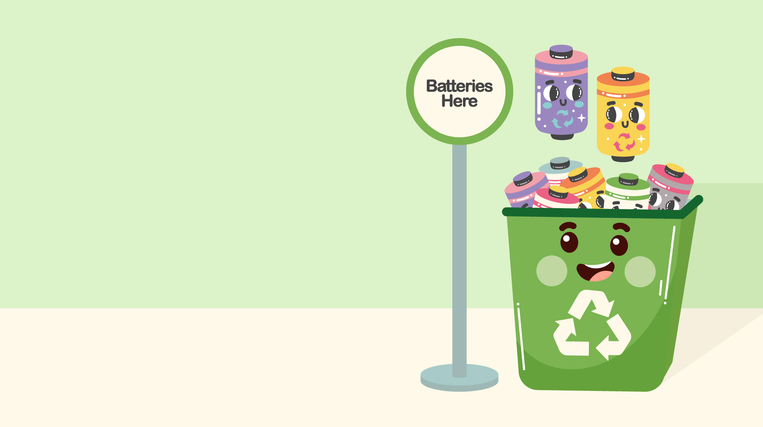
Some waste items need to go to special recycling facilities.
Things like crisp packets and batteries can be taken to your local supermarket or recycling centre ('the tip') where there are recycling bins specifically for these items.
Check the small print on your waste or visit the Hull City Council website if you’re not sure.
Click for activity…

Slide 16
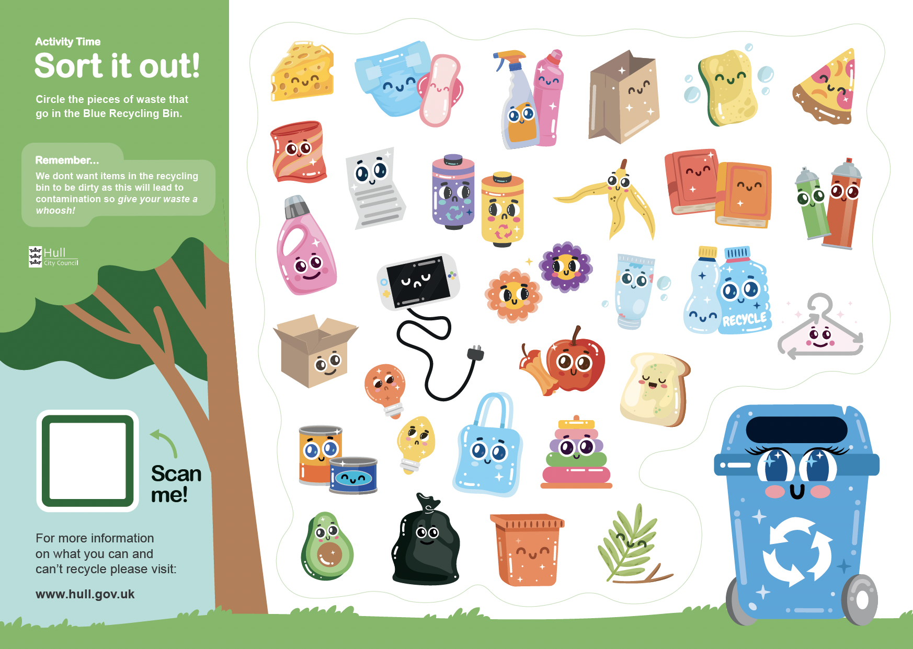
Sort it out!
Activity
In groups, separate the items you have in front of you into two different groups – recyclable and non-recyclable.
The group who can put
the items in the correct bins the quickest, wins!
Remember: Read the fine print -check the recycling logos and if they’re dirty, give it a whoosh!
*alternative worksheet activity if no waste items are available.

Slide 17

How did you find that?
Where did you put the food waste you removed?
Did you wash out containers to avoid contamination before recycling them?
Where have you put non-recyclable items?
Let’s go round each group…

Slide 18
Activity time / Homework
Recycled city
Using the waste materials we separated earlier, create your favourite landmark from the city.
Be prepared to share the pieces you have created with the class and talk about what recyclable items you have used.
Examples:
The Deep, Hull Minster, Humber Bridge, MKM stadium…
External worksheet available – can be done as homework

Slide 19
Recycling
processes
Can anyone list any of the steps an item may take on its journey to being recycled?
Click for answers and discussion…

Slide 20
Collection: Materials are collected from homes, schools, and businesses.
Sorting: Materials are sorted by type (plastic, paper, metal, etc.).
Processing: Recyclable materials are cleaned, broken down, and turned into raw materials.
4. Manufacturing: These raw materials are used to create new products.
5. Buying recycled products: Finally, buying products made from recycled materials helps close the loop.
Can you think of any items you may own that have been through the recycling process?

Slide 21

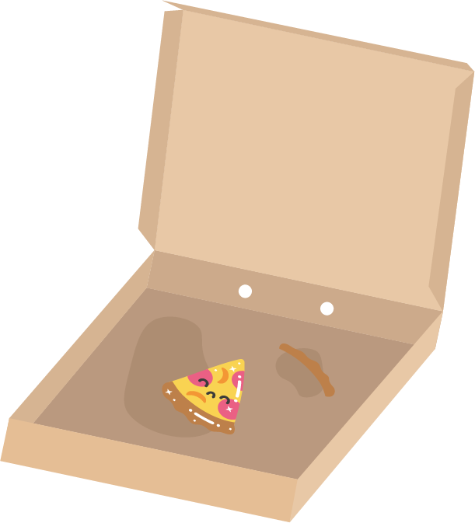
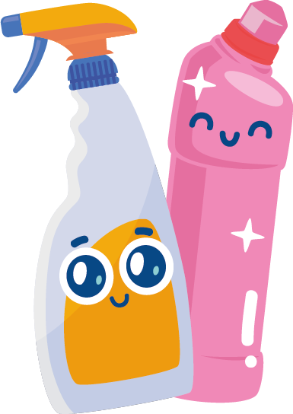
The recycling process doesn’t always run smoothly, and some issues can arise
Contamination
(e.g., food residue or mixed materials) will prevent an item from being recycled.
Complexity of sorting and processing certain materials (e.g., multi-layer packaging). Some parts of an item can be recycled, others maybe can’t.
Limited recycling infrastructure.

Slide 22
Hands up!
As a class, think of ways we could improve recycling in school or at home.
Suggestions could include:
Educating others on recycling.
Setting up more accessible recycling bins.
Reducing single-use plastics.
Supporting products made from recycled materials.

Slide 23
Let’s recap:
Sorting waste is important so that it can easily be recycled.
There are ways to prevent contamination, such as cleaning items that have food waste on them and checking recycling labels.
There are many steps involved in the recycling process.
There are ways we can all come together to improve our recycling and reduce waste.

Slide 24
What’s one thing you learned today about recycling and sorting waste?
Exit Ticket:
Be ready to share your answer when you leave the classroom!

