Slide 1
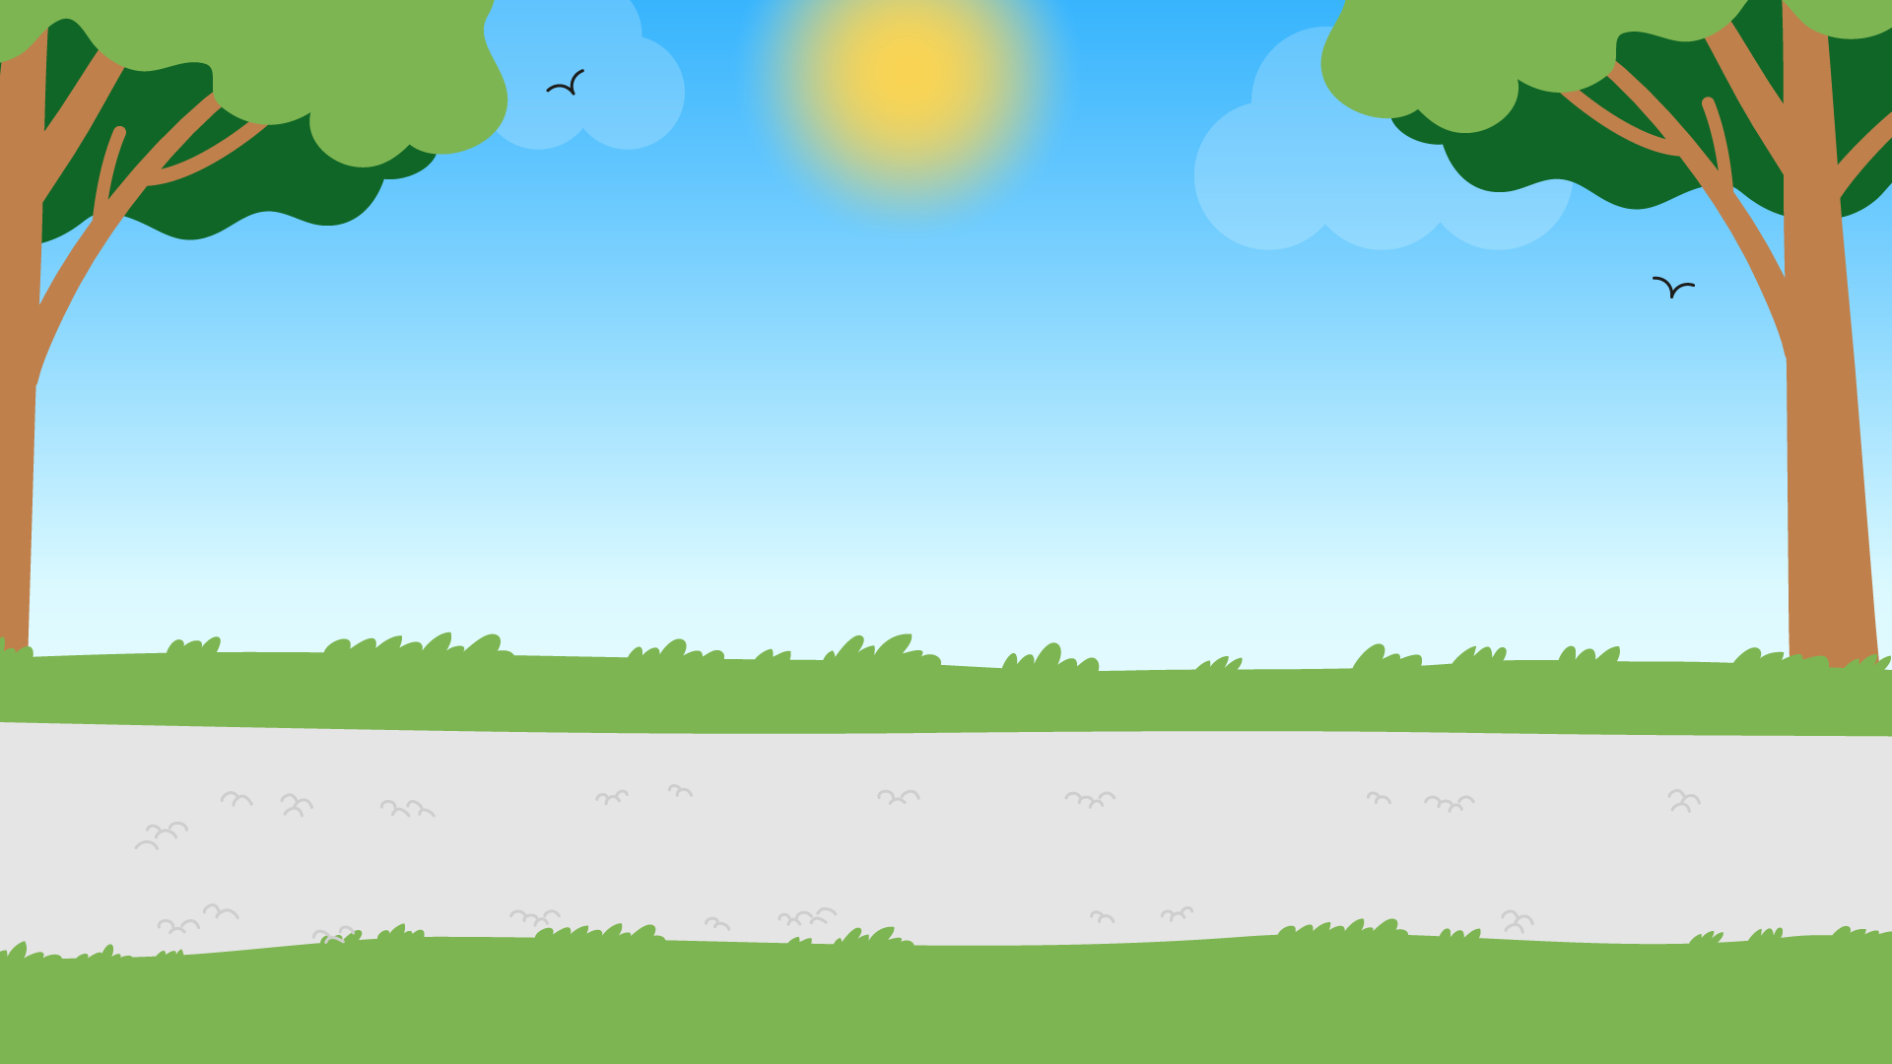
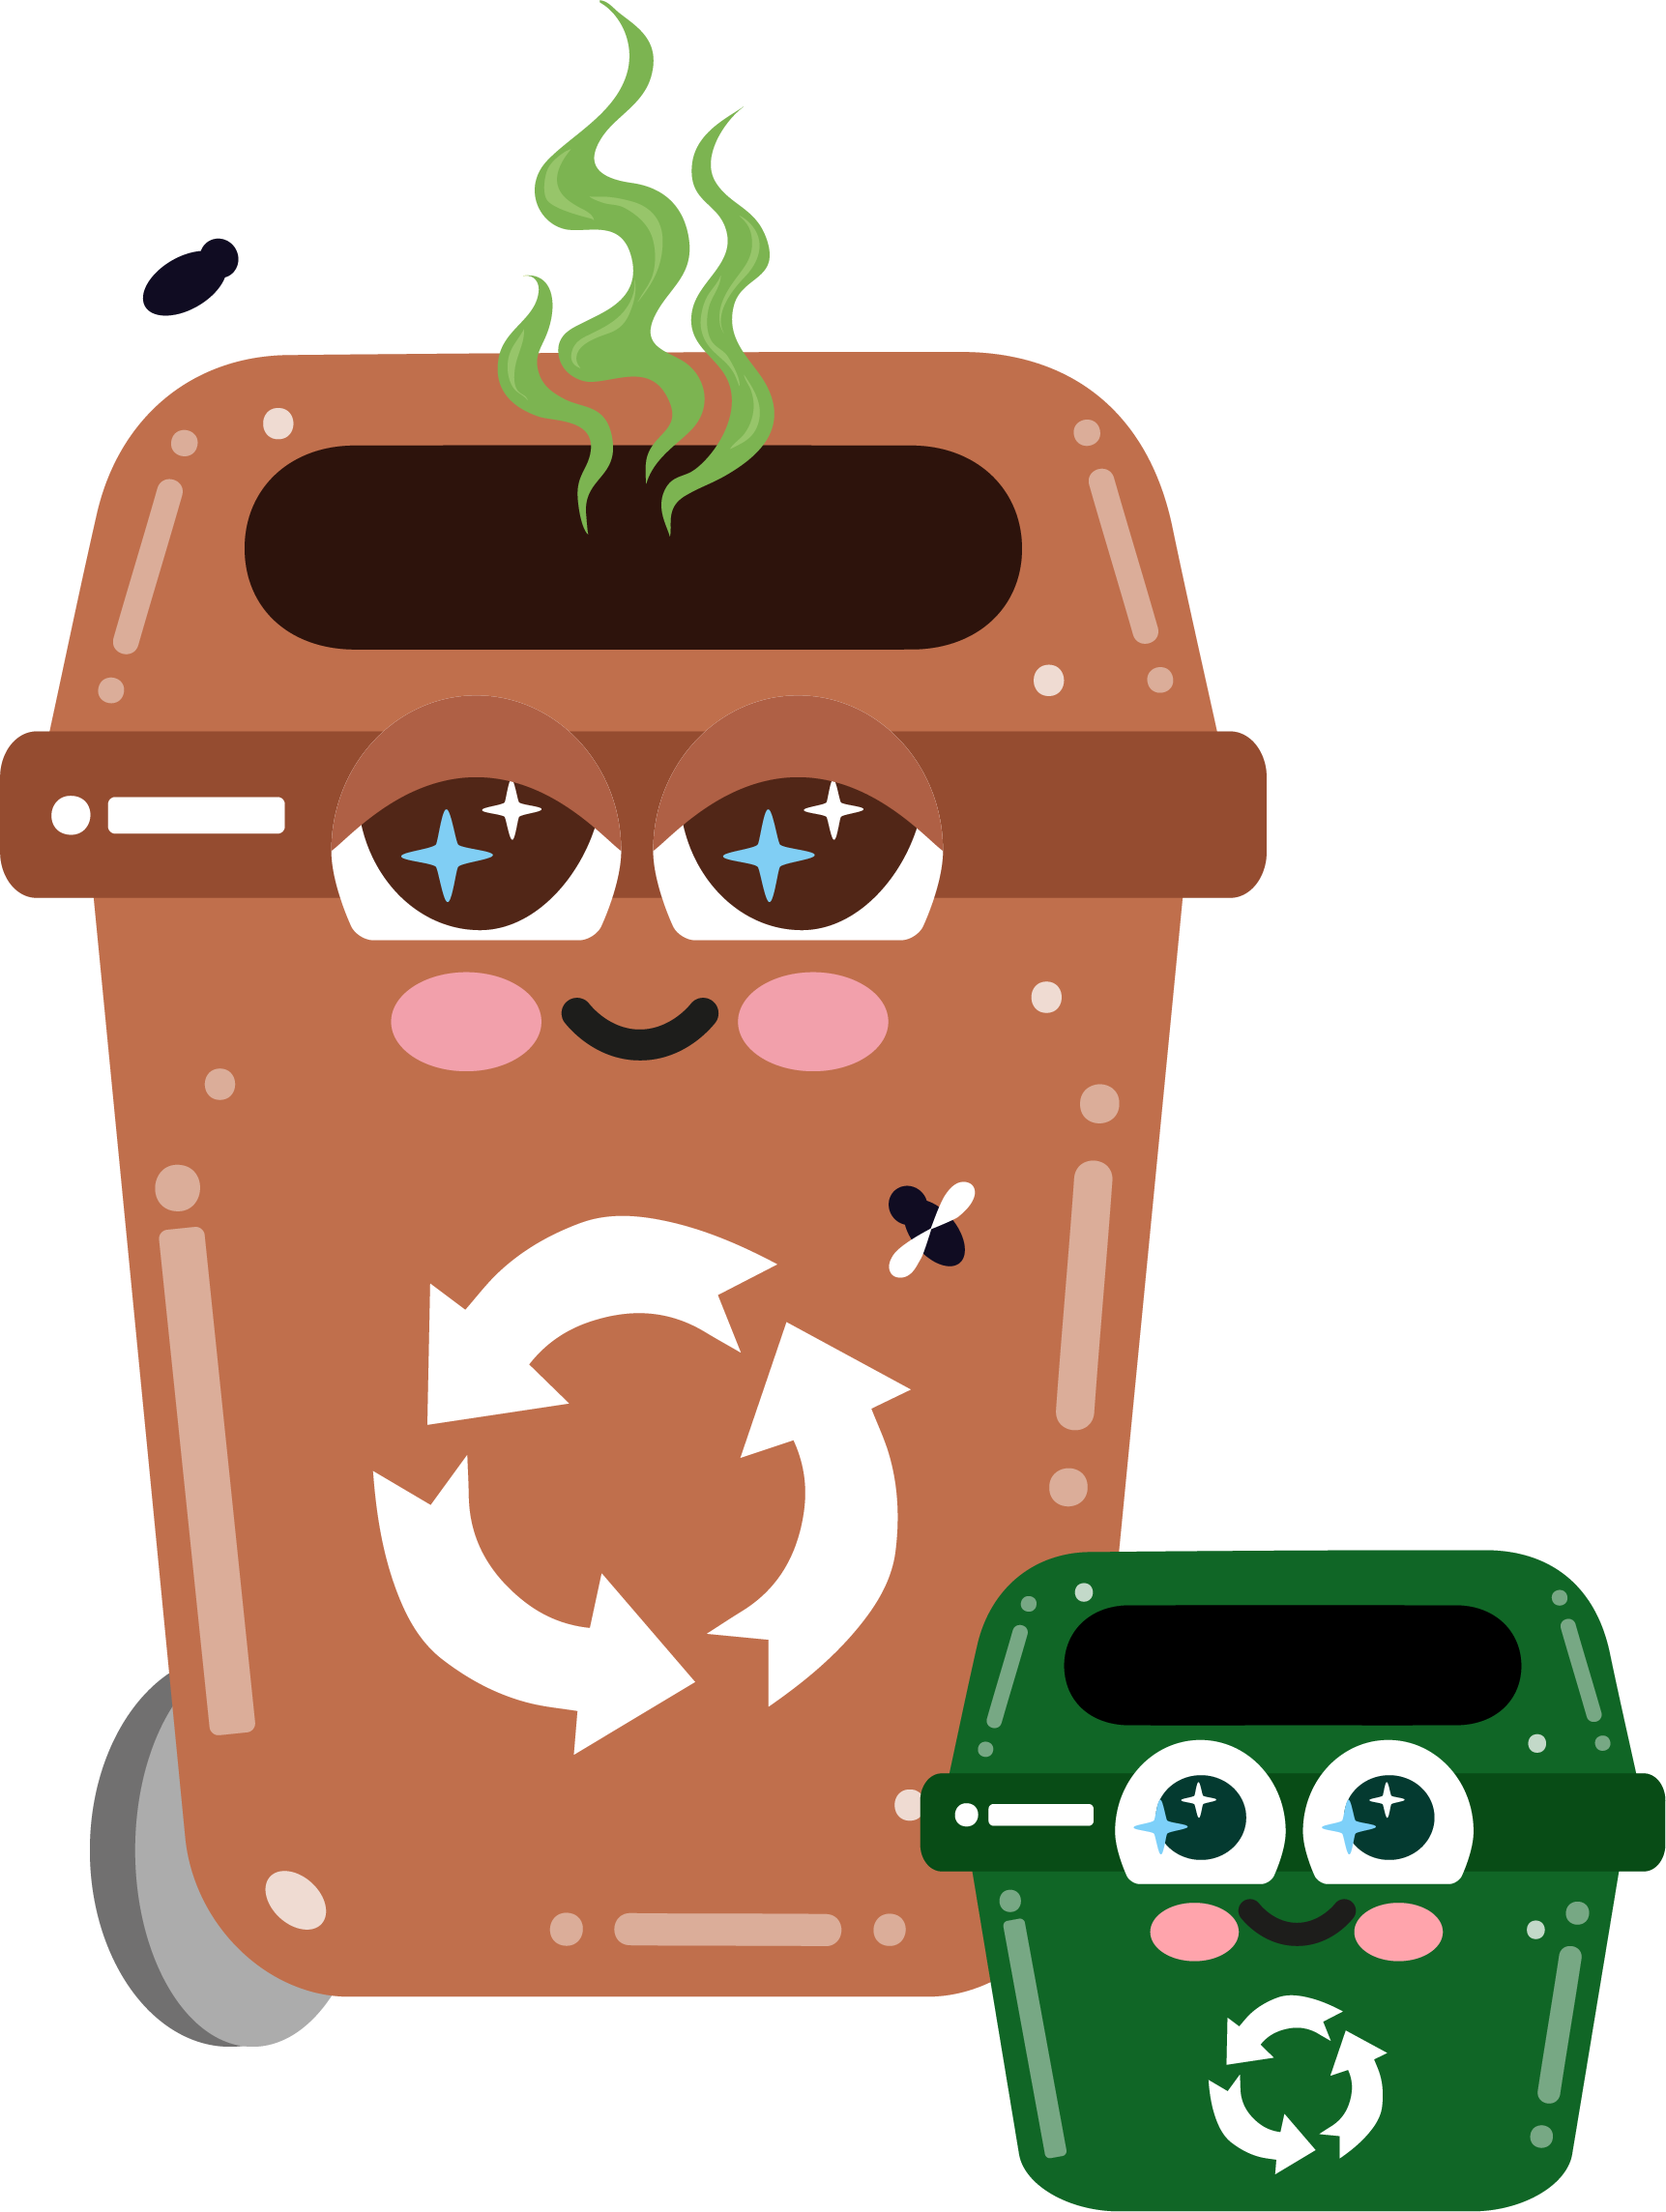



Part 1
Introduction to Waste
Recommended for: Key Stage 3 - 4

Slide 2

Learning
Objectives:
By the end of this lesson, you will:
Understand what waste is and its environmental impact.
Learn about the different bins you have at home and the types of waste that go into each.
Learn how waste is managed (e.g. recycling, composting, incineration, landfill).
Recognise the importance of reducing, reusing, and recycling to improve waste management systems and protect the environment.
Explore strategies to minimise waste at home, school, and in everyday life.

Slide 3
An introduction to waste
?
?
What happens when we
throw something away?
?
?
  • Where does it go?
  • Does it just disappear?
  • Is there a process and
  how does it affect the environment?
Click for discussion…

Slide 4

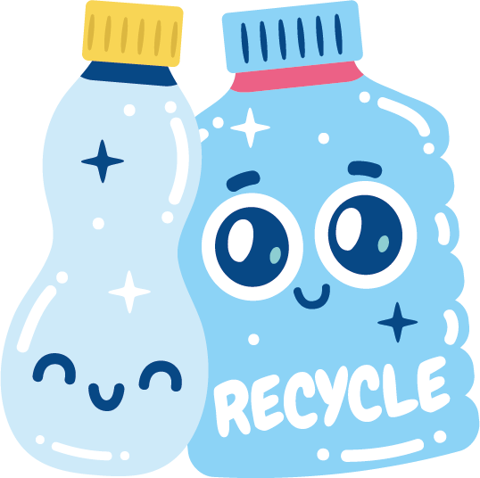
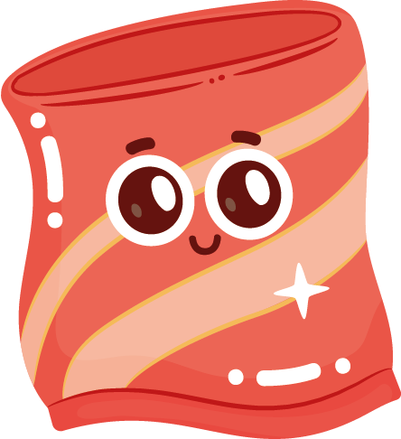



What is waste?
Waste is any material, substance, or product that is no longer wanted, needed, or useful to you.
Can you think of any examples?
• leftover food and packaging
• old toys and clothes
• flowers and grass cuttings

Slide 5


When we use resources like food, paper, or plastic, sometimes we end up with things that we can’t use anymore.
These things are called waste.
It's important to reduce waste by not throwing away things that we can use again and to recycle whenever we can!

Slide 6

Activity
On your whiteboard, work together as a class to list examples of different waste categories.
E.g. Banana peels and stale bread is Food Waste.

Slide 7



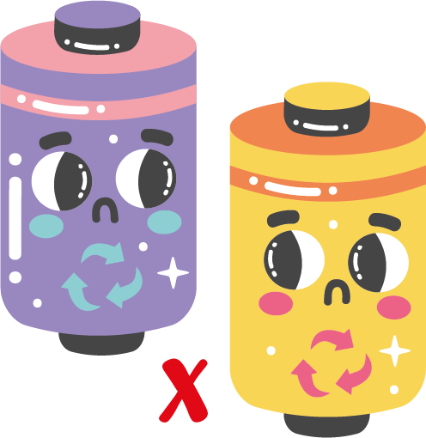
1. Household waste: This is waste that comes from our homes, like food scraps, packaging, or broken items.
2. Industrial waste: This comes from factories or industries, such as waste from making clothes, cars, or electronics.
3. E-waste: This includes old, broken, or unwanted electronics, like phones, computers, and TVs.
4. Food waste: This is when food is thrown away because it’s not eaten or it has gone bad.
5. Hazardous waste: This includes waste that can harm the environment or human health, like chemicals or batteries.
Types of
Waste

Slide 8
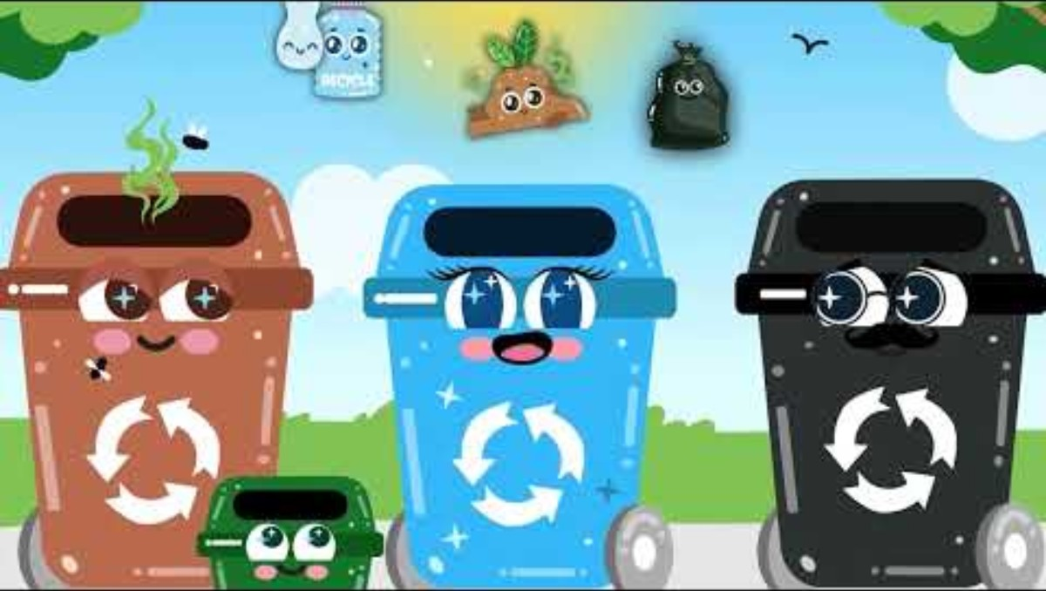

Slide 9

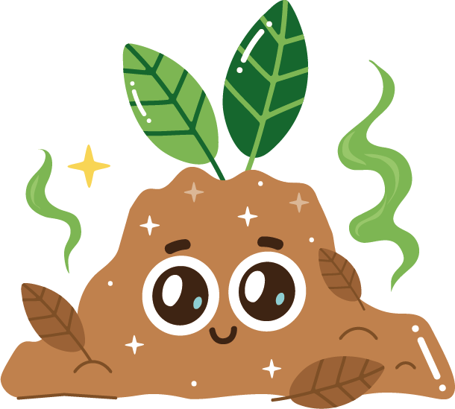

How do you think waste
affects animals and plants?
What about the air, water, and soil?
Click for answers…

Slide 10
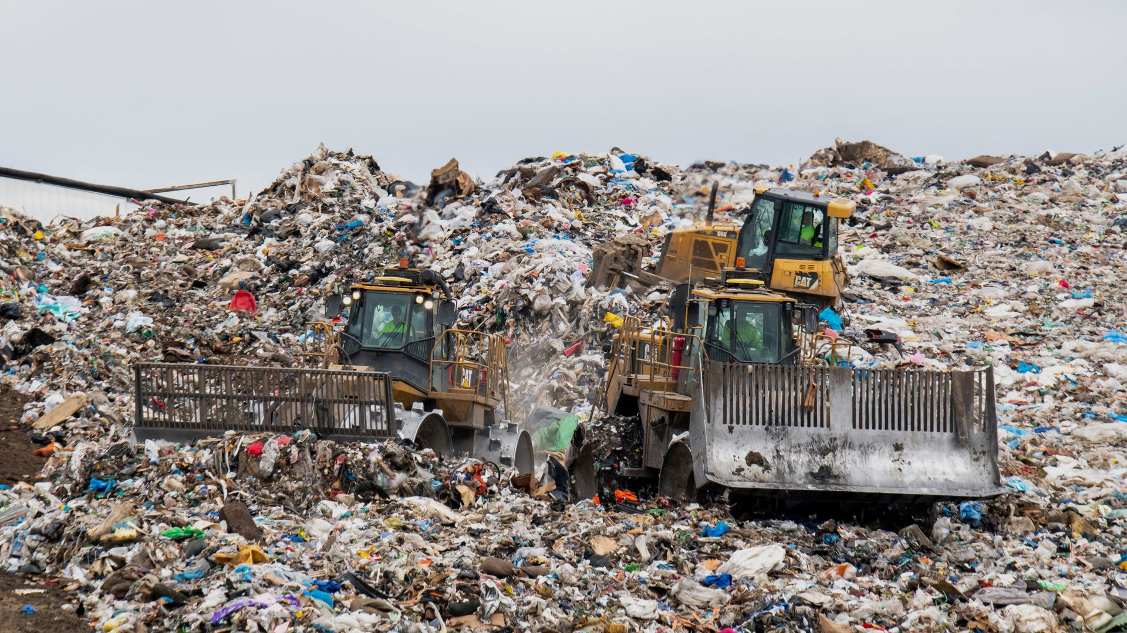
Landfill
Only 0.02% of waste from Hull goes to a landfill. However, when waste is dumped in landfills, it can take years to break down.
Some materials, like plastic, can take hundreds of years to decompose.
Landfills can also release harmful gases into the air and water, affecting wildlife and plants.

Slide 11
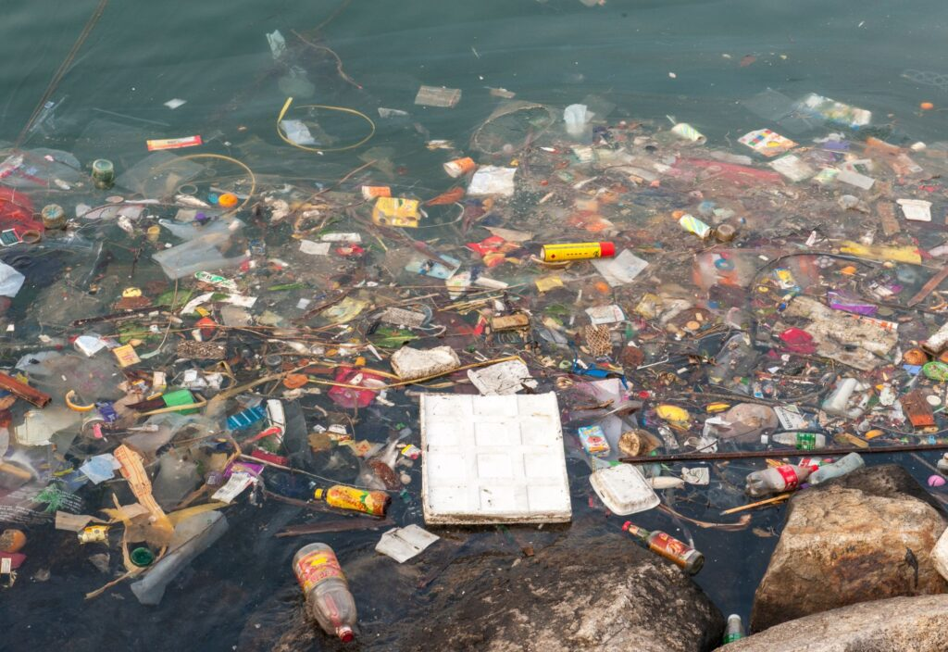
Pollution
If waste is left on the streets or thrown into rivers and oceans, it pollutes the land and water, again harming animals and plants.
This can lead to serious problems like poisoning animals or making water unsafe to drink.

Slide 12
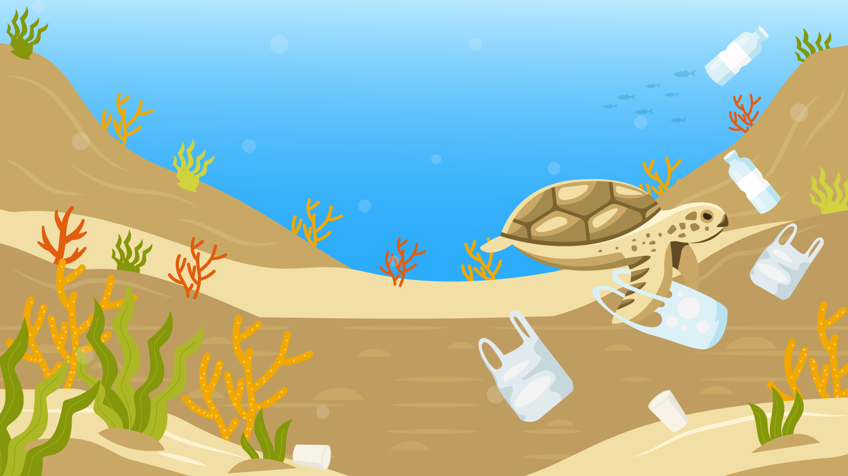
Waste, such as plastic, takes a long time (years!) to break down and can hurt animals, the environment, and even ourselves.
For example:
Animals might get trapped in or eat plastic.
Waste that isn’t recycled releases harmful gases into the air, like carbon dioxide, which contributes to climate change and can lead to extreme weather, rising sea levels, and other problems that affect our health and safety.

Slide 13
Let’s recap…
There are 3 different types of bins.
These are recyclable, compostable and non-recyclable.

Slide 14
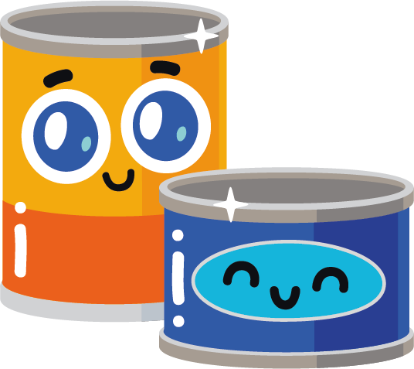
Recycling
Blue bin
Items like paper, plastic bottles, cans, and glass can all be made into new products.

Slide 15

Brown bin &
green caddy
Compost
Organic waste like food scraps and garden waste break down into soil.

Slide 16

Black bin
General
Waste
Things that can't be recycled or composted like dirty tissues, food wrappers or broken items.

Slide 17

Did you know?
If waste that can’t be recycled is mixed with recyclable waste, this is called contamination.
This can cause several problems in the recycling process and leads to wasted effort, wasted energy, and wasted resources.
Can you think of any examples of contamination?
Click for answers…

Slide 18
Examples of contamination:
Food waste in cardboard or plastic containers
Plastic bags containing waste in a recycling bin (make sure recyclable waste is loose)
Unwashed containers like bottles with leftover liquid or food in them
Non-recyclable items like batteries, or electronic waste mixed in with recycling

Slide 19

How to avoid contamination
?
Clean recyclables before putting them in the recycling bin, give them a whoosh! (e.g. rinse out plastic bottles or jars).
Check Hull recycling rules because some areas have different guidelines for what can and can’t be recycled.
Don’t put recyclables in plastic bags ensure your recyclable waste is loose.
Keep non-recyclable waste like batteries, mobile phones, or broken items out of your recycling bin and take to designated household waste recycling centres.
?

Slide 20
Activity time
Sort it out!
Looking at the bins in front of you, get into small groups and put the waste you have been given into the correct bins.
Bonus points:
What else do you need to check when recycling?
* Use the picture and information handouts to help you!

Slide 21
Discuss…
Let’s go through some of
the items as examples…
Can all plastics be recycled? What about plastics with food residue or chemicals on them?
Why is it important to clean recyclables before placing them in the bin?
What about items that show a recycle label - does this mean all of it can be recycled?

Slide 22

*Provide 3 Rs Handout
Introducing the 3 Rs…
Reduce
Cutting down on the amount of waste generated.
For example, choosing reusable items like water bottles and shopping bags ('bags for life’) instead of single use items.
Reuse
Using items multiple times.
For example, donating clothes or repurposing containers for other uses.
Recycle
Turning waste into new products.
For example, recycling paper, glass, and plastics to create new items e.g. aerosol cans can be recycled into car parts.

Slide 23
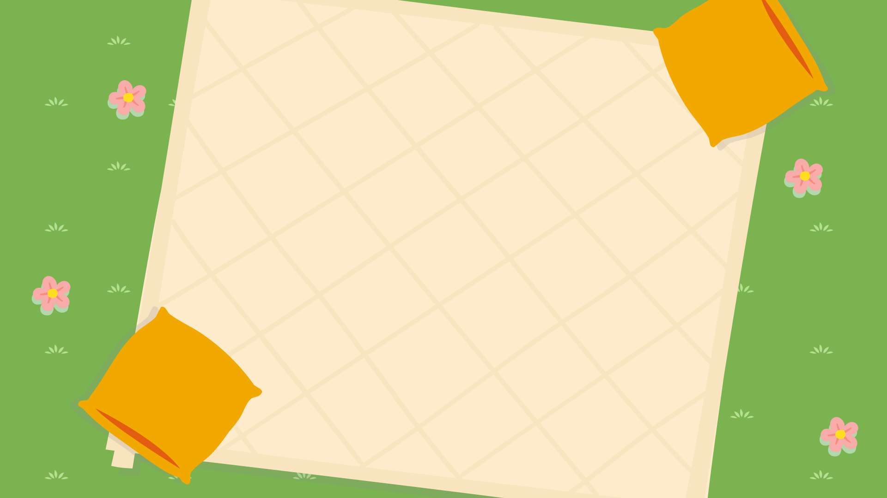



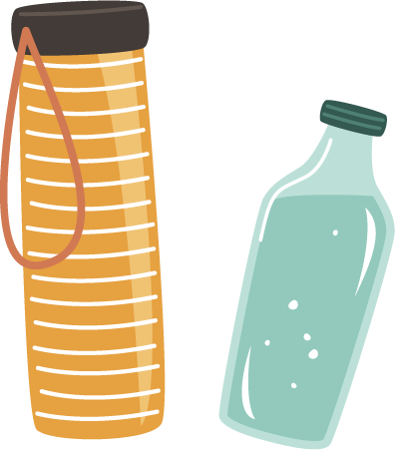
Examples of reusable items
Can you think of any other examples?
Material / reusable bags
Reusable lunch boxes
Reusable
bottles
Bamboo or metal straws

Slide 24
Extra Activity
Can you think of any ways to help minimise waste?
As a class, individually, or in groups, create a poster with ideas on how we can reduce waste in our day-to-day lives. Try to include a list of waste reducing strategies.
Remember to include the 3 Rs!

Slide 25
How did you find that?
Did you mention any of our examples below?
Avoiding single-use plastic items.
Using reusable bags / lunch boxes / water bottles or containers.
Buying products with less packaging.
Reusing glass jars to use as storage containers for other food or as pots for stationery.

Slide 26

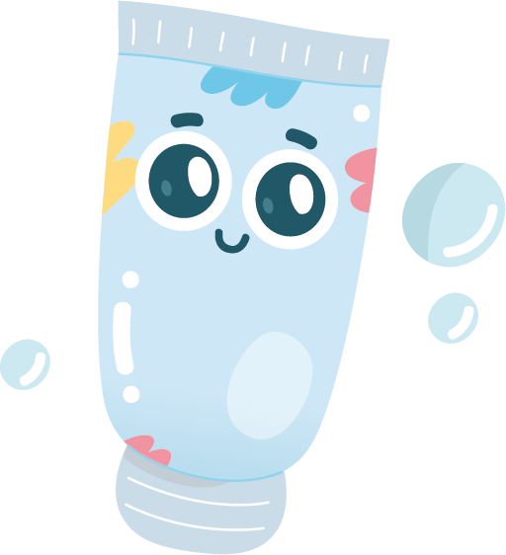
Let’s recap…
Waste is anything we throw away because we no longer need it or it’s broken...

Slide 27
Waste can be sorted
into 3 different bins…
Garden waste & food
Recycling
General Waste

Slide 28
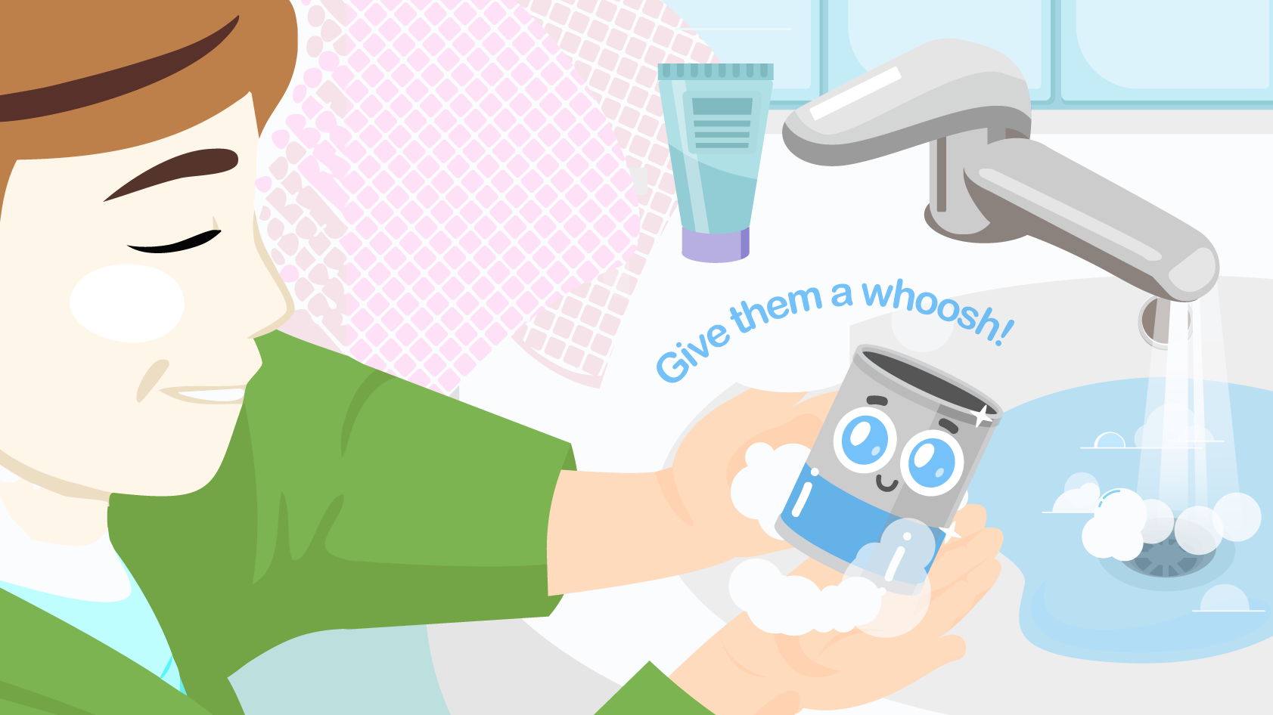
When recycling items…
Items need to be clean before you put them in the blue bin. Please remove food residue from items and check that all parts of the items are recyclable before they go in the blue bin.
Give them a whoosh!
A quick rinse before adding them to your blue bin is all they need! We want to avoid using too much water!

Slide 29
Remember the 3 Rs…
Reduce
Use less. For example, using a reusable water bottle instead of a plastic one.
Reuse
Using things again. For example, turning an old box into a toy or craft project.
Recycle
Making things into new things. For example, recycling paper and plastic.

Slide 30

Continue to think
about ways you can reduce your waste day-to-day by using reusable water bottles, material bags and lunch boxes.
Reusable
lunch boxes
Bamboo or metal straws
Material / reusable bags
Reusable bottles

Slide 31
Any questions on
today’s session?
Exit Ticket:
Share one thing that you will do to reduce waste at home or school.

