Slide 1
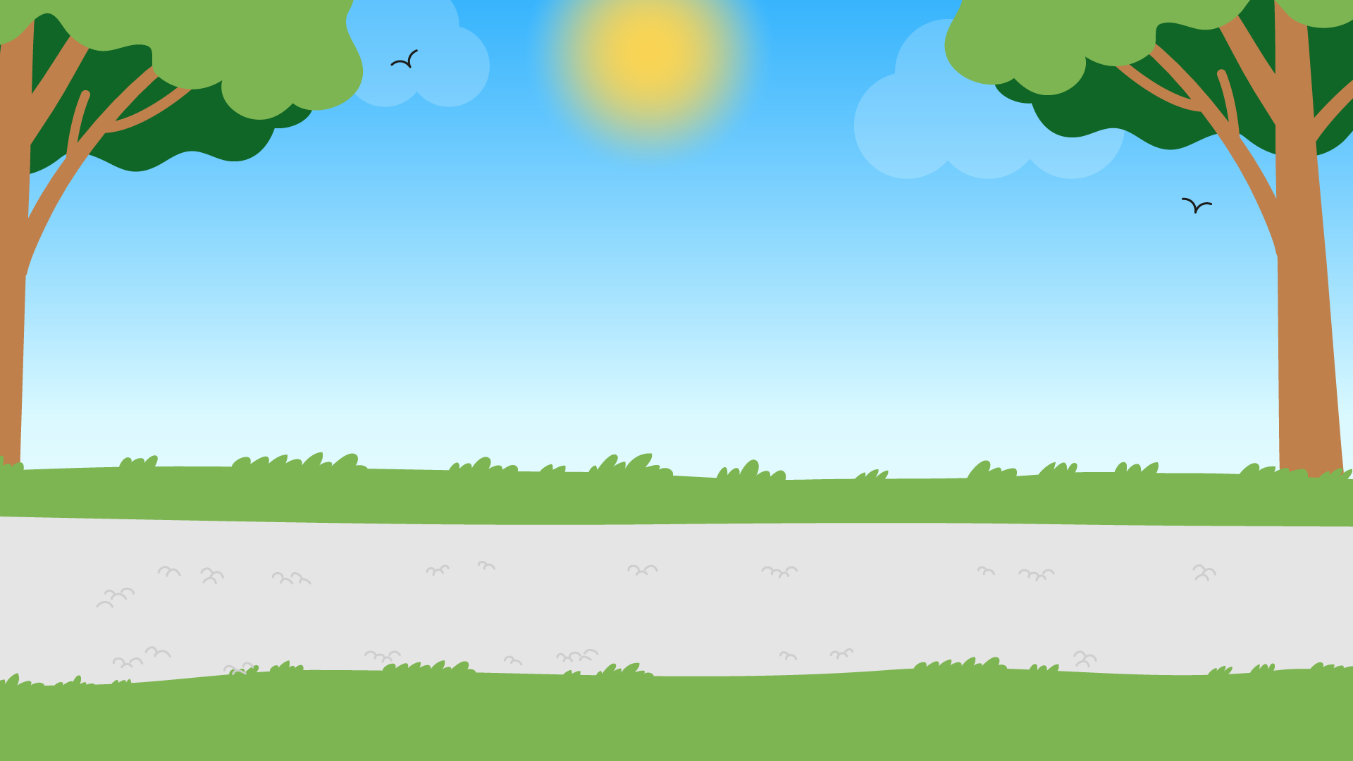
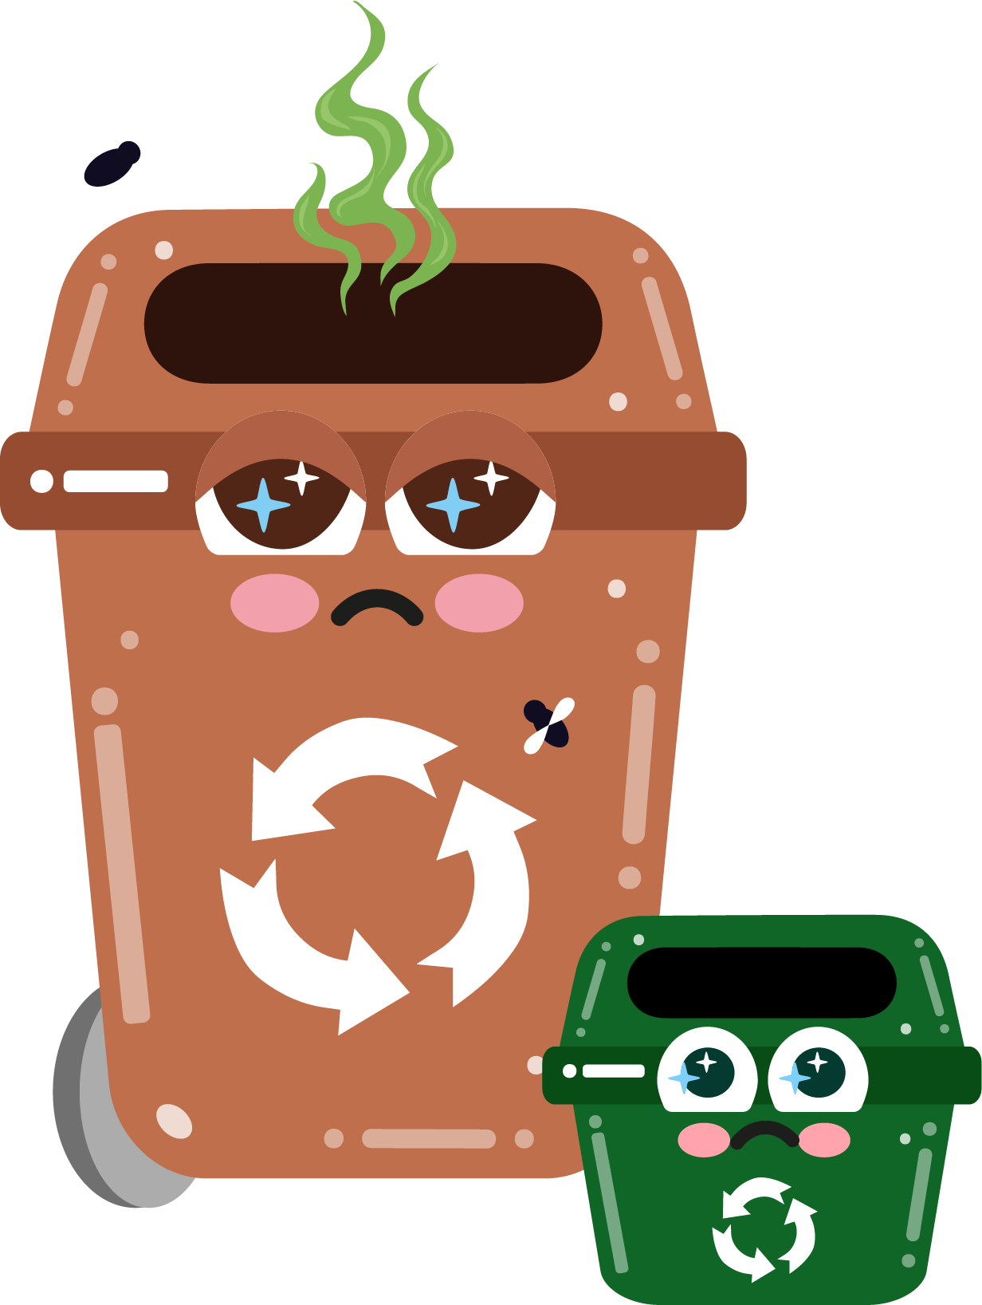




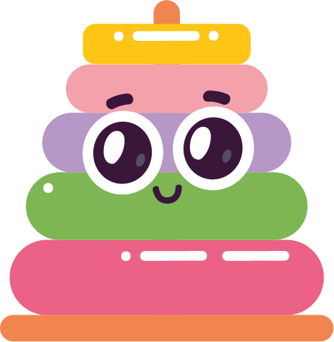



Part 4
Littering & its impact on the environment
Recommended for: Key Stage 1 - 2

Slide 2

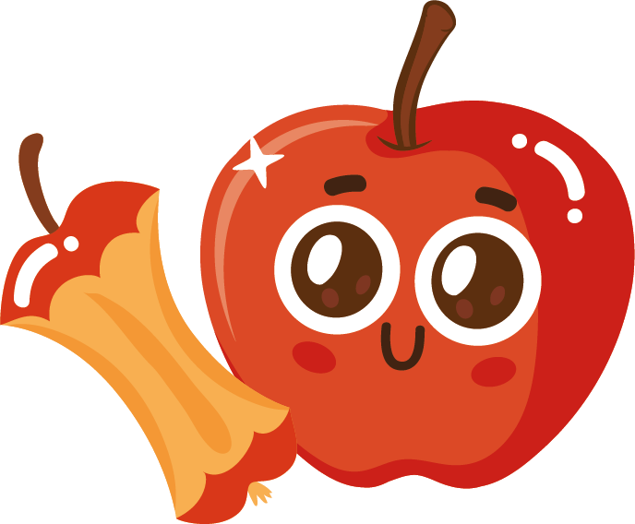
Learning
Objectives:
By the end of this lesson, you will:
Understand what littering is and why it is harmful to the environment.
Learn how litter can harm wildlife and pollute natural habitats.
Recognise the importance of keeping our surroundings clean.
Discuss ways to reduce littering at school, at home, and in our community.

Slide 3
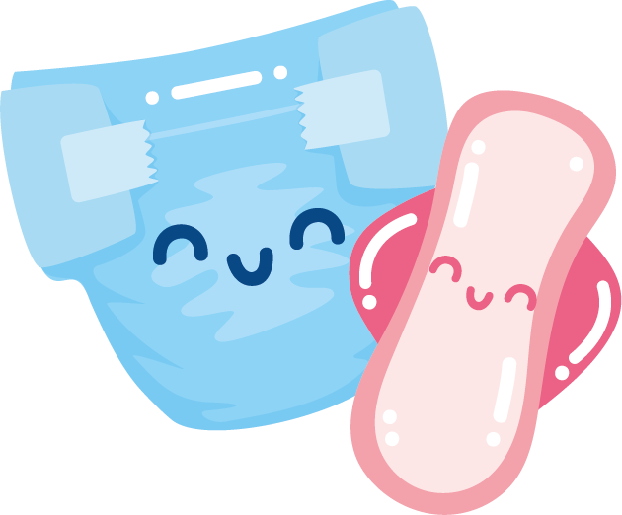
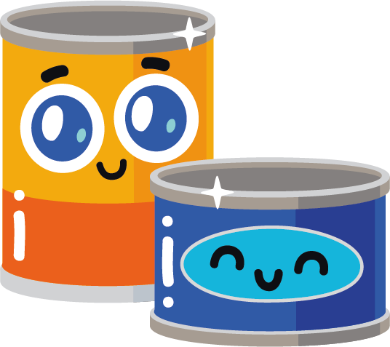
What does
‘littering’ mean?
?
?
What comes to mind when you think about it?
Where might you find litter?
?
?
Click for explanation…

Slide 4
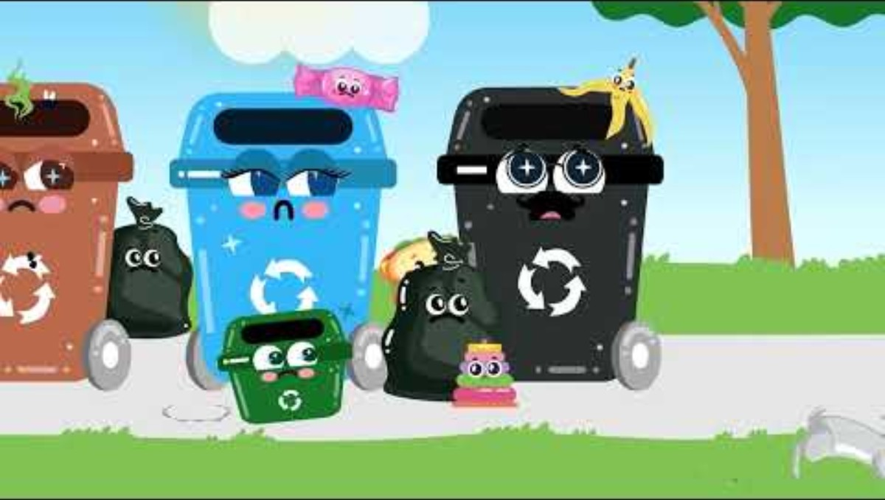

Slide 5
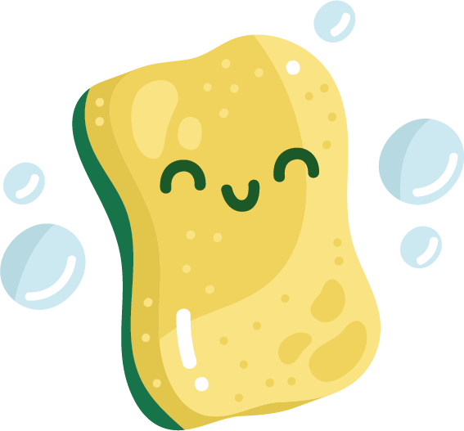
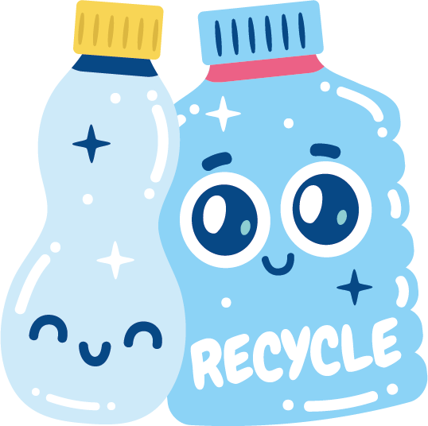

Discussion
After watching that video, how did seeing the littered environment make you feel?
How would you feel if your favourite park or playground looked like that?
What do you think would happen to animals and plants if there is too much litter around?

Slide 6

Can you think of any ways that we could reduce litter?
Click for answers…
Take rubbish home at the end of the day or put it in school bins.
Recycle items wherever possible.
Use reusable containers and water bottles.

Slide 7
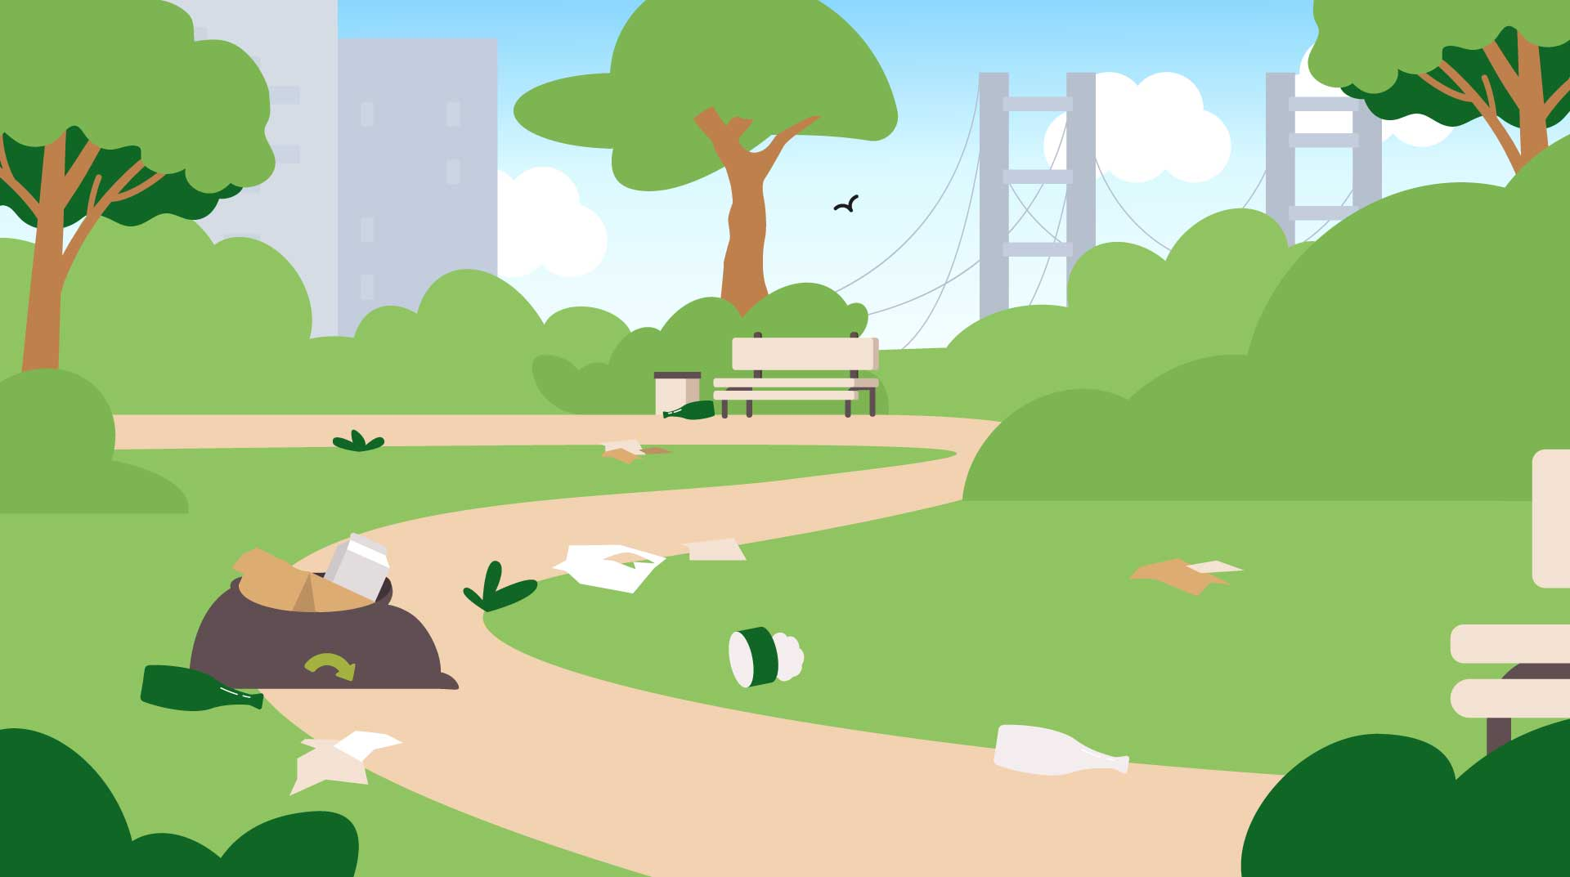
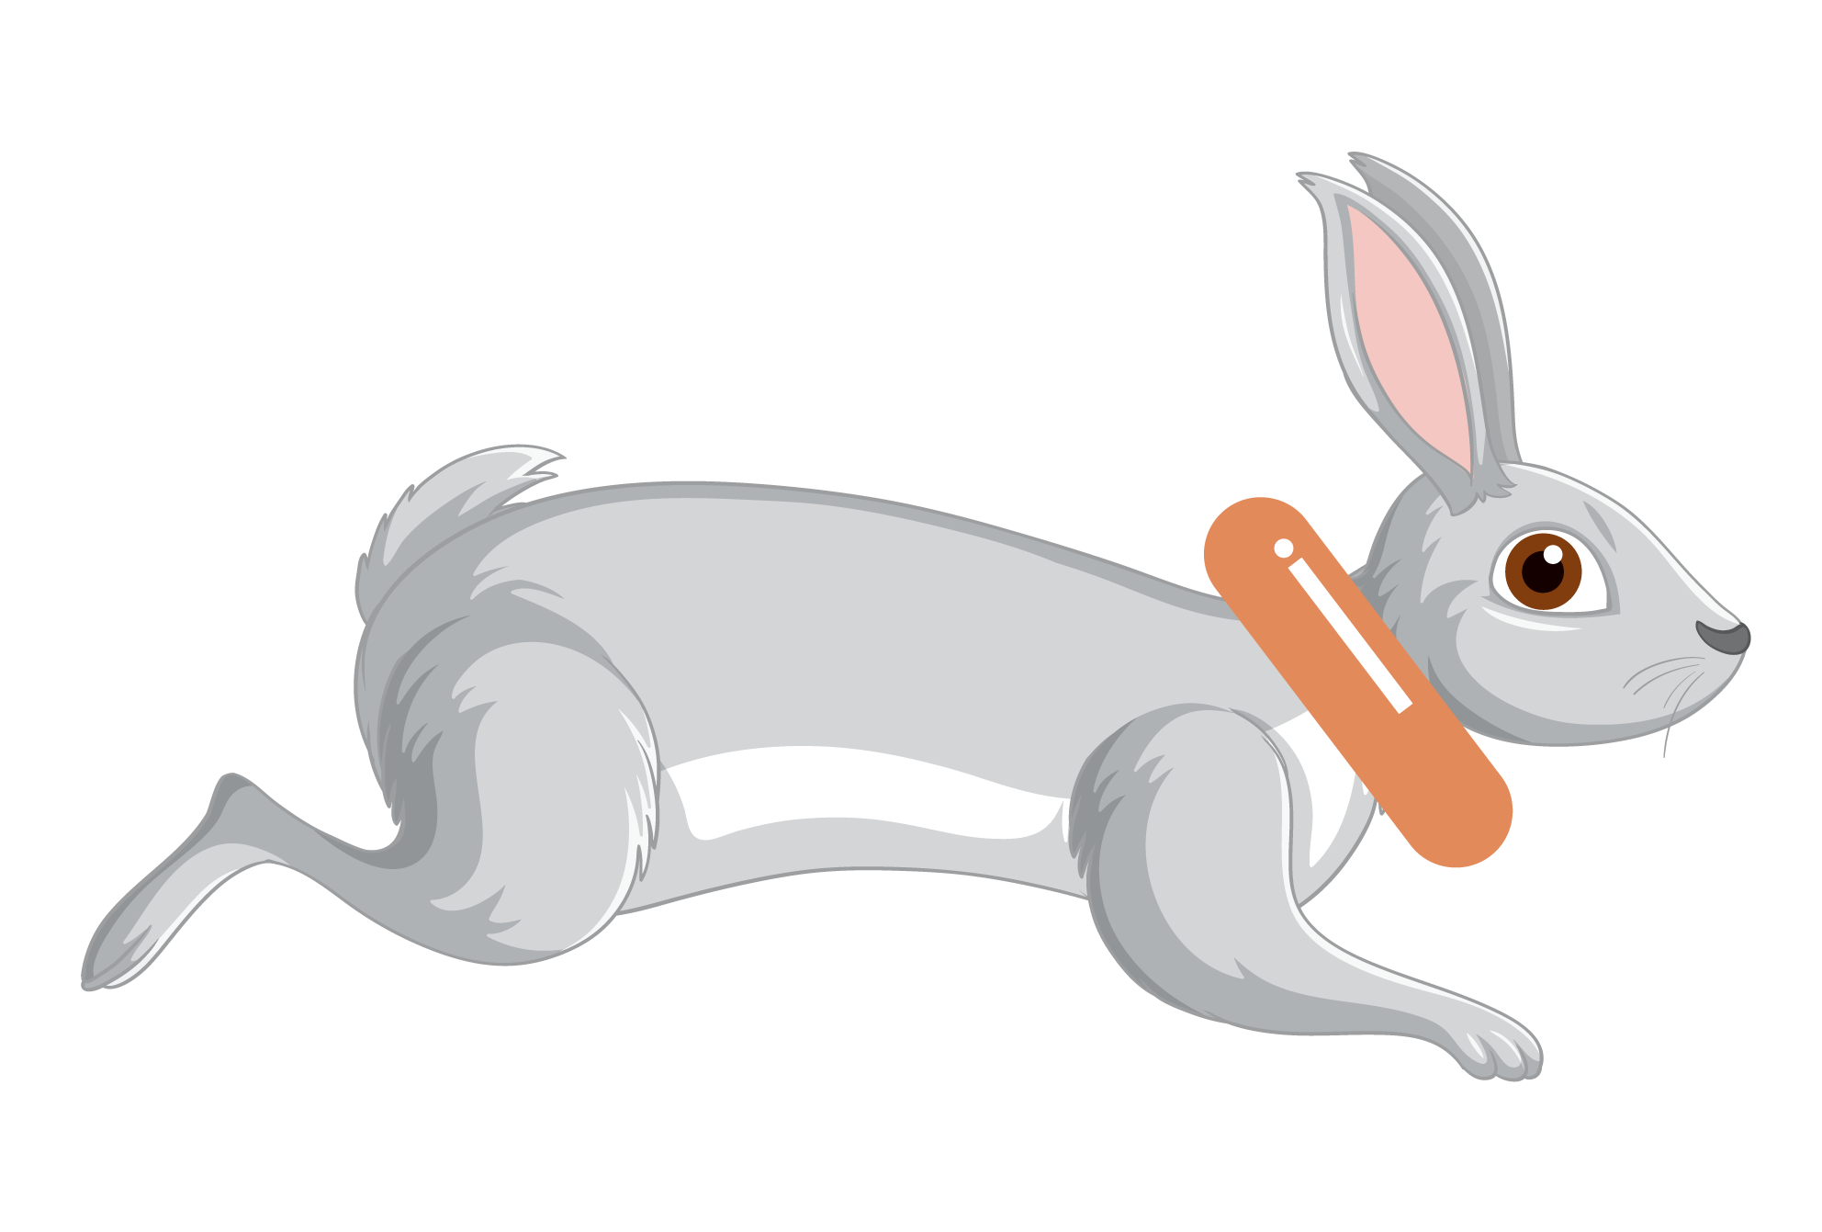
Discussion
Why should we keep our environment clean?
As a group, let’s discuss the importance of keeping places clean and how we can help make the world a nicer and safer place to live in.
Think of animals too!

Slide 8
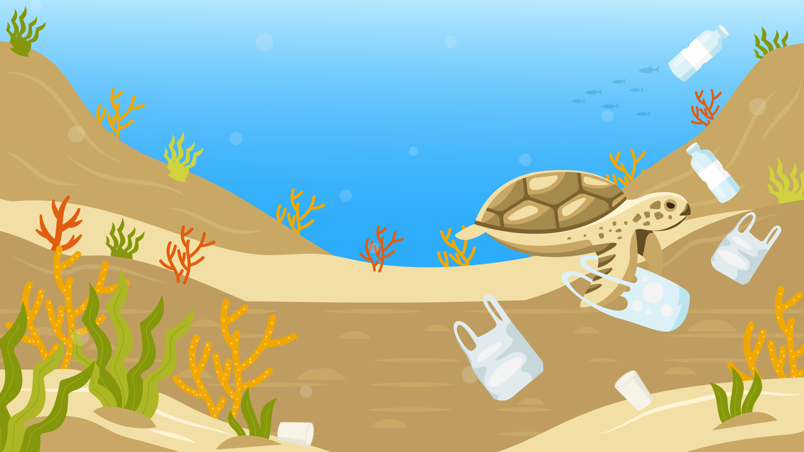
Waste left on our streets can blow away into rivers and end up in the ocean.
Animals in the ocean will think things like plastics are food and eat it.
They can also get stuck in our waste and this can really hurt them.
Using reusable items or recycling correctly can make a big difference.

Slide 9
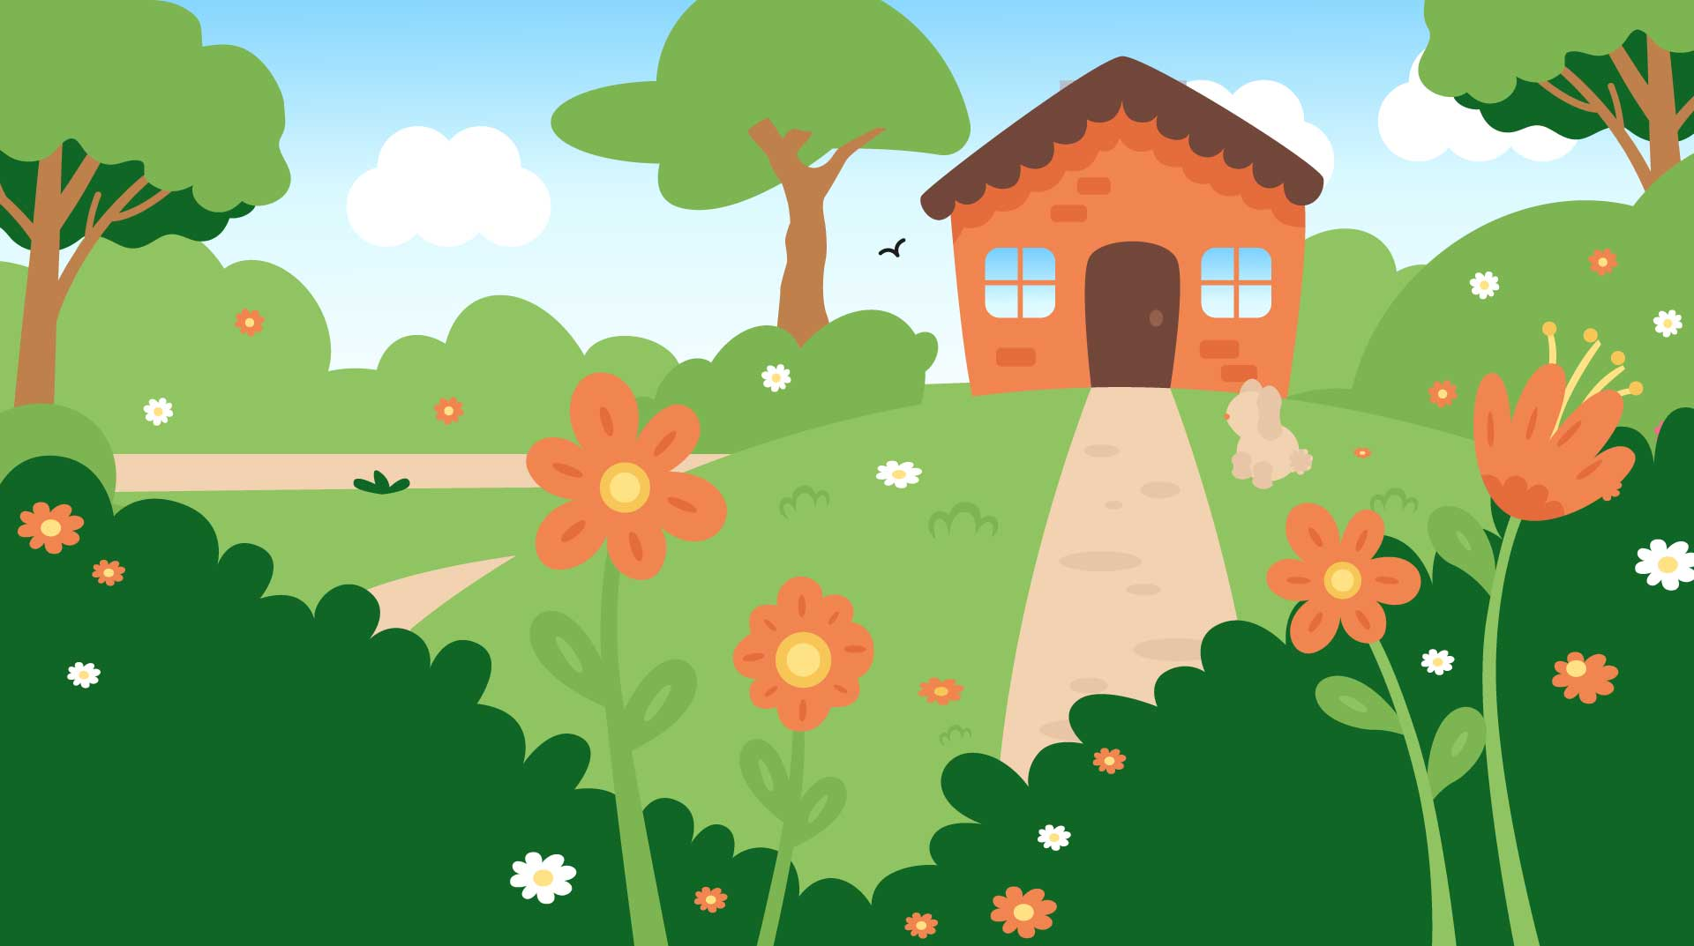
How can we keep our school or home environment clean?
Remember to think about:
Health and animals: A clean environment prevents harm.
Safety: Avoiding dangerous items like broken glass or sharp objects.
Tidiness: A clean place is more enjoyable to play and work in.

Slide 10
Activity Time
Litter Hunt
In pairs or small groups, go outside and look for any litter you can find around the school.
Use the sheet provided to take note of what you find and where you find it.
In the classroom: Sort through the waste you found and separate it into general, recyclable and compostable waste and discard appropriately.

Slide 11
Let’s recap…
Dangers of
littering
Littering can harm wildlife and plants and also pollute the air, water and soil. It can make places look dirty and unhealthy.

Slide 12


How to keep the environment clean
Discard food and garden waste in the Brown Bin and Green Caddy or make your own compost bin
Recycle paper, glass, plastic and metal in the Blue Bin
Put your other rubbish in General Waste Bins

Slide 13
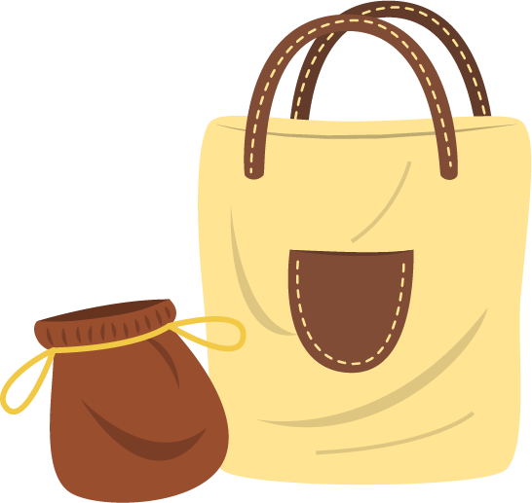
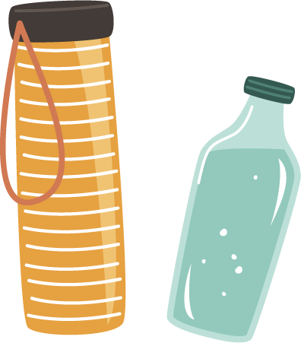

Ways we can reduce littering:
Use reusable materials such as lunch boxes, bags and water bottles.
Pick up any litter you leave lying around or on the floor.
Share knowledge with others and teach ways to care for the environment.

Slide 14

Extra activity
‘Do not Litter’ poster
Using everything you have learned today and the litter you found as examples, create a poster to go up around the school to encourage others to not litter.
Tip: Explain why littering is bad. Include tips on how to reduce littering e.g. use reusable items, take waste home if there are no bins. Share examples of the correct bins to use.

Slide 15
Share one thing you
will do to help keep your environment clean.
Exit Ticket:
Be ready to share your answer when you leave the classroom!

