Slide 1

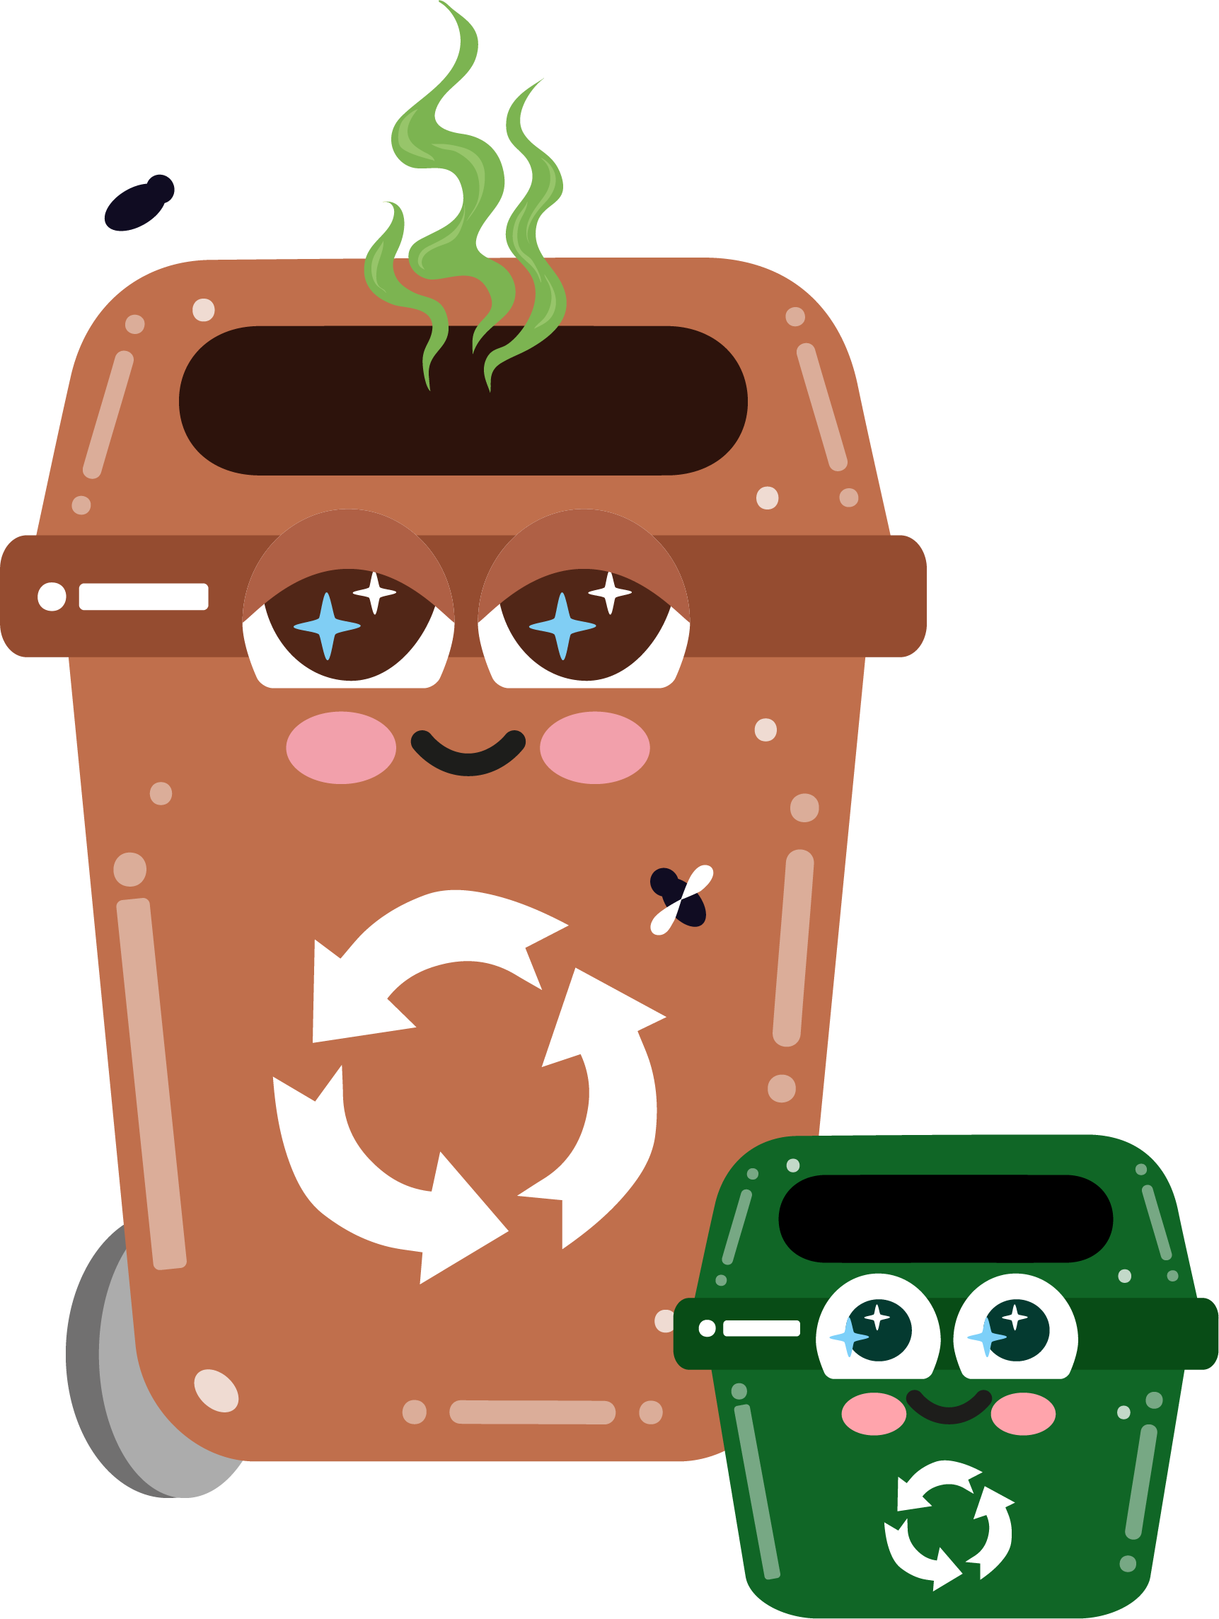


Part 3
Composting and Organic
Waste
Recommended for: Key Stage 1 - 2

Slide 2

Learning
Objectives:
By the end of this lesson, you will:
1. Understand what goes in your green caddy bin and in your brown bin.
2. Understand what composting is and why it’s important for the environment.
3. Know which materials can be composted and which cannot.
4. Understand how composting helps reduce waste and enrich the soil.
5. Understand how you can start composting at home or school.

Slide 3
An introduction to composting
?
?
What do you think happens to food scraps or plant waste if we put them in the black bin?
?
?
  • Where do they go?
?
Click for discussion…

Slide 4
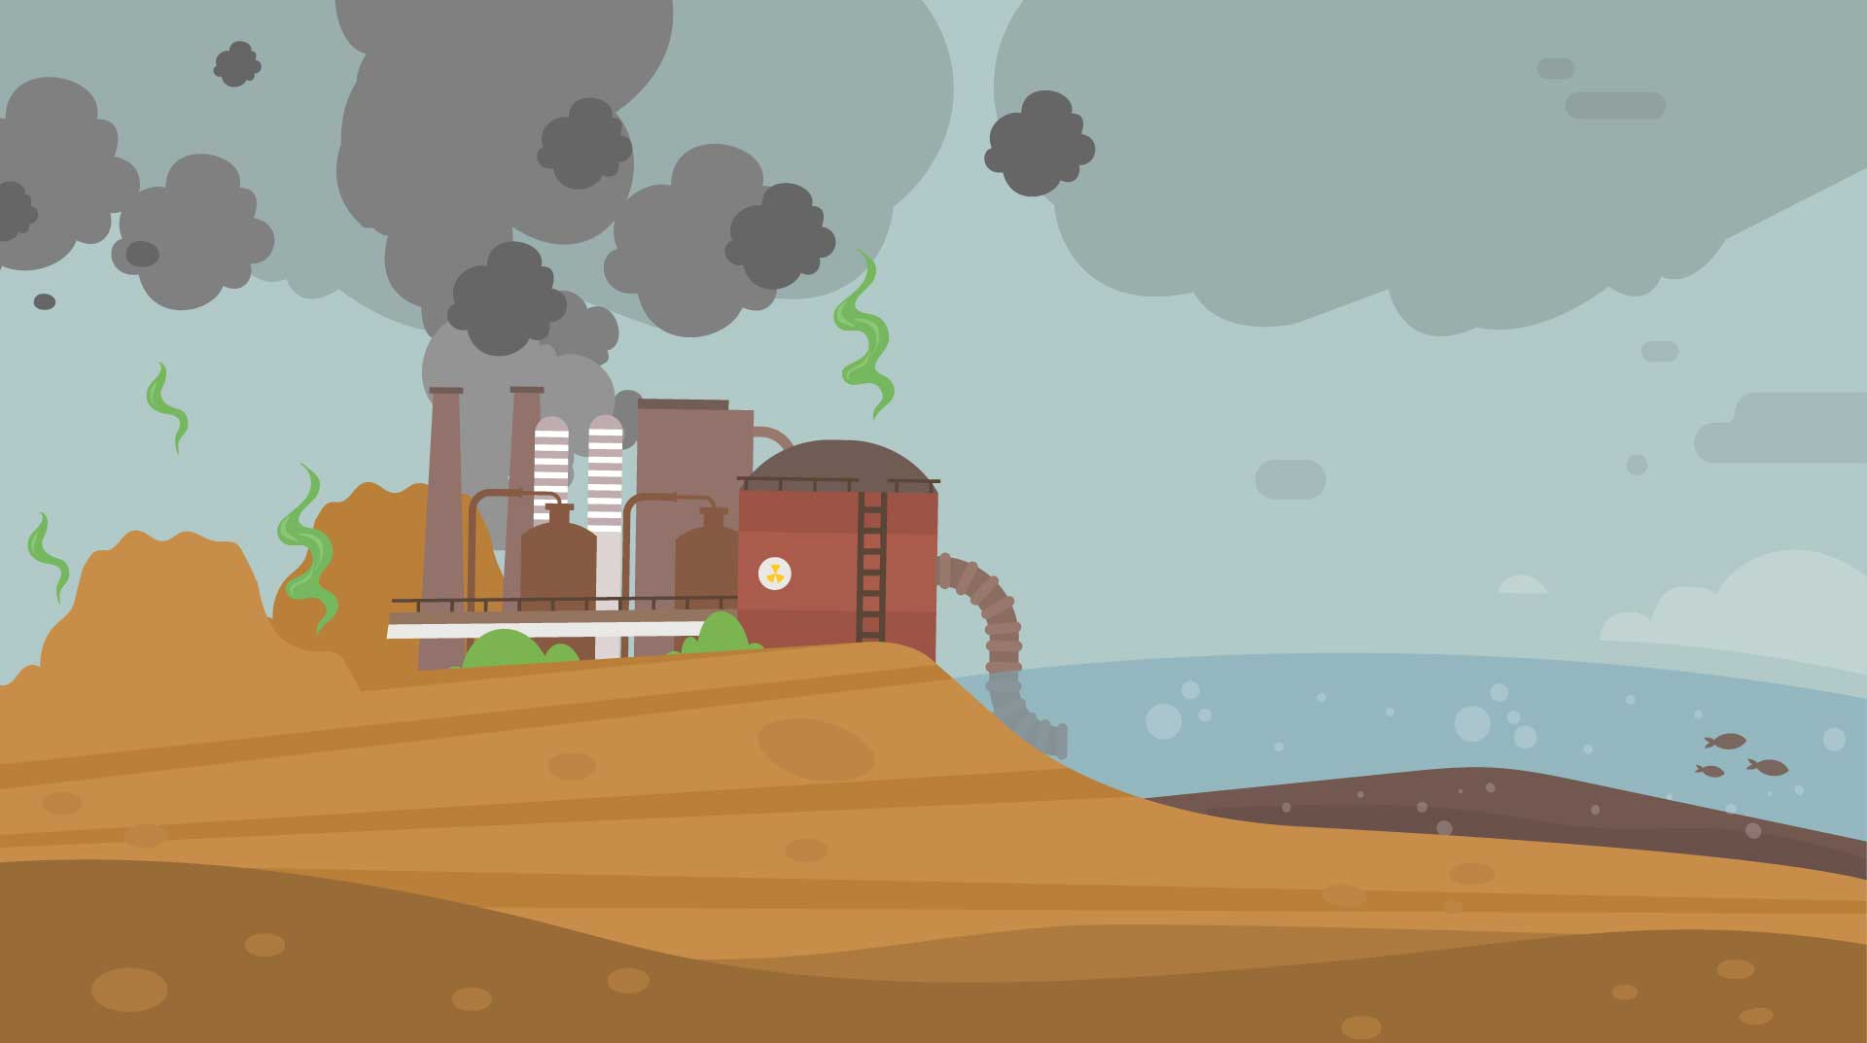
Where do food scraps go?
When we put food waste, like apple cores or banana peels, into the rubbish (black) bin they are taken to places like landfills or incinerators.
Landfills: A landfill is a big hole in the ground where rubbish is buried. When food scraps go there, they don’t break down properly. They make a gas called methane, which makes the Earth hotter - not good!
Incinerators: Some rubbish is burned in big
machines called incinerators. Burning food scraps makes smoke, which can make the air dirty - not good!

Slide 5
Why is it bad?
Liquids from landfills can
make water dirty or even toxic for animals and humans.
Methane gas and dirty air are bad for the Earth and can make it unhealthy for people, animals, and plants.

Slide 6
Compost!
What can we do instead?
I’m the
Brown Bin
We should put garden waste in our Brown Bin and food waste in the Caddy Bin. It is then taken away to be composted.
Composting turns food scraps into healthy soil for plants and doesn’t harm the planet.
It is a natural process of breaking things down.
..and I’m
your Food
Caddy!

Slide 7
An easy
way to help keep the earth clean and safe!
Your Caddy Bin and
your Brown Bin work together as a team!
Food waste goes in your Green Caddy Bin and once it is full you tie up the caddy liner and add it to your Brown Bin.
Garden waste like grass cuttings, leaves, and twigs go straight in your Brown Bin and it is all taken away together to be composted!

Slide 8
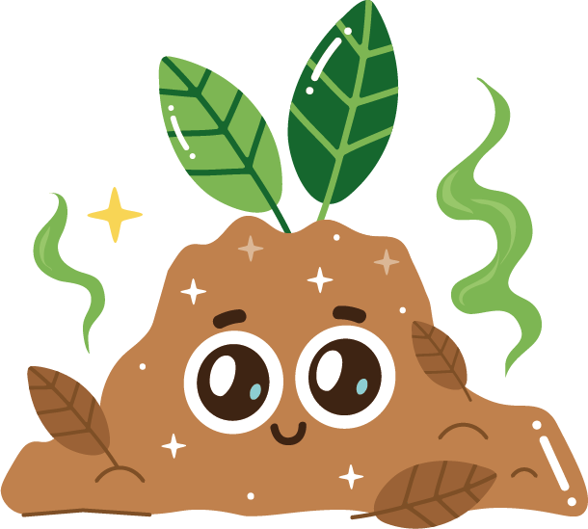
What are the benefits
of composting?
Click for answers…
Reduces waste going to landfills and incinerators.
Creates nutrient-rich soil for gardens and plants.
Helps reduce greenhouse gases by decreasing organic waste in landfills and incinerators.

Slide 9
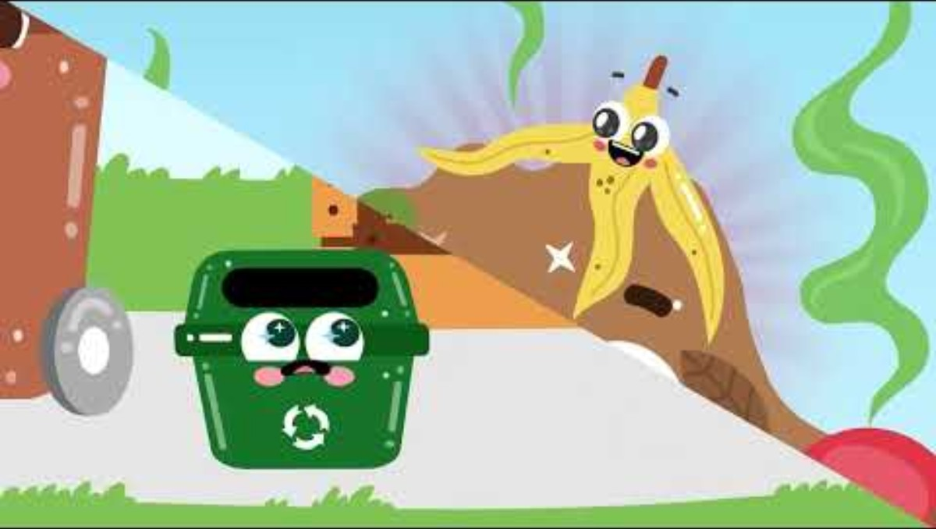

Slide 10
Let’s recap…
What can be composted?
I take your
garden waste
Fruit peels
(like banana, orange, or apple cores)
Vegetable scraps
(like carrot tops or potato peels)
Eggshells
Pasta, bread or rice
Plate scrapings or leftovers
Hair or pet fur
Shredded paper
Twigs, cut grass or flowers
..and I
take food
scraps

Slide 11


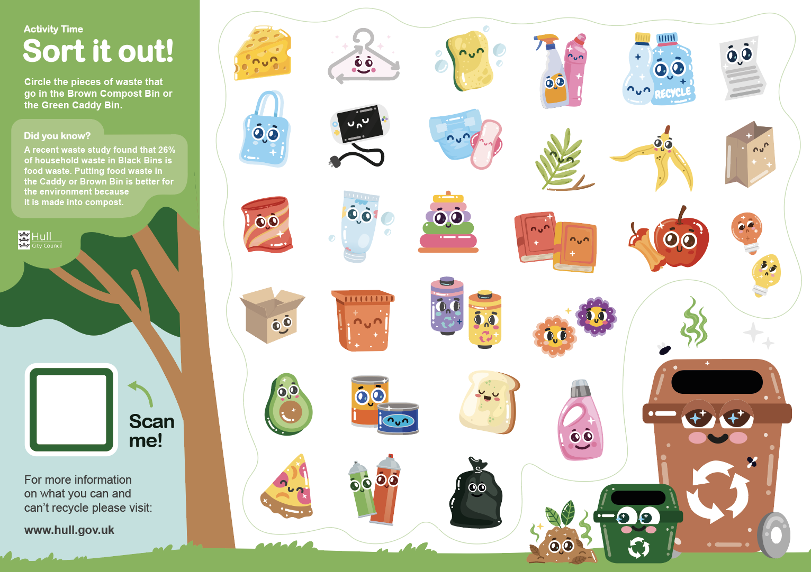




Sort it out!
Starter Activity
As a class, look at the waste items in front of you and decide if they go into your Brown Bin and Caddy Bin, or if they have to be thrown away.
*worksheet alternative if no physical waste items available
Bonus points if you know
which bin they should go in!

Slide 12
Optional activity
Create a
school compost bin
Let’s see this process in action!
Choose a dry spot outside and place a large container in the area to create a school compost bin.
Add the compostable waste you sorted earlier to the container and over the next term add food leftovers, paper and card, twigs and leaves and see how it degrades over time.
An external worksheet is available to show students how they can create a compost bin at home.

Slide 13

Compost care
Activity / homework
Now you know what can and can’t be composted, design a poster to put up in your school about composting, how the process works and why it is important.
You can do this in small
groups or on your own!

Slide 14
Let’s recap
Remember,
we work
together!
Food scraps that we don’t eat should be put in the Caddy Bin which then goes into the compost (Brown) Bin once full.
Garden waste such as grass cuttings, leaves and plants go straight into the Brown Bin.
Composting helps reduce waste and makes healthy soil for plants and gardens.
Composting is good for the environment and helps keep the
planet clean!

Slide 15
Does anyone
have any questions about today’s session?
Exit Ticket:
List two things you can compost at school or at home.

