Slide 1
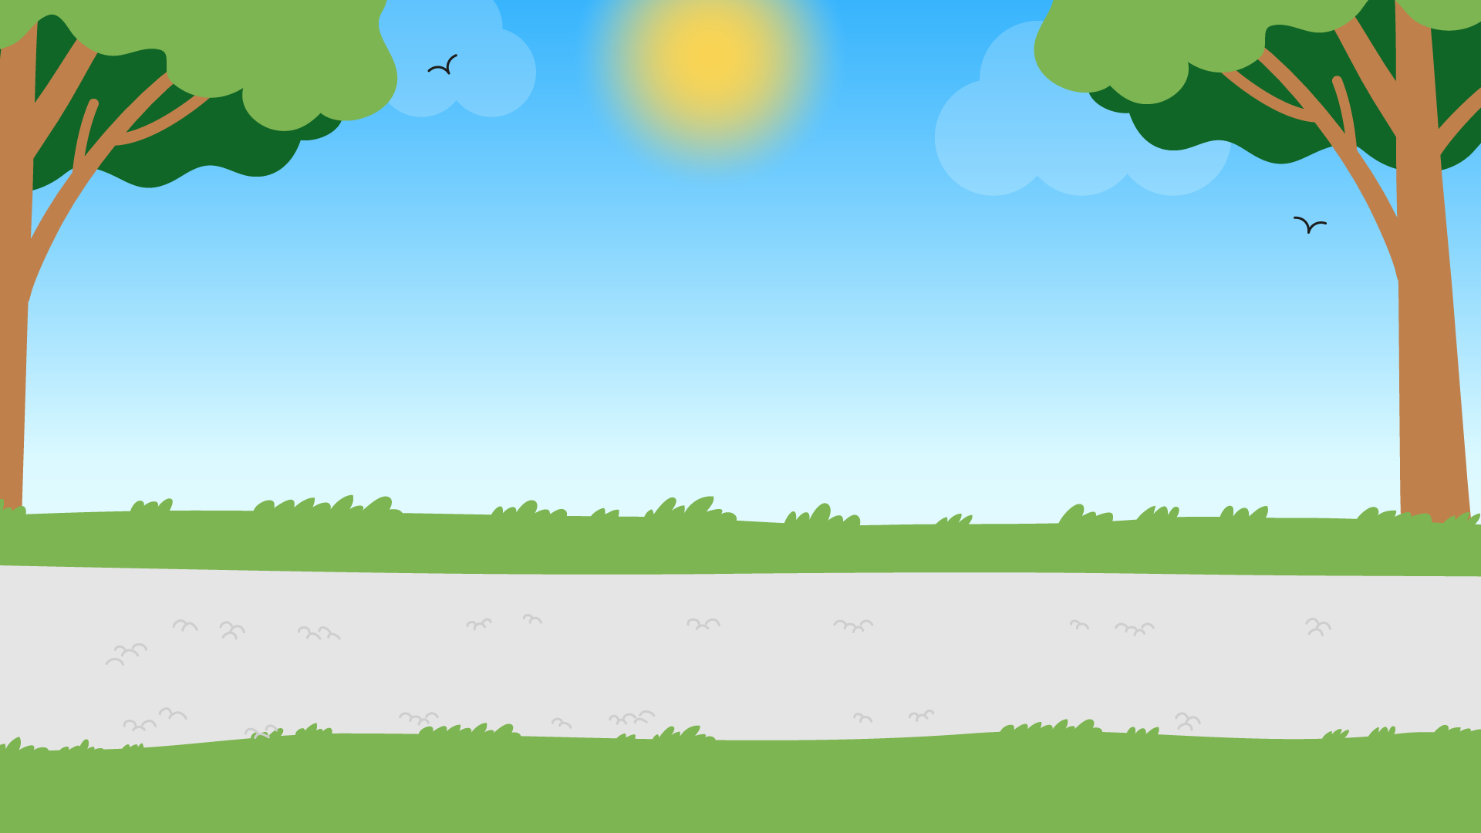



Part 2
Recycling &
Contaminated
Waste
Recommended for: Key Stage 1 - 2

Slide 2

Learning Objectives:
By the end of this lesson, you will:
Understand the importance of the 3 Rs and their role in protecting the environment.
Understand what waste contamination is, why it is important to separate waste and how to do it correctly.
Identify simple ways you can reduce, reuse, and recycle at home and school.

Slide 3
An introduction to recycling
?
?
  What is recycling?
  What happens when we put waste in our blue recycling bin?
?
?
Click for answers…

Slide 4

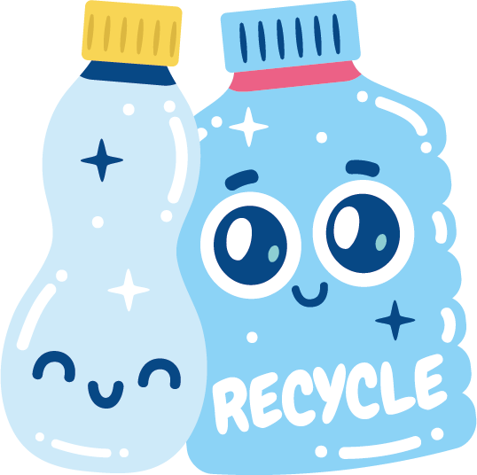



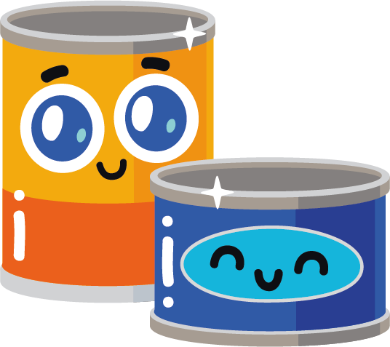
Recycling means turning old things into new things so we don’t have to use as many new resources, and we can help protect our planet.
However, recyclable items can cause contamination if, for example they have food waste in / on them and haven’t been cleaned properly.
Tip: If you see a tin or container that has some food on it, give it a quick whoosh with some water to clean it!

Slide 5
Watch the video on the next slide and take note of…
What items can be recycled?
Why should we recycle these items?
What should we check for when recycling items?
Where does food waste go?
Once finished, discuss as a class.

Slide 6
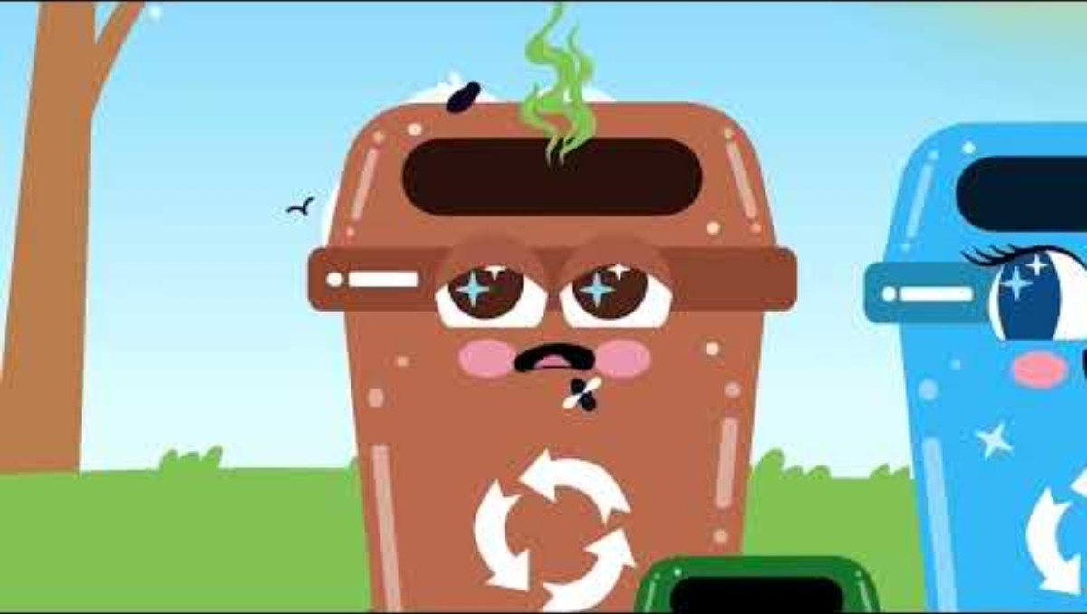

Slide 7
In front of you, there are some contaminated items.
Although some of these items are okay to recycle, contamination occurs when these items are not cleaned properly, making it harder to recycle or not possible at all.
Click for activity…

Slide 8
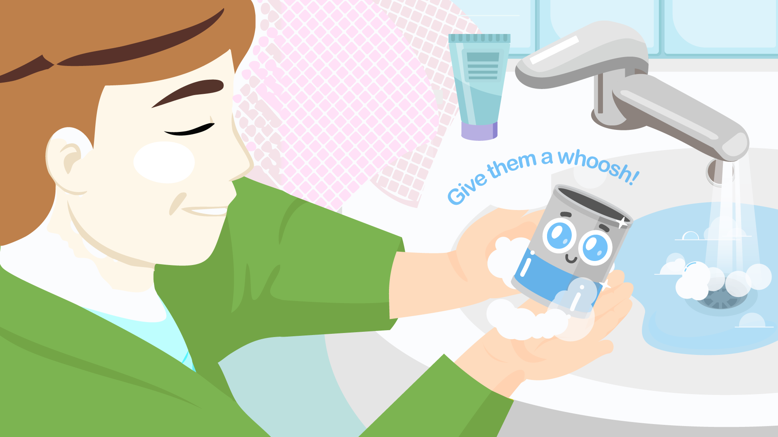
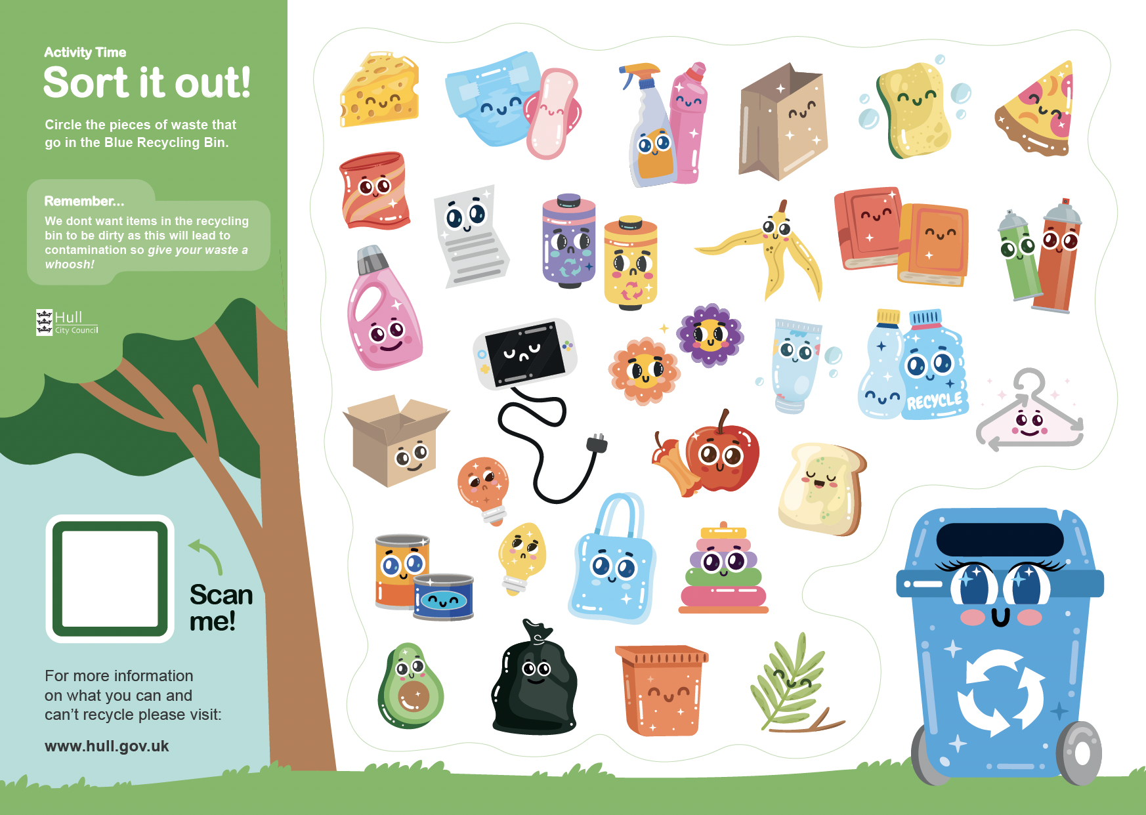
Sort it out!
Short Activity
In groups, separate the
items you have in front of you into two different groups – recyclable and non-recyclable.
*alternative worksheet activity if no physical waste items are available.
Important: If they are dirty, give it a whoosh! Once clean, add them to the correct bin.

Slide 9
Let’s discuss…
Why have you placed each item in the specific group?
If there are any waste items in the incorrect groups or items that are contaminated, discuss why it is incorrect and what would happen to the other items in that bin.
Bonus activity – do you know which bins the non-recyclable items should go in? the Brown bin or Black bin? Why?

Slide 10

The importance of recycling and reducing waste
Let’s discuss…
Why is it important to recycle?
What do you think happens to the Earth if we don’t recycle?

Slide 11
There are many benefits of recycling, such as:
Reducing the amount of waste put in the black bin.
Saving energy and resources.
Protecting wildlife and the environment.
Can you remember what the 3 Rs are?
Click for answers

Slide 12
The 3 Rs
Reduce
For example, using less plastic and packaging.
Reuse
Use things again before throwing them away.
Recycle
Turn rubbish into new items.

Slide 13
Activity Time
Recycled city
Using the waste materials we separated earlier, create your favourite landmark from the city.
Be prepared to share the pieces you have created with the class and talk about what recyclable items you have used.
Examples:
The Deep, Hull Minster, Humber Bridge, MKM stadium…
External worksheet available to be done as homework

Slide 14
Let’s recap…
Items that have waste such as food on them can not be recycled – this is called contamination.
To be able to recycle the items, any food waste needs to be washed off, and the items need to be clean.
Give them a whoosh!

Slide 15
Let’s recap…
Once these items have been cleaned, they can then be recycled correctly!
Any items that aren’t recycled correctly can cause harm to wildlife, the environment and even ourselves!
Top Tip: Check the labels to see if all parts of an item can be recycled too!

Slide 16
What’s one thing you learned today about recycling and sorting waste?
Exit Ticket:
Be ready to share your answer when you leave the classroom!

