Slide 1
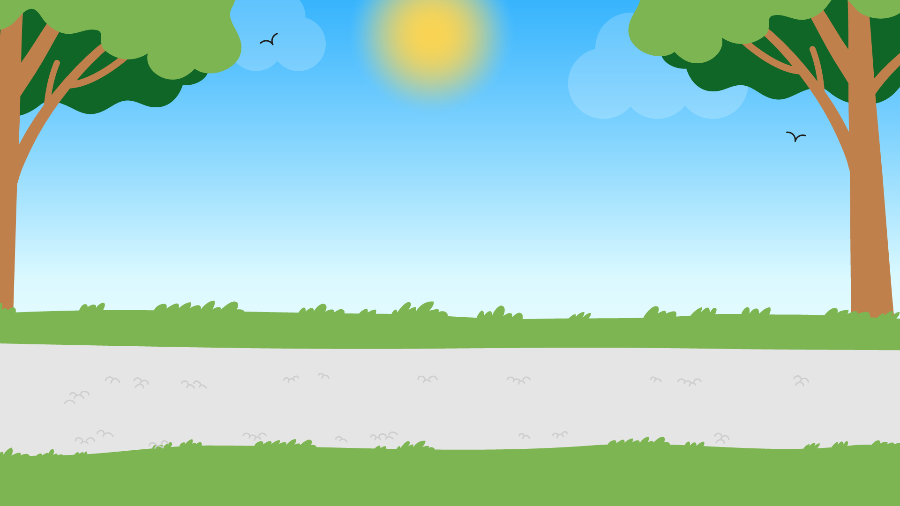
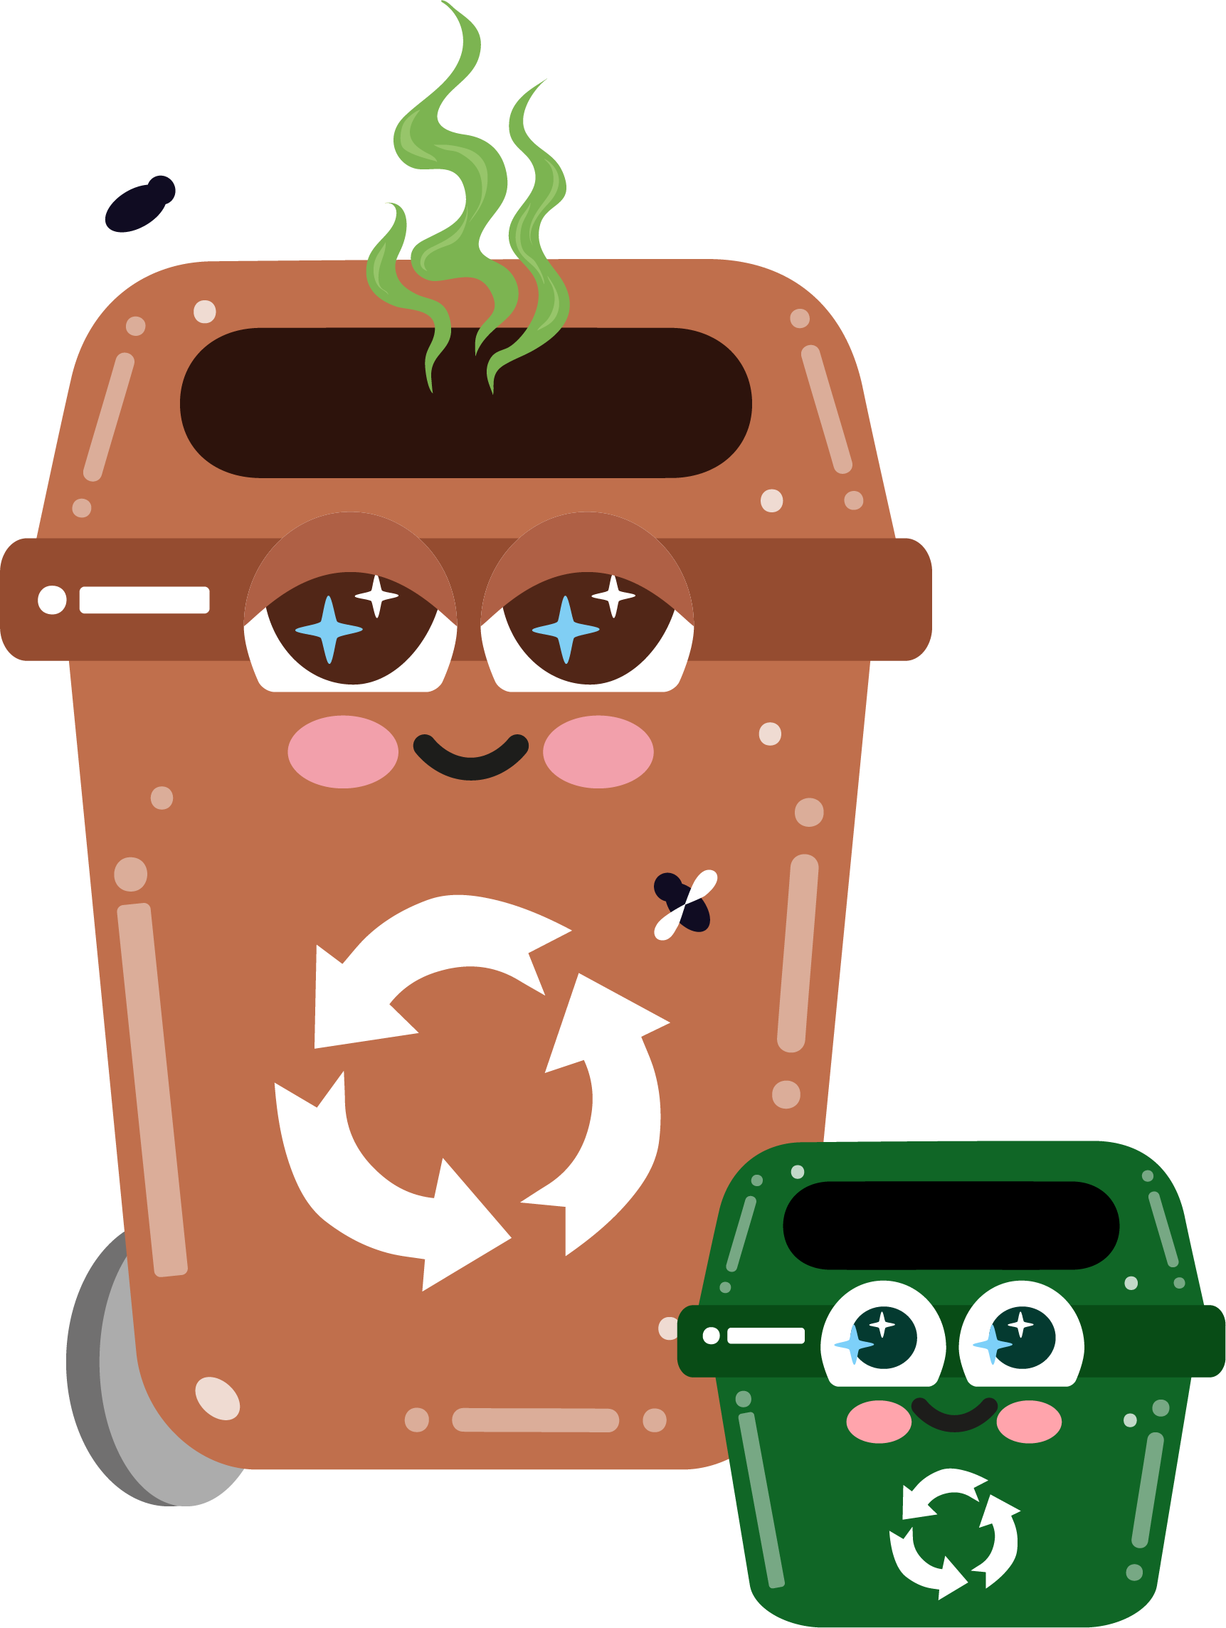




Part 1
Introduction to Waste
Recommended for: Key Stage 1 - 2

Slide 2

By the end of this lesson, you will:
Learning
Objectives:
1. Understand what waste is and why it is important to reduce waste.
2. Learn about the different types of waste, the bins they go in and how they
are sorted at home.
3. Identify strategies to minimise waste at home, school, and in everyday life.

Slide 3
An introduction to waste
?
?
What happens when we
throw something away?
?
?
  • Where does it go?
  • Does it just disappear?
Click for discussion…

Slide 4

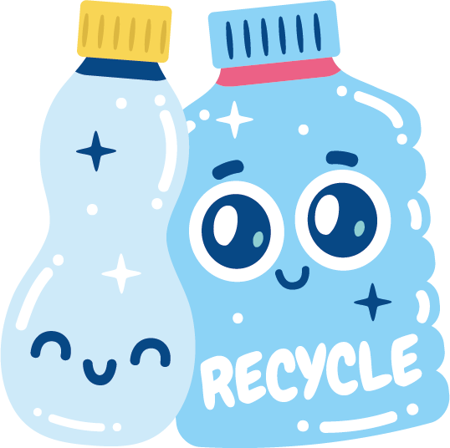
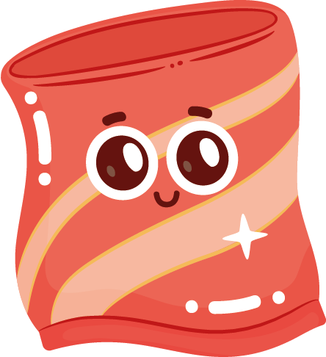
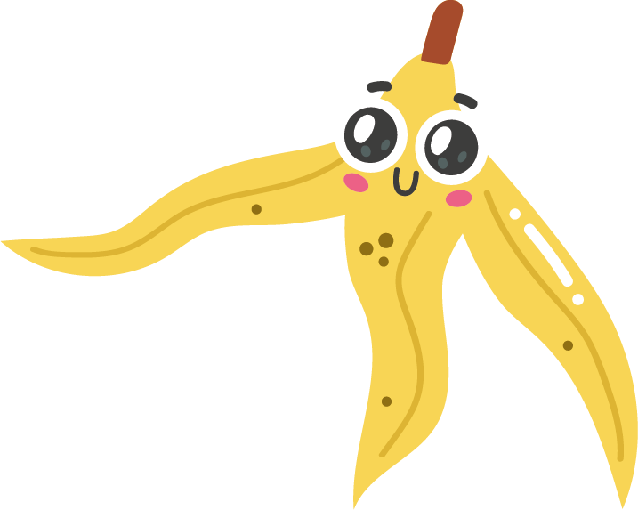
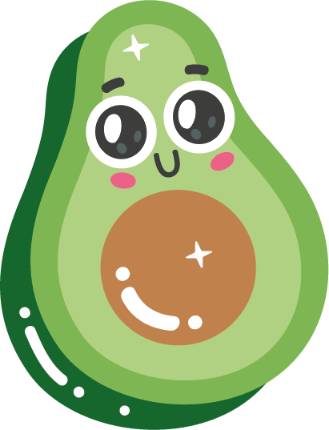

What is waste?
Waste is anything we throw
away because we no longer
need it, or it’s broken.
Can you think of any examples?
• leftover food and packaging
• old toys and clothes
• flowers and grass cuttings

Slide 5


Some waste can be recycled, like paper or bottles, and turned into something new.
Other waste, like food scraps, might go to a special place where it can be used to help plants grow!
It's important to reduce waste by not throwing away things we can use again and recycling whenever we can!

Slide 6

Time to meet the bins!
We’re going to watch a short video.
Take note of the examples of waste and which bin they go in.

Slide 7
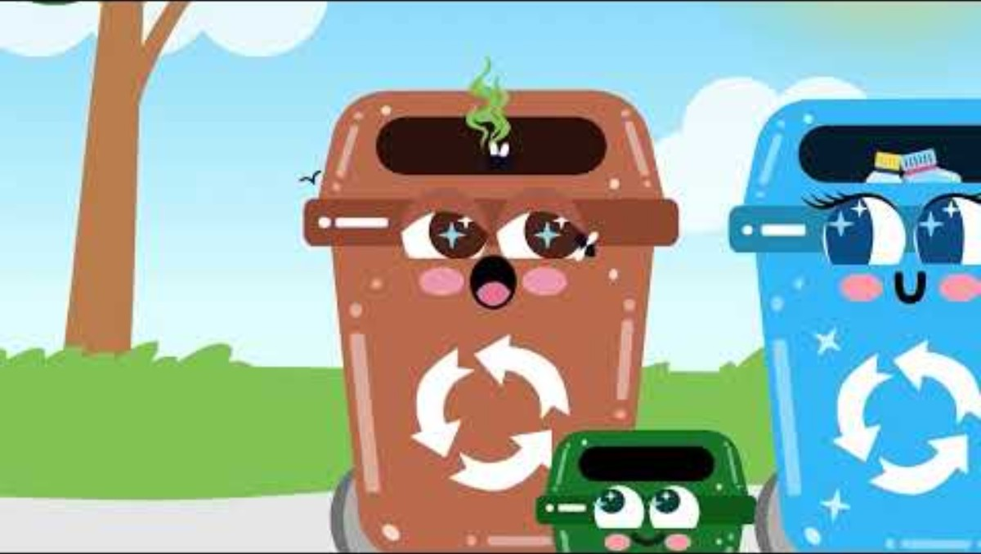
Bintroductions

Slide 8


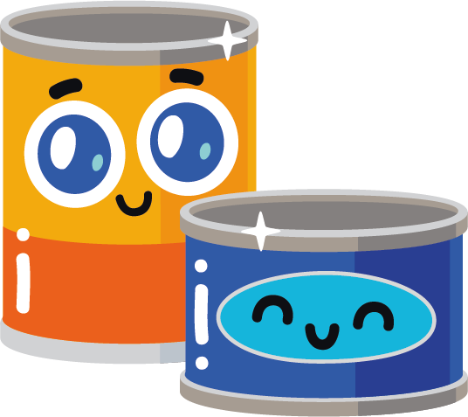
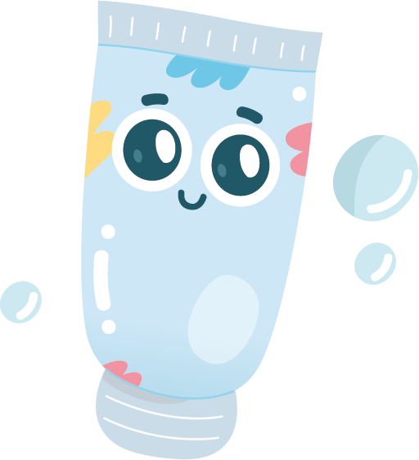
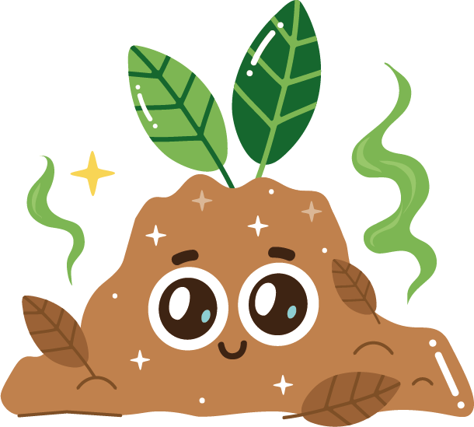

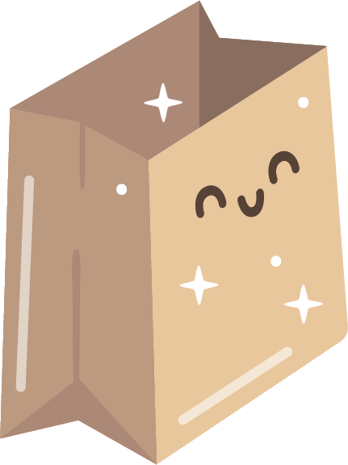
To recap
Which of these items go in which bin?
Click for
answers
Blue bin
Brown / caddy bin
Blue bin
Black bin
Black bin
Brown bin
Brown bin
Blue bin

Slide 9


Activity Time
Sort it out!
Looking at the bins in front of you, get into small groups and put the waste you have been given into the correct bins.
Use the picture and information handout sheets to help you!

Slide 10
General Waste

Slide 11
Recyclable Waste

Slide 12
Compostable Waste
(garden and food)

Slide 13
Discussion
Why do you think it's important to take care of your waste and recycle what you can and not just throw everything in the black bin?
Click for answers…

Slide 14
What happens if we don’t recycle?
If we don’t recycle, lots of things like plastic, food waste, and glass end up mixed in with everything else.
Click for discussion…

Slide 15
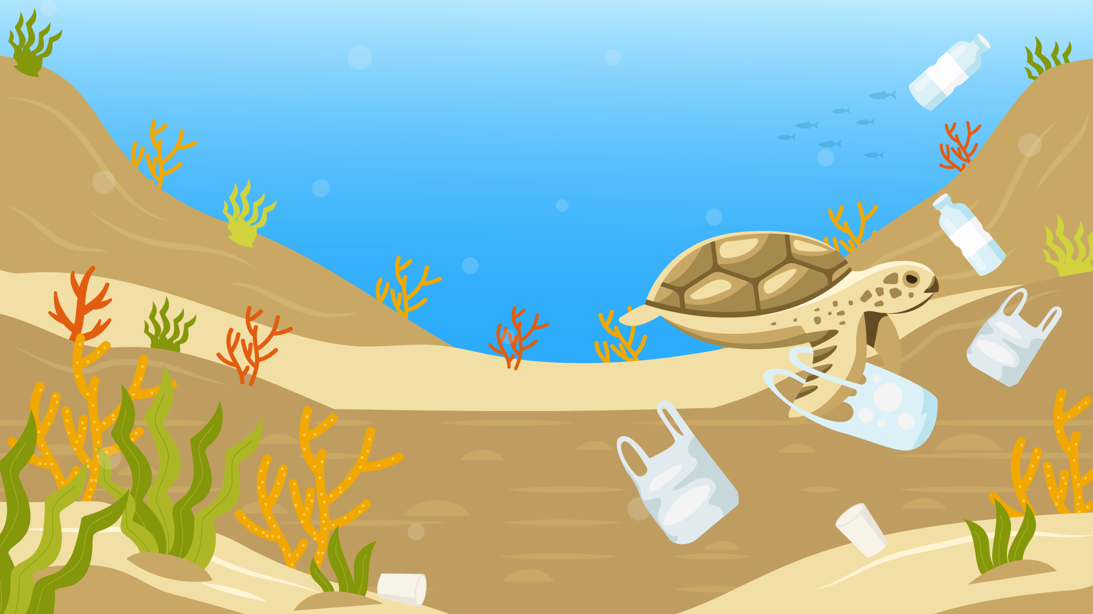
These things take a long time (years!) to break down and can hurt animals, the environment, and even ourselves.
For example:
Animals might get trapped in or eat plastic.
Waste that isn’t recycled releases harmful gases into the air, like carbon dioxide, which contributes to climate change and can lead to extreme weather, rising sea levels, and other problems that affect our own health and safety.

Slide 16
Discuss…
What are some things we could do to create less waste?
Can you think of other ways to reduce waste at home or at school?
Click for answers…

Slide 17
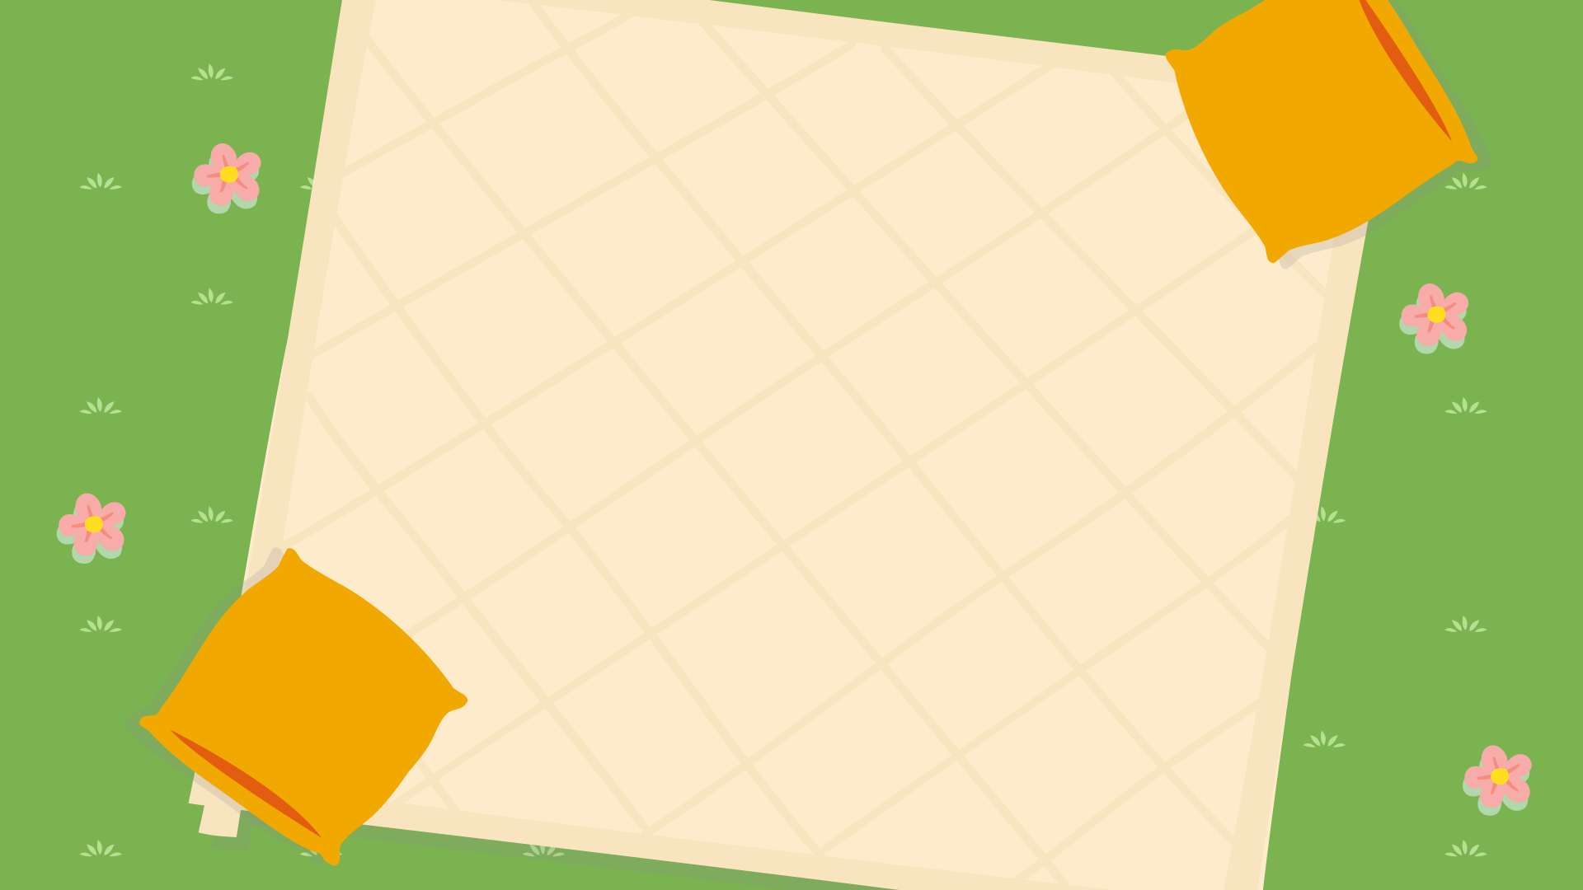
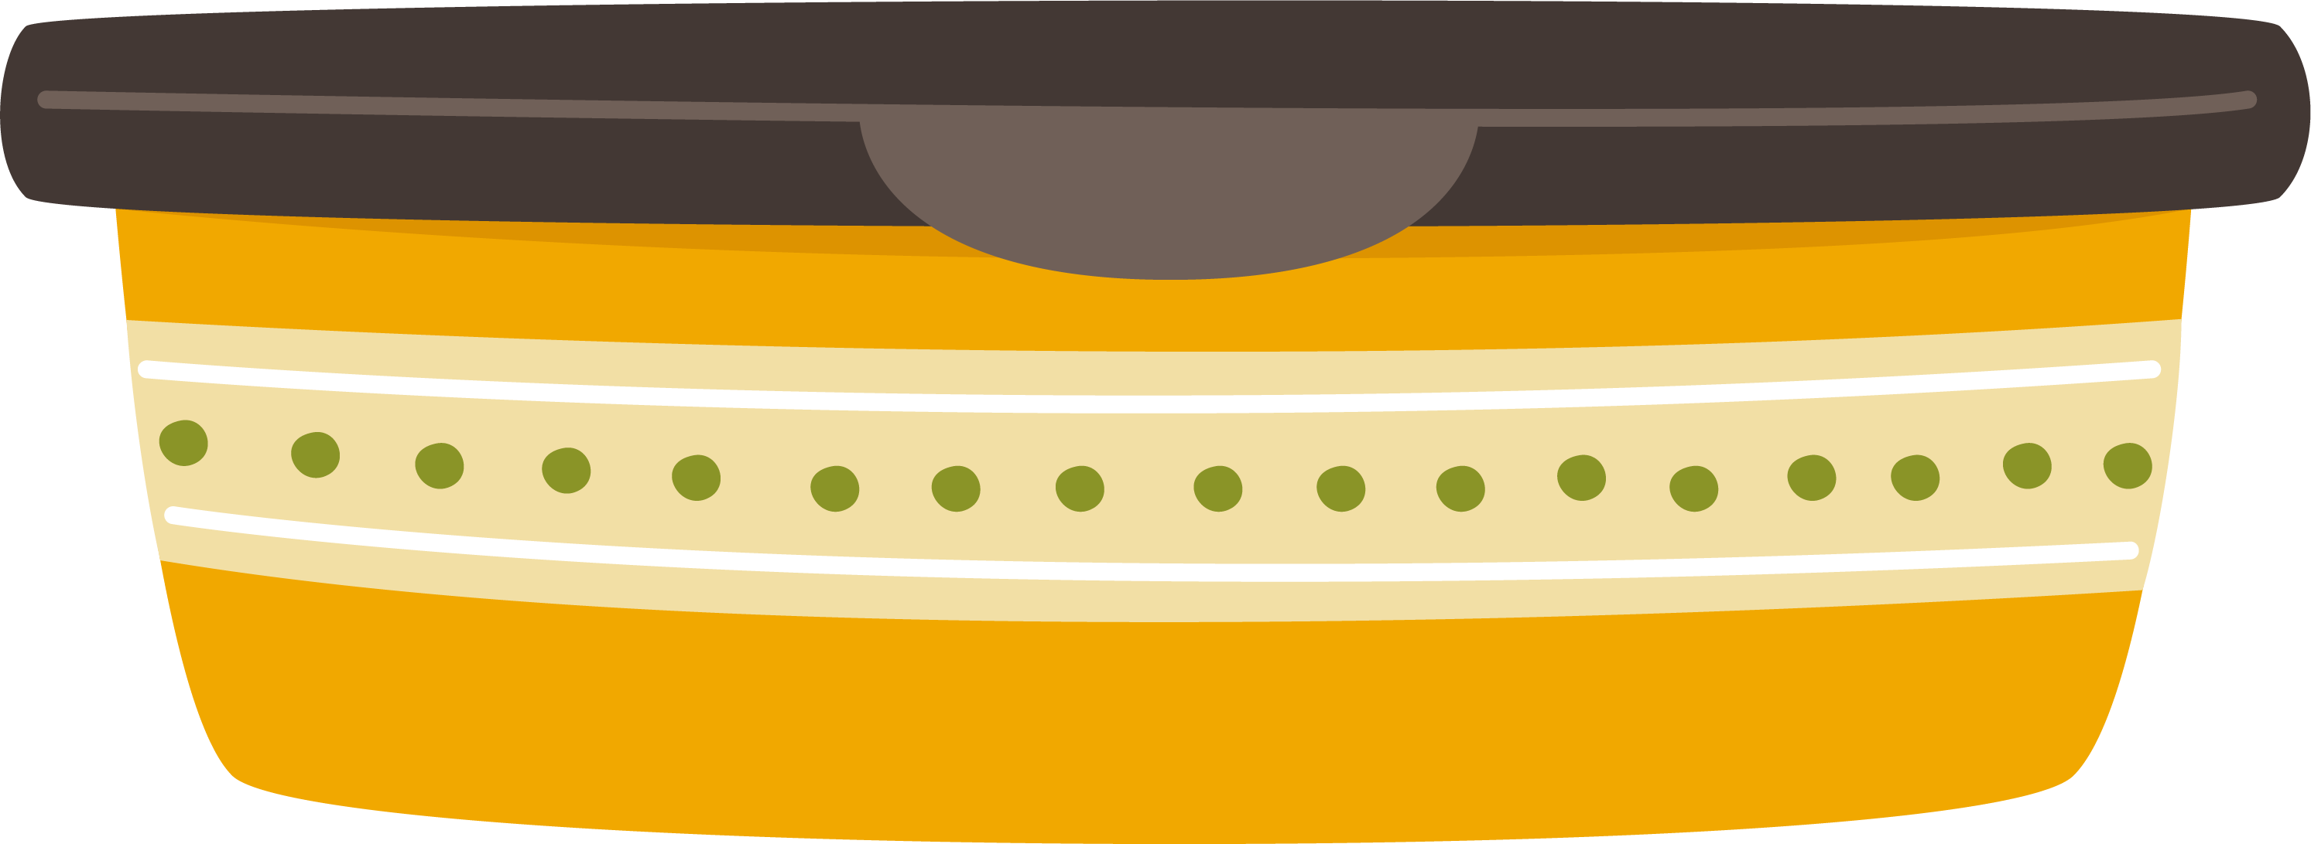
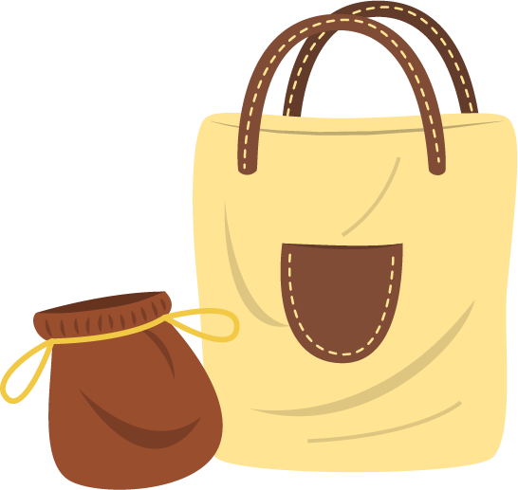

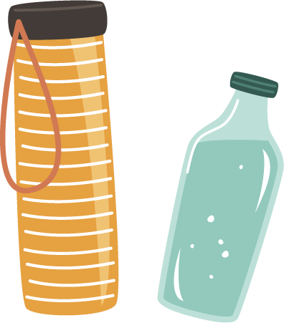
Material / reusable bags
Reusable lunch box
Bamboo or metal straws
Reusable
bottles

Slide 18

Introducing the 3 Rs…
*Handout the 3Rs info sheet
Reduce
Using less. For example, using a reusable water bottle instead of a plastic one.
Reuse
Using things again. For example, turning an old box into a toy or craft project.
Recycle
Making things into new things. For example, recycling paper and plastic.

Slide 19
Extra Activity
This can be done as homework.
From everything you have learnt this lesson, create a poster with tips on how to dispose of waste correctly and how you could reduce waste at home or at school.
Share with the class and put the posters
up around the school to encourage others.

Slide 20
Let’s recap…
Waste is anything we throw away because we no longer need it or it’s broken.

Slide 21
Waste can be sorted
into 3 different bins…
Garden Waste & Food
Recycling
General Waste

Slide 22
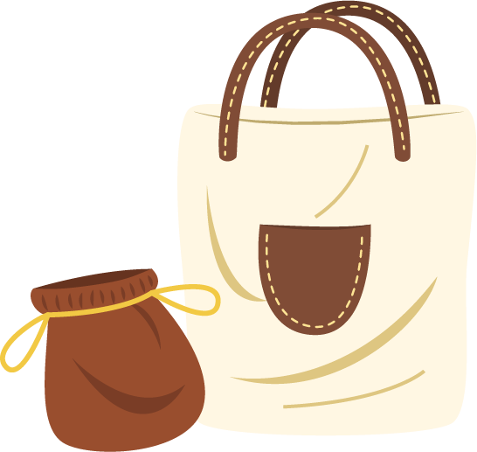
We can reduce waste by using things such as…
Material / reusable bags
Reusable lunch boxes
Reusable
bottles
Bamboo or metal straws

Slide 23
Remember the 3 Rs…
Reduce
Using less. For example, using a reusable water bottle instead of a plastic one.
Reuse
Using things again. For example, turning an old box into a toy or craft project.
Recycle
Making things into new things. For example, recycling paper and plastic.

Slide 24
Any questions on
today’s session?
Exit Ticket:
Share one thing that you will do to reduce waste at home or school.

