Slide 1
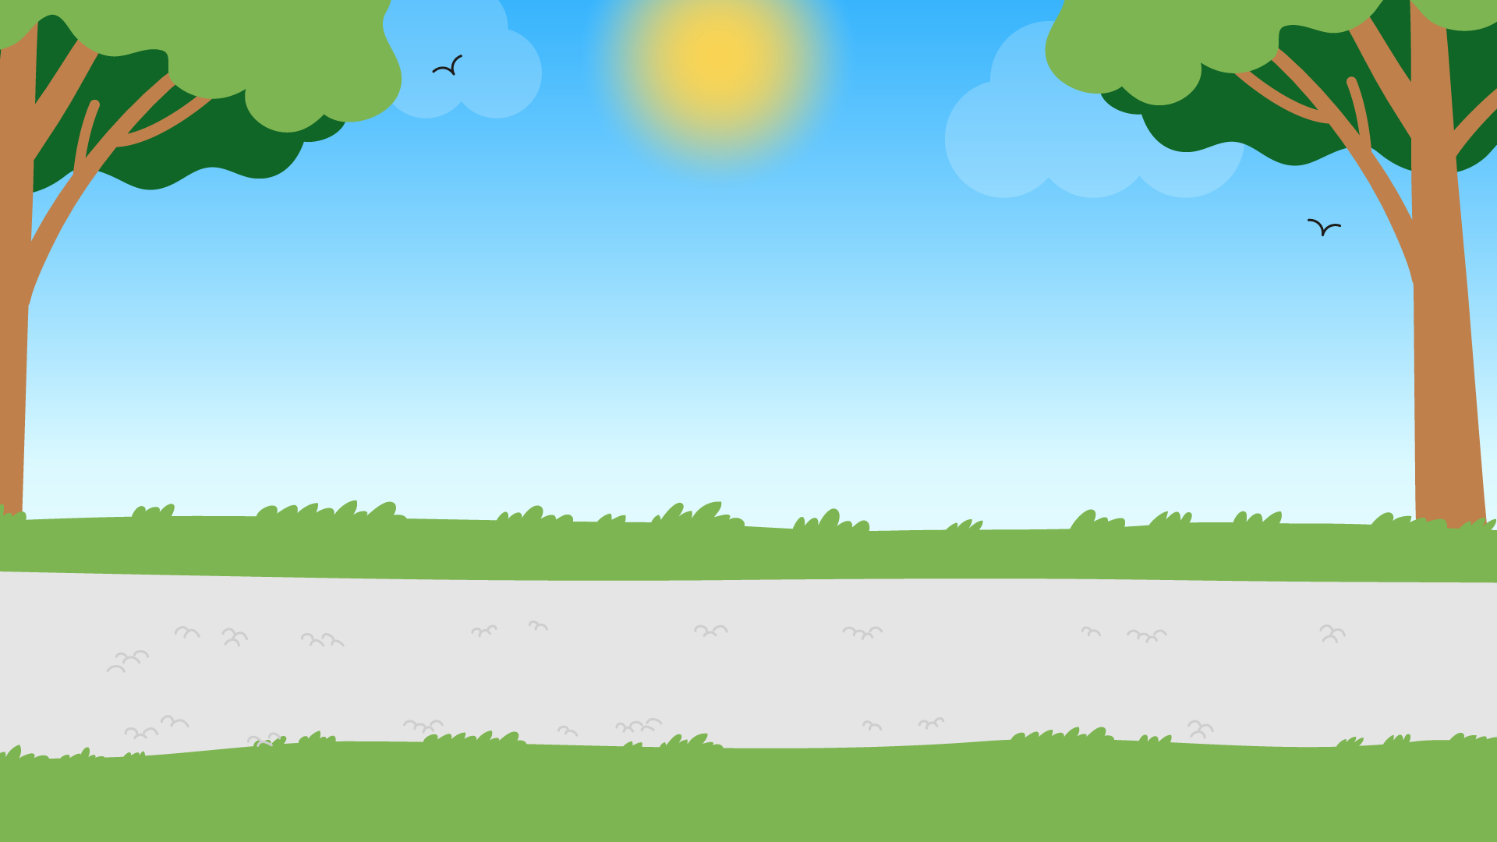
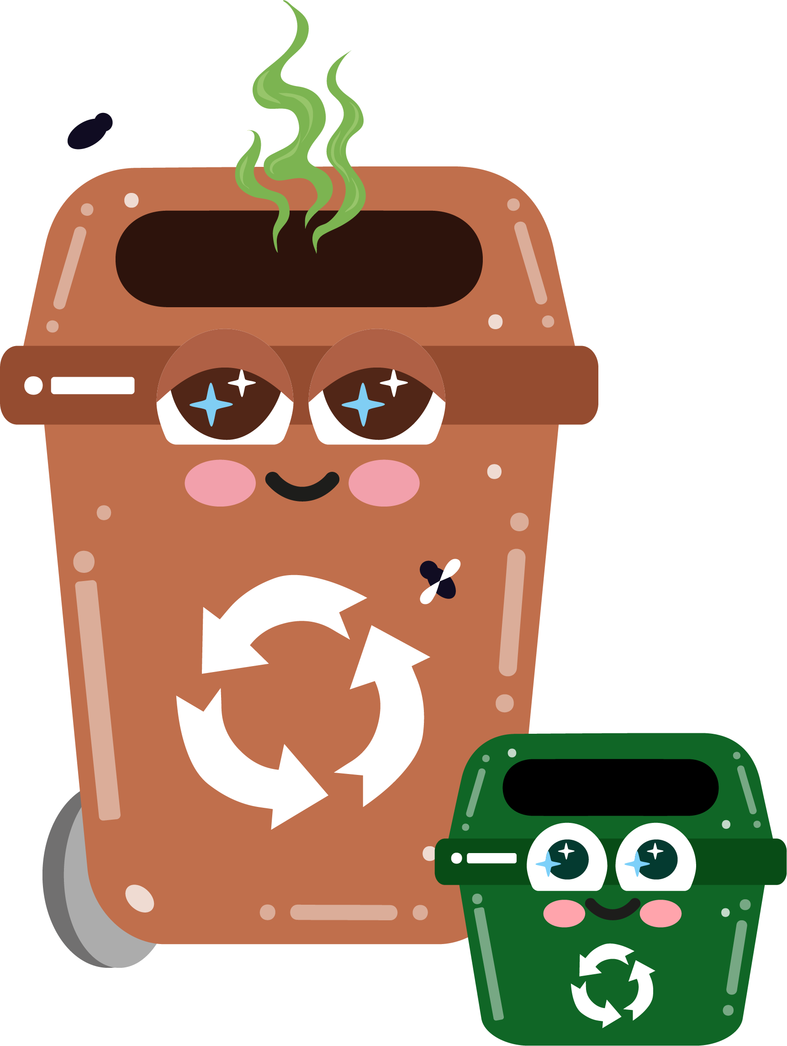




Part 5
The environmental impact of waste
Recommended for: Key Stage 1 - 2

Slide 2

Learning
Objectives:
By the end of this lesson, you will:
Understand how incorrect waste disposal affects the environment, ecosystems, and wildlife.
Learn about the impact of waste on landfills, pollution and plastic in oceans.
Recognise the importance of reducing, reusing, and recycling to protect the environment.
Be able to explain the long-term effects of waste on the planet and how we can make a positive impact.

Slide 3

An introduction to the environmental impact of waste:
?
?
How does our waste affect the environment?
  How does our waste affect animals on our planet?
  Why should we care about waste management?
?
?
Click for discussion…

Slide 4
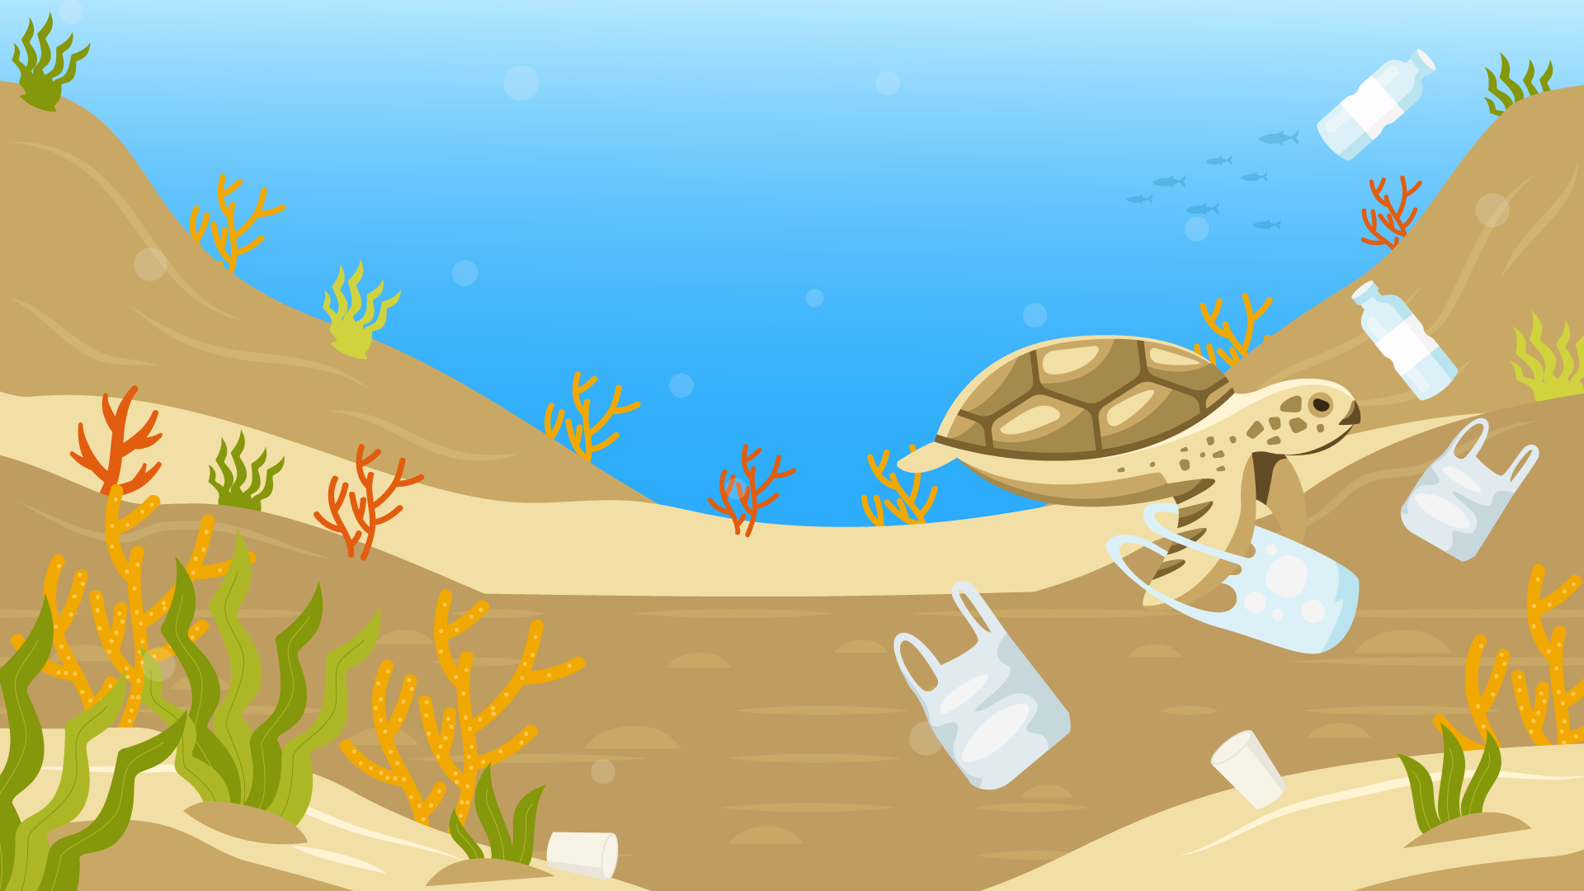

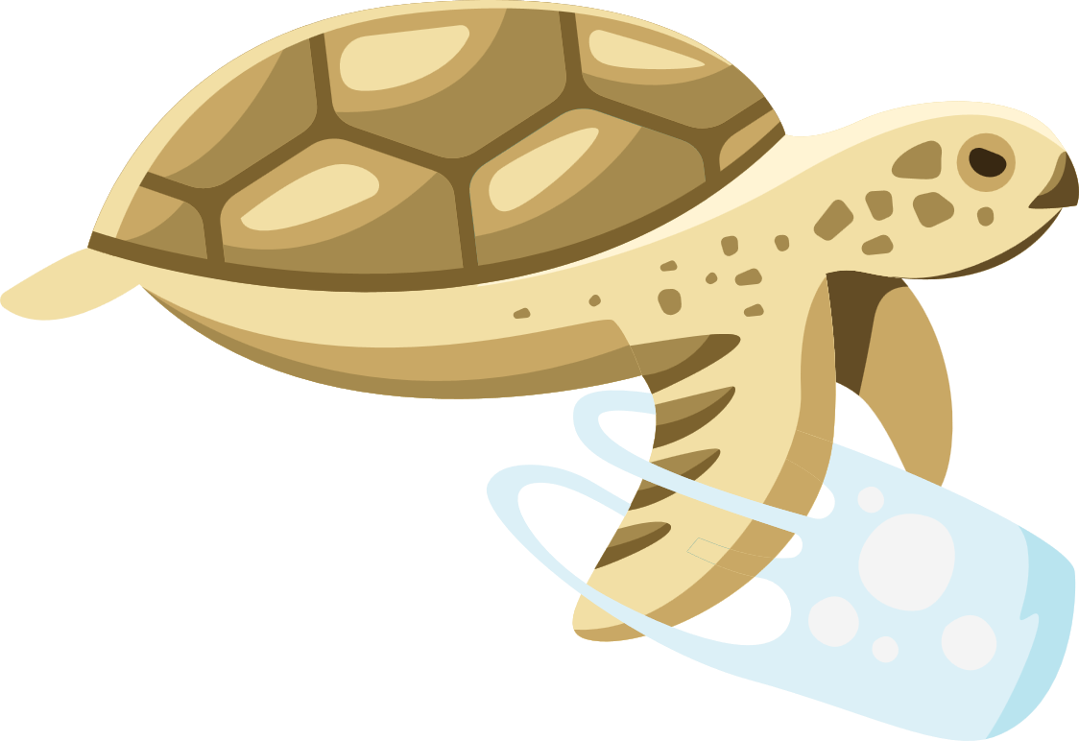

What happens when waste isn’t put in the right place?
Litter on streets
Animals can eat or get stuck in rubbish, which hurts them.
It makes places look dirty and unsafe.
Rivers and oceans
Litter can wash into rivers and oceans when it rains.
Plastic in the water can hurt fish, turtles, and birds. They might eat it and get sick, or even get stuck in it.
Landfill
If rubbish isn’t sorted properly, it goes to landfills and makes harmful gases like methane. This gas makes the Earth hotter.

Slide 5
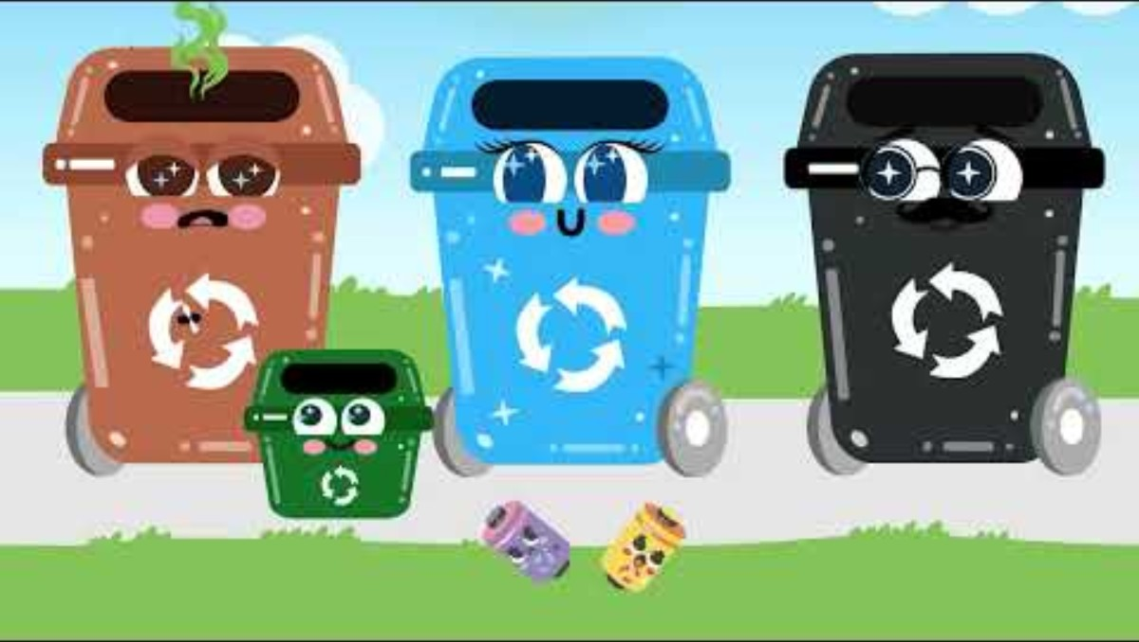

Slide 6

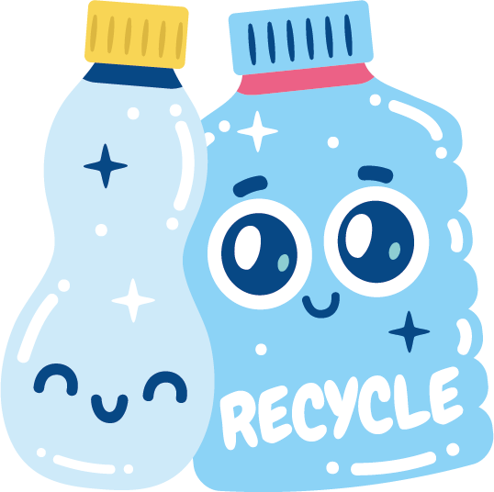
What can we do to help?
Put rubbish in the right bin and recycle when you can.
Don’t litter.
Use less plastic and more reusable items.
Remember to give your waste a whoosh to make it safe and correct for disposal.

Slide 7
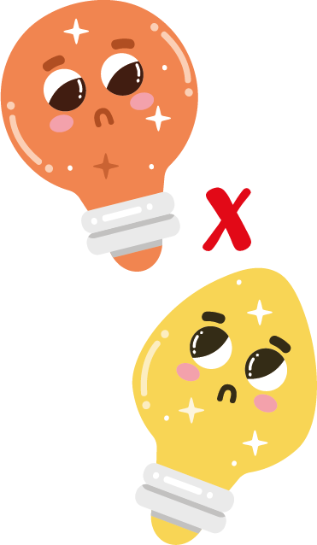
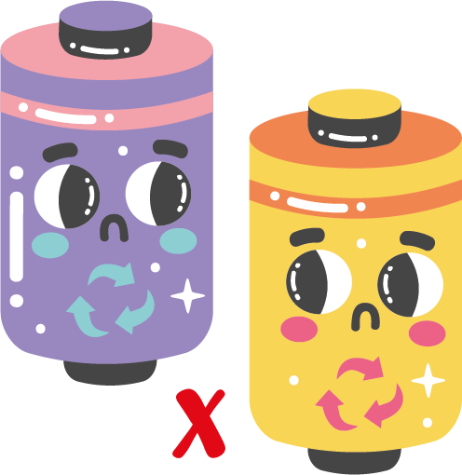

What about items that can’t fit in our household bins?
Let’s discuss…
Our household bins are great for disposing of food waste and smaller items, but what do we do with the bigger items that won’t fit like old furniture, or electronics like mobile phones and batteries?
Let’s discuss…

Slide 8
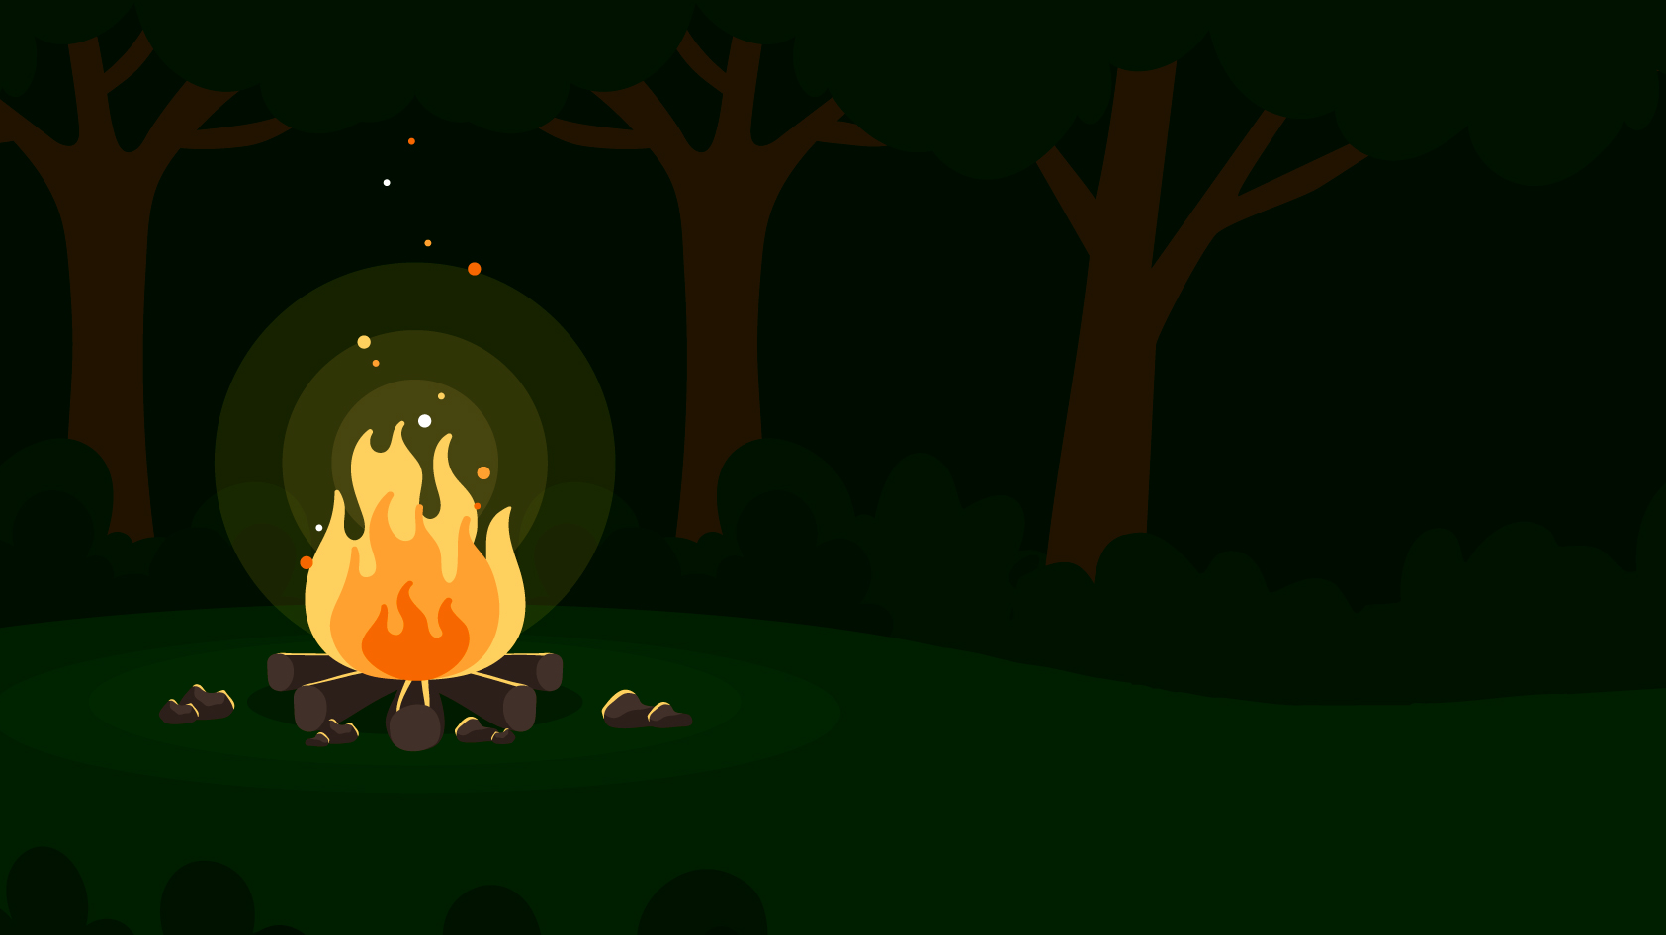
x
Let’s discuss…
Sometimes people are unsure on what to do with these items, and put them in their black bin, burn them in garden fires or even dump them on the streets themselves!
This is known as fly tipping and is illegal.
They don’t realise the harm they are causing to the environment by doing this!

Slide 9
If these things are not disposed of properly, waste will blow away on to our streets, into our rivers and then into the ocean.
Some waste can take years to decompose and some things like plastic can even last forever!

Slide 10
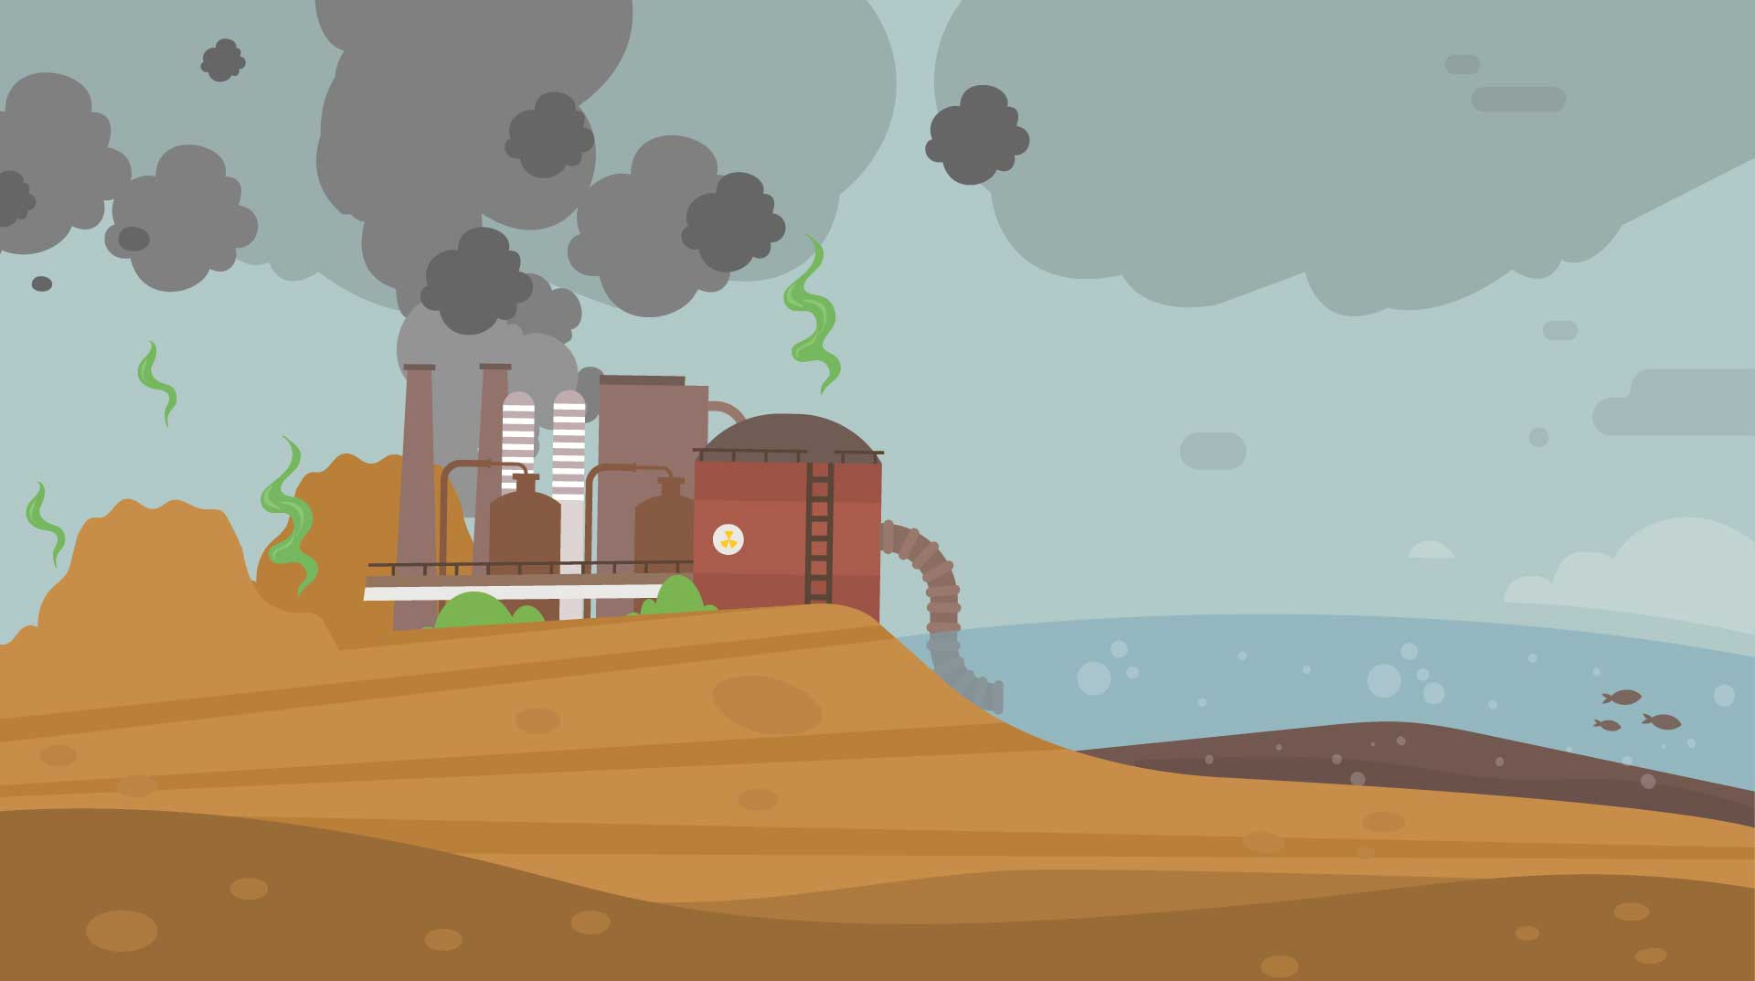
Let’s discuss…
Waste also placed in the wrong bins such as batteries and mobile phones end up in landfill.
Sometimes these items explode, cause fires and leak harmful chemicals into the soil.
This is known as pollution.

Slide 11

Different types of pollution
Air pollution: Harmful gases released from burning waste.
Water pollution: Waste that gets into rivers, oceans, and lakes.
Soil pollution: Waste that contaminates the earth and harms plants and animals.

Slide 12
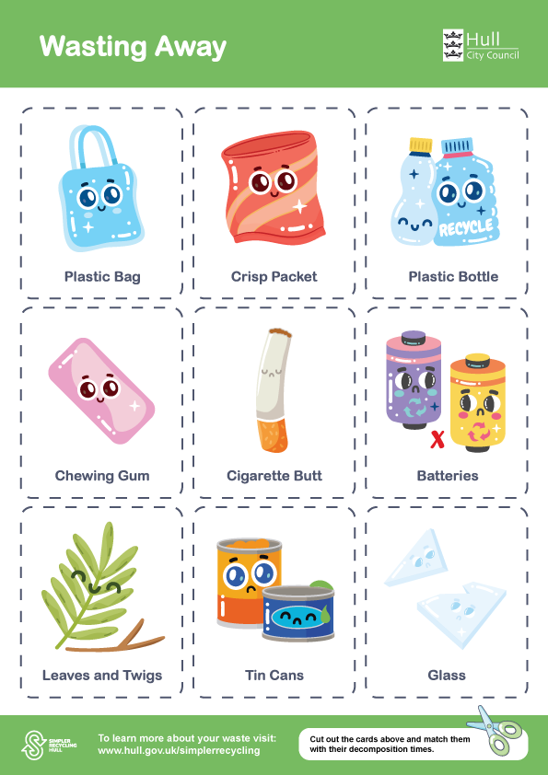
Activity
Wasting Away
Setup: Print and cut out the cards with different waste items (plastic bag, glass, tin can). Then print and cut out the second set containing decomposition time.
Activity: Students need to match the waste items to their decomposition times.
Discussion: Highlight which materials are the biggest problems and why reducing or reusing matters more than just recycling.
Answers on the next slide

Slide 13







Wasting Away - Answers
More information on the next slide >>
Plastic bag
Crisp packet
Plastic bottle
Chewing gum
Cigarette butt
10 - 20 years
80 - 300 years
450 years
5 - 1000 years
2 - 10 years
Batteries
Leaves and twigs
Tin cans
Glass
100 + Years
6 months - 3 years
50 years
1 Million + years

Slide 14
Wasting Away – extra information
Leaves and twigs
6 months - 3 years
In a compost pile, leaves and small twigs can decompose much faster (weeks to months) compared to being left in a dry environment.
When left in a dry environment they can also be a fire hazard.

Slide 15
Wasting Away – extra information
Cigarette butt
2 - 10 years
A cigarette butt takes anywhere from 18 months to 10 years to decompose, depending on environmental conditions.
The filter is made of cellulose acetate, a form of plastic that breaks down very slowly and leaches toxic chemicals into the environment.

Slide 16
Wasting Away – extra information
Glass
1 Million + Years
Glass from broken items or bottles does not decompose but only breaks down into tiny pieces.
If recycled correctly it is taken to a facility to be cleaned, sorted and crushed into small pieces called cullet which can then be melted to make new glass products, such as jars and bottles.

Slide 17
Wasting Away – extra information
Chewing gum
5 – 1000 Years
Chewing gum is not biodegradable. Most chewing gum products are made from the same materials used to make adhesives and tyre tubes. They’re designed to be long-lasting for heavy-duty use.
That’s why so much chewing gum exists on streets lasting months, even years with very little change in their form.

Slide 18
Wasting Away – extra information
Crisp packet
80-300 Years
Crisp packets are usually made using layers of plastic and aluminium foil.
This mixed material is very difficult to break down and doesn’t biodegrade fully. When left, the packet breaks down into microplastics and aluminium fragments, which stay in the environment much longer.

Slide 19
Wasting Away – extra information
Batteries
100 + Years
Batteries corrode slowly, releasing heavy metals into the soil and water. The acid inside can leak in a matter of a few years, while the lead casing takes centuries to break down.
That’s why batteries should always be disposed of at special recycling centres, never in regular bins.

Slide 20
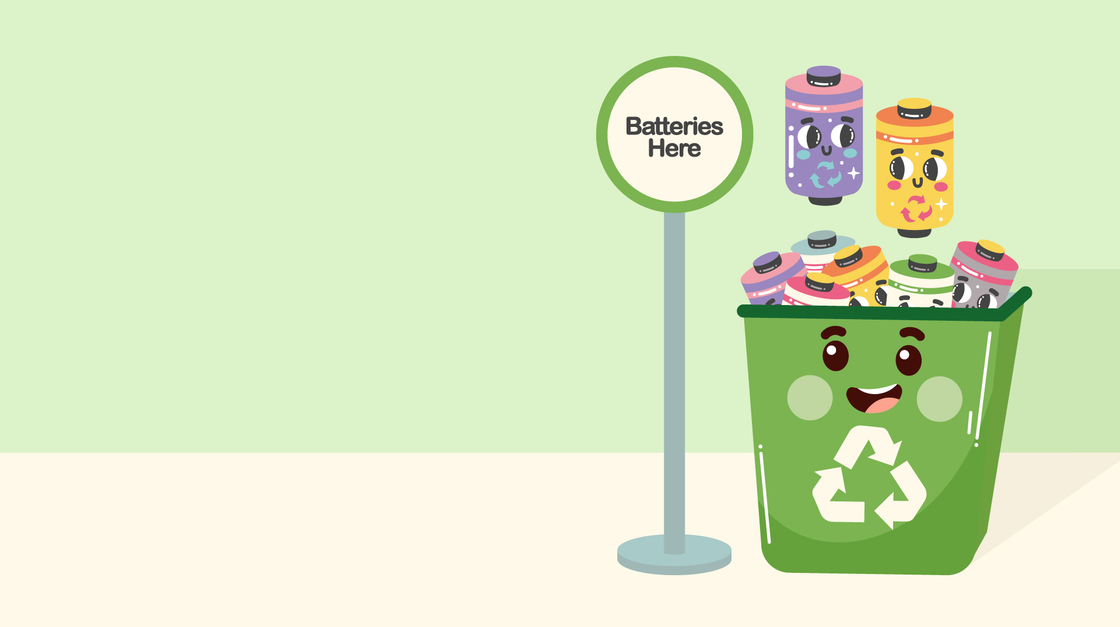
So, what do we do with these items?
Items / waste that can’t be recycled need to be taken to special bins in supermarkets, or to Household Waste Recycling Centres near you.
Sites include:
Burma Drive household waste recycling centre
Sutton Fields household waste recycling centre
Wiltshire Road household waste recycling centre

Slide 21

Reduce, reuse and recycle
Remember the 3 Rs…
If we remember to reduce, reuse and recycle correctly, we can minimise the amount of waste that ends up on our streets, incinerated or in landfills.

Slide 22
To reduce pollution, keep the earth clean and keep animals and humans safe!
And why do we do this…

Slide 23
Helping our environment
Extra activity
As a class discuss how we can properly dispose of the waste items in front of you to keep our areas safe. Create a poster to share these important tips!
Think about how we can make things safer when we dispose of them.
Tips on the next slide…

Slide 24



Disposing of waste safely
Take hazardous waste to specialised recycling centres or drop-off locations.
Remove lids and scrunch them up to prevent hedgehogs and other animals from getting their heads stuck.
Cut can rings / elastic bands to stop animals getting stuck in them.

Slide 25
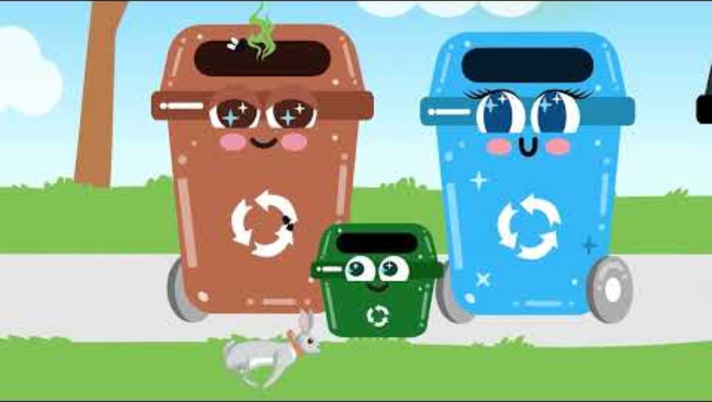

Slide 26
Congratulations!
You have now finished your Waste Management training from Talking Rubbish!
For more information and activities to learn even more, visit: www.hull.gov.uk/simplerrecycling

